Slide 1
Learning Synergies between Pushing and Grasping with Self-supervised Deep Reinforcement Learning
Presenter: 靳子灿 左可玮 王子豪 刘瀚迪 鲁逸舟
2023/4/6

Slide 2
Motivation and Main Problem
Why is the problem important
With such a method, there will be even fewer people needed in transportation
Solving the problem helps robots grab things and transport them with more wisdom.
Machine learning will help collecting, filtering and analyzing the data we need and is trained to help solve the problem
Notes:
High-level description of problem being solved
Why is the problem important?
its significance towards general-purpose robot autonomy
its potential application and societal impact of the problem
Technical challenges arising from the problem
the role of the AI and machine learning in tackling this problem
High-level idea of why prior approaches didn’t already solve
Key insight(s) (try to do in 1-3) of the proposed work

Slide 3
Motivation and Main Problem
Technical challenges arising from the problem
Both networks are trained jointly in a Q-learning framework, and are entirely self-supervised by trial and error, where rewards are provided from successful grasps.
In this way, our policy learns pushing motions that enable future grasps, while learning grasps that can leverage past pushes.

Slide 4
Motivation and Main Problem
High-level idea of why prior approaches didn’t already solve
It remains unclear how to plan sequences of actions that combine grasps and pushes, each learned in isolation.
While hard-coded heuristics for supervising push-grasping policies have been successfully developed by exploiting domain-specific knowledge, they limit the types of synergistic behaviors between pushing and grasping that can be performed.

Slide 5
Motivation and Main Problem
Key insights of the proposed work
We learn joint pushing and grasping policies through self-supervised trial and error. Pushing actions are use-ful only if, in time, enable grasping. This is in contrast to prior approaches that define heuristics or hard-coded objectives for pushing motions.

Slide 6
Motivation and Main Problem
Key insights of the proposed work
We train our policies end-to-end with a deep network that takes in visual observations and outputs expected that takes in visual observations and outputs expected return (i.e. in the form of Q values) for potential pushing and grasping actions. The joint policy then chooses the action with the highest Q value – i.e. , the one that maximizes the expected success of current/future grasps. This is in contrast to explicitly perceiving individual objects and planning actions on them based on hand-designed features.

Slide 7
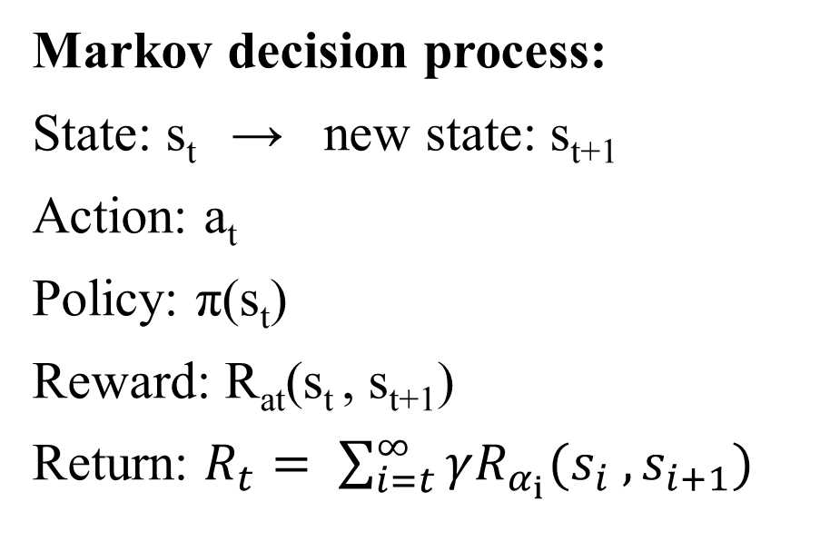
Problem Setting
The best control method and off-policy Q-learning
Markov decision process:
State: s_{t} → new state: s_{t+1}
Action: a_{t}
Policy: π(s_{t})
Reward: R_{at}(s_{t} , s_{t+1})
Return: $R_{t}= \sum_{i=t}^{∞}{γR_{α_{i}}(s_{i} , s_{i+1})}$
A greedy deterministic policy
chooses actions by maximizing the Q-function --- Q_{π}(s_{t}, a_{t}),
Notes:
Problem formulation, key definitions and notations
Be precise -- should be as formal as in the paper
马尔可夫决策过程：
为了解决最优控制问题
状态 动作 策略 奖励 回报
action-value function
which measures the expected reward of taking action at in state s_{t} at time t

Slide 8

Problem Setting
Learning objective
A fixed target value y_{t} :
To minimize the temporal difference value δ_{t} between Q and y_{t}
Notes:
argmax --- arguments of the maxima 最大值自变量点集
a’ --- the set of all available actions

Slide 9
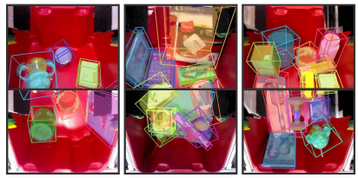
Limitations of Prior Work
Paper: Multi-view Self-supervised Deep Learning for 6D Pose Estimation in the Amazon Picking Challenge
1.Chaotic. Shelves and handbags may have multiple objects and may be arranged to deceive visual algorithms.
Notes:
Which other papers have tried to tackle this problem or a related problem?
The paper’s related work is a good start, but there may be others
What is the key limitations of prior work(s)?

Slide 10
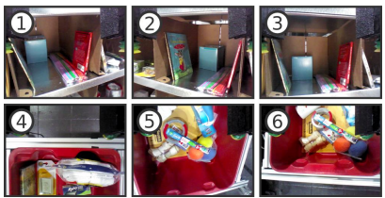
Limitations of Prior Work
2.Self shielding. Due to the limited location of the camera, the system can only see a partial view of the object.
3.Sensor noise. Commercial depth sensors are not reliable in capturing reflective, transparent, or mesh surfaces.
Notes:
Which other papers have tried to tackle this problem or a related problem?
The paper’s related work is a good start, but there may be others
What is the key limitations of prior work(s)?

Slide 11
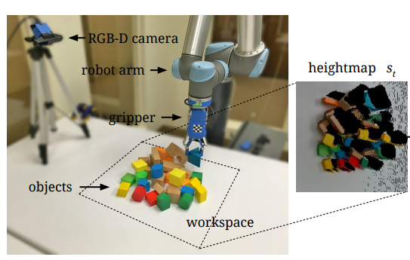
Proposed Method
A. State Representations
For each state s_{t} : visual 3D data --- heightmaps
1.Capture RGB-D images from a fixed-mount camera
2.Project the data onto a 3D point cloud
3.Orthographically back-project upwards
Workspace: 0.448m²
Pixel resolution: 224*224

Slide 12
Proposed Method
B. Primitive Actions
ψ : a motion primitive behavior parametrized from action α_{t} (can be pushing or grasping)
Pushing: 10cm horizontal movement
Grasping: 3cm vertical decline

Slide 13
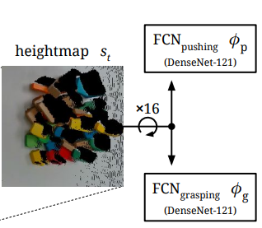
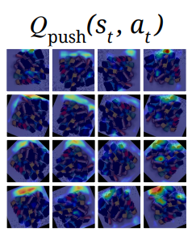
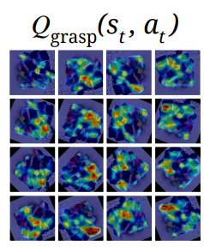
Proposed Method
C. Learning Fully Convolutional Action-Value Functions
16 directions: each 22.5°
First, the Q value prediction for each action now has an explicit notion of spatial locality with respect to other actions.
Second, FCNs are efficient for pixel-wise computations.
Finally, FCN models can converge with less training data.
Notes:
首先，每个动作的Q值预测现在具有相对于其他动作的明确的空间局部性概念.
其次，fcn对于像素级计算非常有效
最后，我们的FCN模型可以用更少的训练数据收敛，因为末端执行器位置(按像素采样)和方向(通过旋转st)的参数化使得卷积特征可以在位置和方向之间共享(即平移和旋转的等效方差)

Slide 14
Proposed Method
D. rewards
Grasp successfully: R_{g}(s_{t}, s_{t+1}) = 1
(if antipodal distances between gripper fingers after a grasp attempt exceed threshold)
Pushes that make detectable changes: R_{p}(s_{t}, s_{t+1}) = 0.5
(if sum of differences between heightmaps exceeds threshold)
R_{p} does not ensure one push action enables future grasp actions!
Notes:
Threshold 阈值

Slide 15
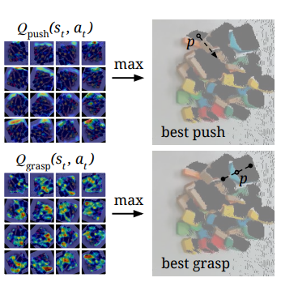
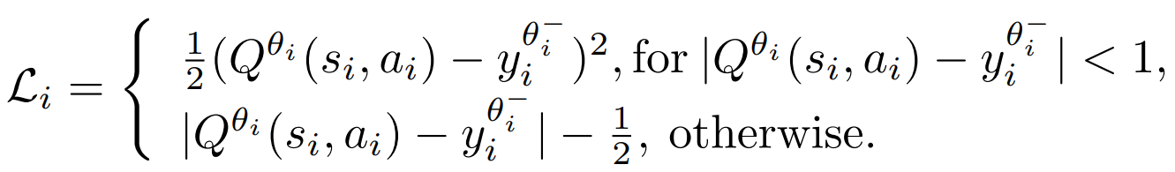
Proposed Method
E. Training details
Huber loss function
θ_{i} : parameters of the neural network at iteration I
θ_{i}⁻ : fixed
φ_{ψ} : network to be trained
ϵ : =0.5~0.1
γ : future discount = 0.5

Slide 16
Proposed Method
F. Testing details
Greedy deterministic policy --- easy to get stuck (repeat same actions)
No changes
Same Value
Same action
Network weights are reset to original state when:
1.All objects are grasped successfully
2.No change of environment exceed 10 times
Notes:
Naively weighting actions based on visit counts can also be inefficient due our pixel-wise parameterization of the action space
由于动作空间的像素参数化，基于访问次数对动作进行简单的加权也是低效的。

Slide 17
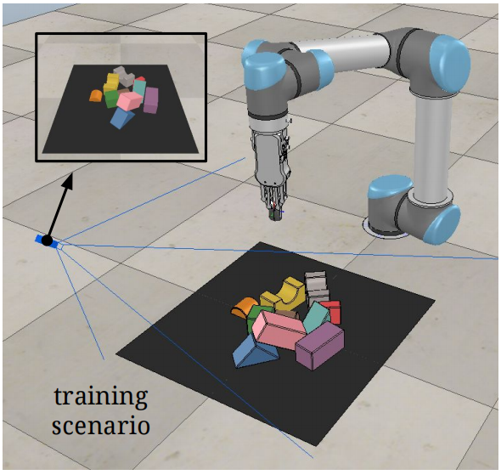
Experimental Set up
Virtual Simulation
Environment:
UR5 robot arm with an RG2 gripper in V-REP [39] (illustrated in Fig.3) with Bullet Physics 2.83 for dynamics and V-REP’s internal inverse kinematics module for robot motion planning.
Each test run in simulation was run n = 30 times. The objects used in these simulations include 9 different 3D toy blocks
simulate a statically mounted perspective 3D camera in the environment, from which perception data is captured. RGBD images of resolution 640×480 are rendered with OpenGL from the camera, without any noise models for depth or color.

Slide 18
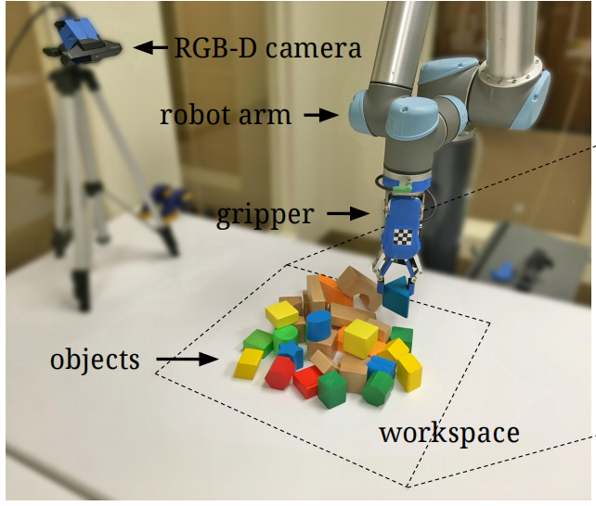
Experimental Set up
Real-world
Environment:
a UR5 robot arm with an RG2 gripper, overlooking a tabletop scenario. Objects vary across different experiments, including a collection of 30+ different toy blocks for training and testing
For perception data, RGB-D images of resolution 640 × 480 are captured from an Intel RealSense SR300, statically mounted on a fixed tripod overlooking the tabletop setting.

Slide 19
Experimental Setup
Baselines and hypotheses
Baselines:
Reactive Grasping-only Policy (Grasping-only) ;
Reactive Pushing and Grasping Policy (P+G Reactive)
Tested hypotheses:
Visual Pushing for Grasping (VPG)

Slide 20
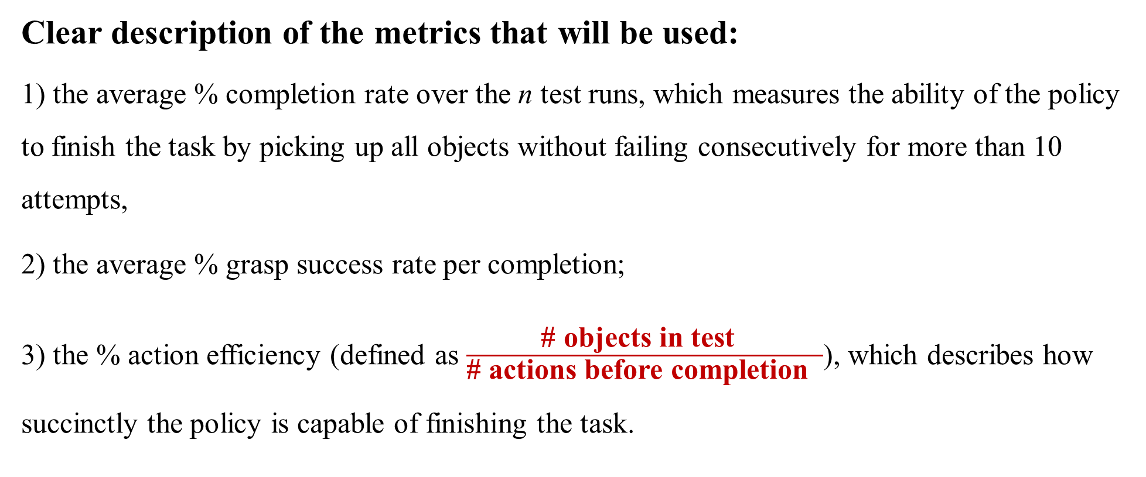
Experimental Setup
Evaluation Metrics
Clear description of the metrics that will be used:
1) the average % completion rate over the n test runs, which measures the ability of the policy to finish the task by picking up all objects without failing consecutively for more than 10 attempts,
2) the average % grasp success rate per completion;
3) the % action efficiency (defined as $\frac{\text{\# }\text{objects} \text{in} \text{test} }{\text{\# }\text{actions} \text{before} \text{completion} }$), which describes how succinctly the policy is capable of finishing the task.

Slide 21
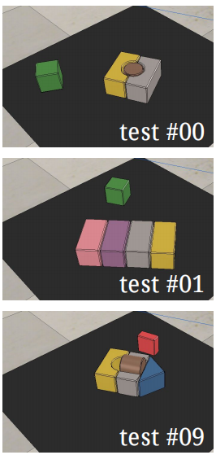
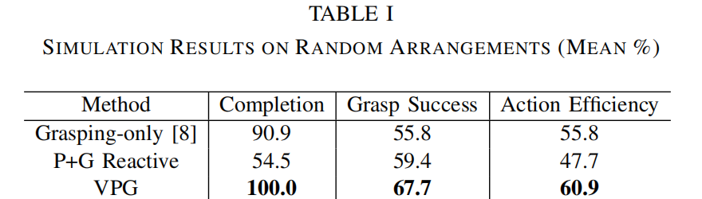
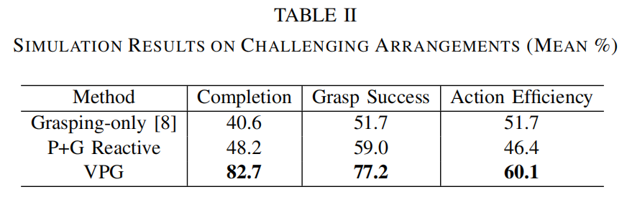
Experimental Results
Virtual Simulation
Random arrangements
Challenging arrangements
30
objects are randomly dropped onto a table
11 challenging test
Cases similar to the right figure

Slide 22
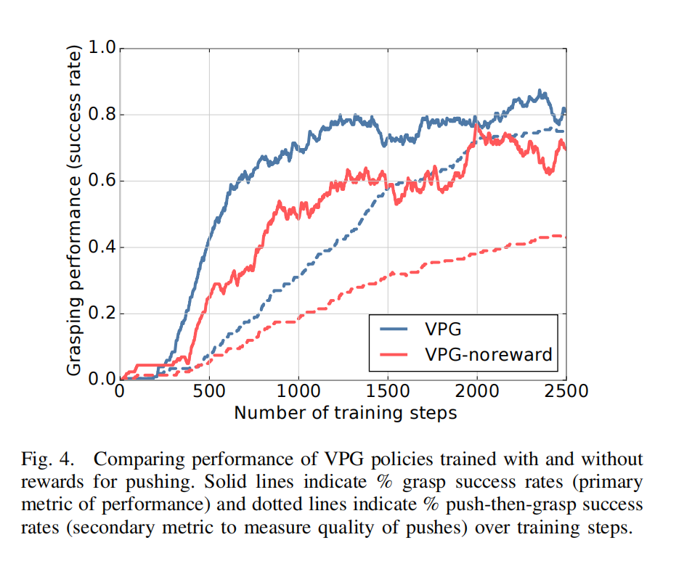
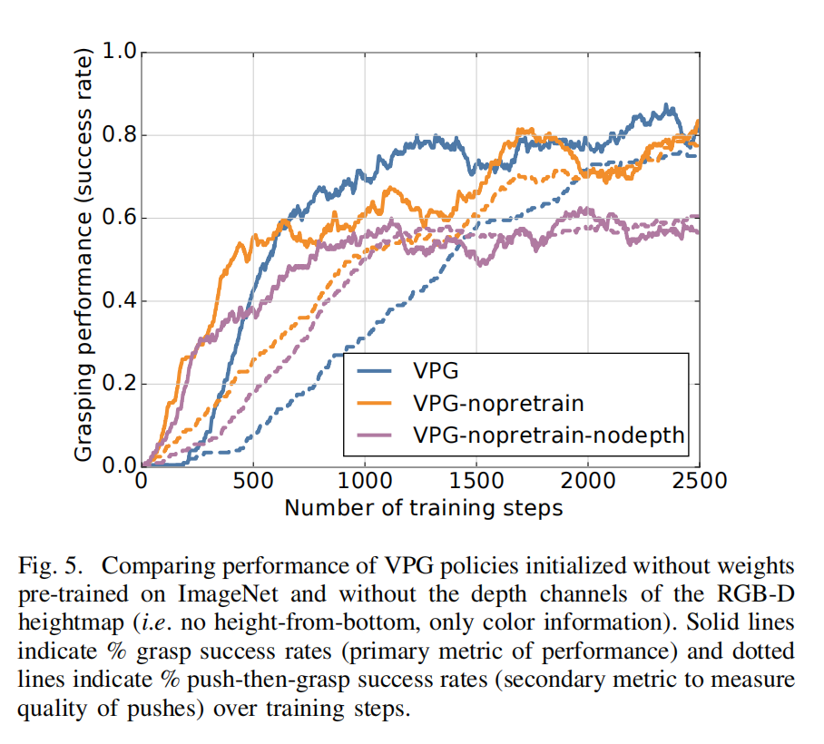
Experimental Results
Success rate with respect to training steps(in simulation)
Notes:
No reward: 没有对推做出奖励
No pretrain：没有对FCN 进行权重的提前训练
No pretrain-no depth：相机没有深度，只有平面

Slide 23
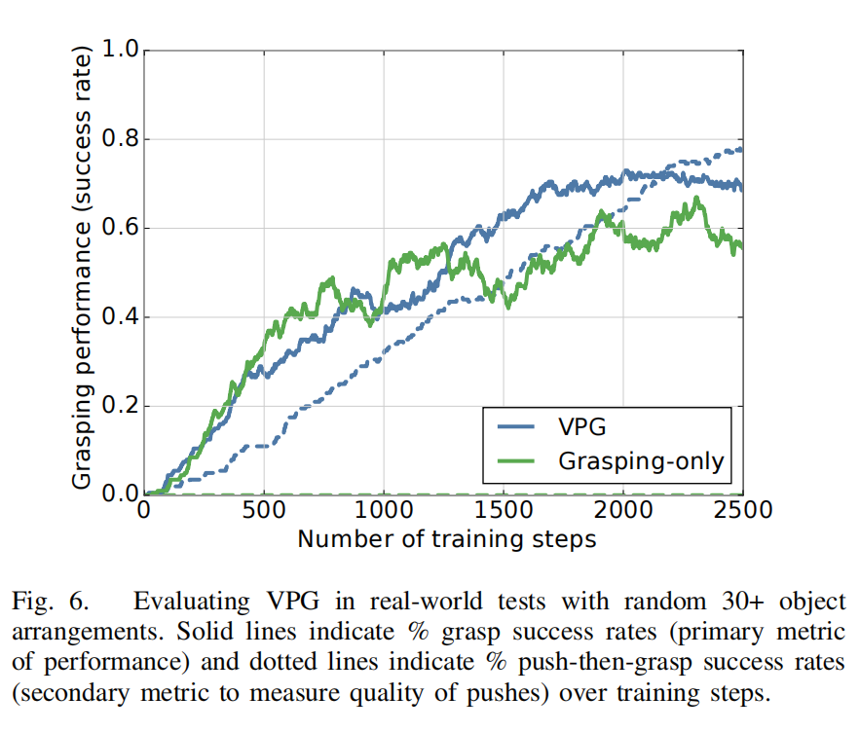
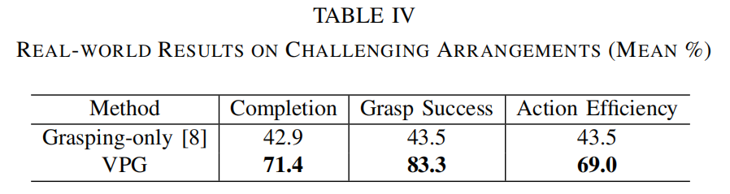
Experimental Results
Real-world result
Notes:
Noreward: 没有对推做出奖励
Nopretrain：没有对FCN 进行权重的提前训练
Nopretrain-nodepth：相机没有深度，只有平面

Slide 24
Discussion of Results
It can be easily concluded that VPG performs better in completion rate, success rate and efficiency.
Moreover, it has high training efficiency for it can perform well in just six hours of training.
Notes:
What conclusions are drawn from the results by the authors?
What insights are gained from the experiments?
What strengths and weaknesses of the proposed method are illustrated by the results?
Are the stated conclusions fully backed by the results and references?
If so, why? (Recap the relevant supporting evidences from the given results + refs)
If not, what are the additional experiments / comparisons that can further support/repudiate the conclusions of the paper?

Slide 25
Limitations
Limitations of this paper
First Motion primitives are defined with parameters specified on a regular grid (heightmap), which provides learning efficiency with deep networks, but limits expressiveness.
Second The deep learning system has only been trained with blocks and tested with a limited range of shapes (fruit, bottles, etc.).
Third The synergy just covers two examples (pushing and grasping) of the larger family of primitive manipulation actions.
Notes:
What are the key limitations of the proposed approach / ideas? (e.g., does it require strong assumptions that are unlikely to be practical? Computationally expensive? Require a lot of data?)
Are there any practical challenges in deploying the approach on physical robots in the real world? Are there any safety or ethical concerns of using such approach?
If follow-up work has addressed some of these limitations, include pointers to that. But don’t limit your discussion only to the problems / limitations that have already been addressed.

Slide 26
Future Work
Ideas for future work based on limitations
First Parameterizations with more expressive motions
(parallel combinations of pushing and grasping)
Various contact surfaces
Second Training on larger varieties of shapes
further evaluate the generalization capabilities of the learned policies
Third Study strategies of many other primitive manipulation actions (rolling, toppling, squeezing, levering, stacking, etc.)
Notes:
What interesting questions does it raise for future work?
Your own ideas for future work
Others’ ideas (if others have already built on this idea)

Slide 27
Extended Readings
[1] Official website of amazon picking challenge. [Online]. Available: http://amazonpickingchallenge.org
[2] J. Long, E. Shelhamer, and T. Darrell, “Fully convolutional networks for semantic segmentation,” in CVPR, 2015, pp. 3431–3440.
[3] Website for code and data. [Online]. Available: http://apc.cs.princeton.edu/
[4] R. Jonschkowski, C. Eppner, S. Hofer, R. Martin, and O. Brock, “Probabilistic multi-class segmentation for the amazon pick_x0002_ing challenge,” http://dx.doi.org/10.14279/depositonce-5051, 2016.
[5] C. Eppner, S. Hofer, R. Jonschkowski, R. Martın-Martın, A. Sieverling, V. Wall, and O. Brock, “Lessons from the amazon picking challenge: Four aspects of building robotic systems,” in RSS, 2016.

Slide 28
Conclusion and Summary
Summary
This paper shows that the synergy between planning non-prehensile (pushing) and prehensile (grasping) actions can be learned by the deep reinforcement learning system.
It is the first to realize performing complex sequences of pushing and grasping on a real robot in a short training time.
The planning of combined manipulation actions for robots is still a new field which has unlimited potential and needs further more research.
Notes:
Approximately one bullet for each of the following
Problem the reading is discussing
Why is it important and hard
What is the key limitation of prior work
What is the key insight(s) (try to do in 1-3) of the proposed work
What did they demonstrate by this insight? (tighter theoretical bounds, state of the art performance on X, etc.)

Slide 29
Thank You

