Slide 1
Learning Agile and Dynamic Motor Skills for Legged Robots
Presenter: 陈逸飞 方艺钧
杨德宇 宁晨辉 朱思颖

Slide 2
Problem
present situation
So far, reinforcement learning research for legged robots is mainly limited to simulation, and only few and comparably simple examples have been deployed on real systems.
what we do？
In the present work, we report a new method for train_x0002_ing a neural network policy in simulation and transfer_x0002_ring it to a state-of-the-art legged system, thereby weleverage fast, automated, and cost-effective data gener_x0002_ation schemes.

Slide 3
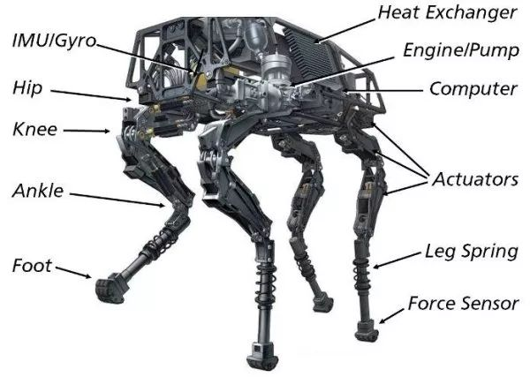
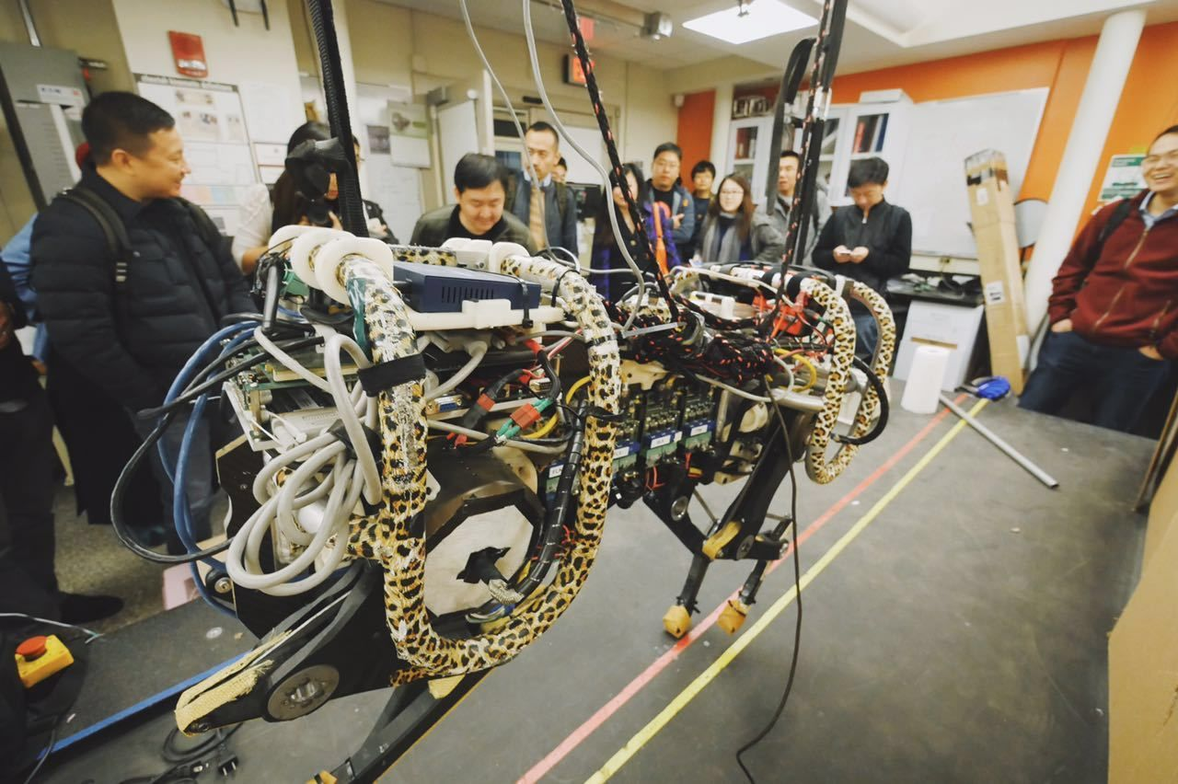
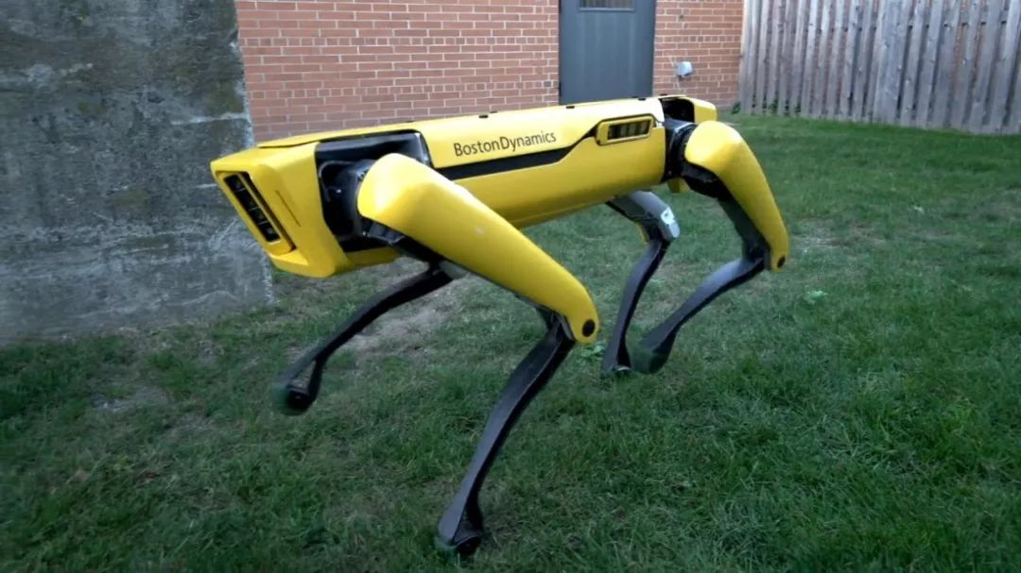
Problem
Legged systems have the potential to perform any physical activity humans and animals are capable of.
Big dog by Boston Dynamics
Cheetah by MIT
SpotMini by Boston Dynamics

Slide 4
Problem
Big dog by Boston Dynamics
large scale，generate smoke and noise
limiting indoor environment
Cheetah by MIT
has not been thoroughly evaluated with respect to battery life, turn_x0002_ing capability, mechanical robustness, and outdoor applicability
SpotMini by Boston Dynamics
the complicated actuator design
increases cost and compromises
the power output of the robot.

Slide 5
Related Work
Designing control algorithms for these hardware platforms
remains exceptionally challenging.
1. high-dimensional and non-smooth systems cause uncertainties in the dynamics
2 lengthy design process and arduous parameter tuning.
Popular approach
controlling physical legged systems is modular controller design
Example
Robust Quadrupedal Locomotion on Sloped Terrains:
A Linear Policy Approach

Slide 6
Related Work
Trajectory optimization approaches have been
proposed to mitigate the aforementioned problems.
planning :uses rigid-body dynamics and numerical optimization to
compute an optimal path thatthe robot should follow to reach the
desired goal.
tracking:follow the path

Slide 7
Related Work
Data-driven methods
By learning effective controllers directly from experience. Direct application
of learning methods to physical legged systems is therefore complicated and
has only been demonstrated on relatively simple and stable platforms or in a
limited context

Slide 8
State-of-art
Reason:
The discrepancy between simulation and the real system
in terms of dynamics and perception
Solution：
There are two general approaches to bridging the reality gap
improve simulation fidelity or accept the imperfections of simulation

Slide 9
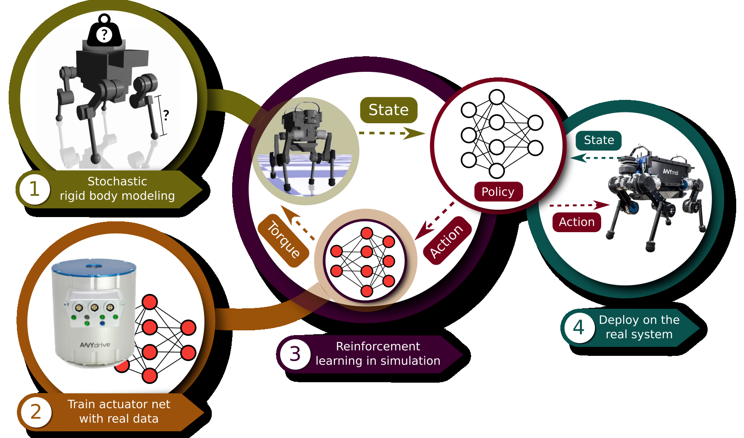
State-of-art
ANY-mal robot
ANYmal has a much larger leg length relative to footprint, therefore more
difficult tocontrol
Solution:

Slide 10
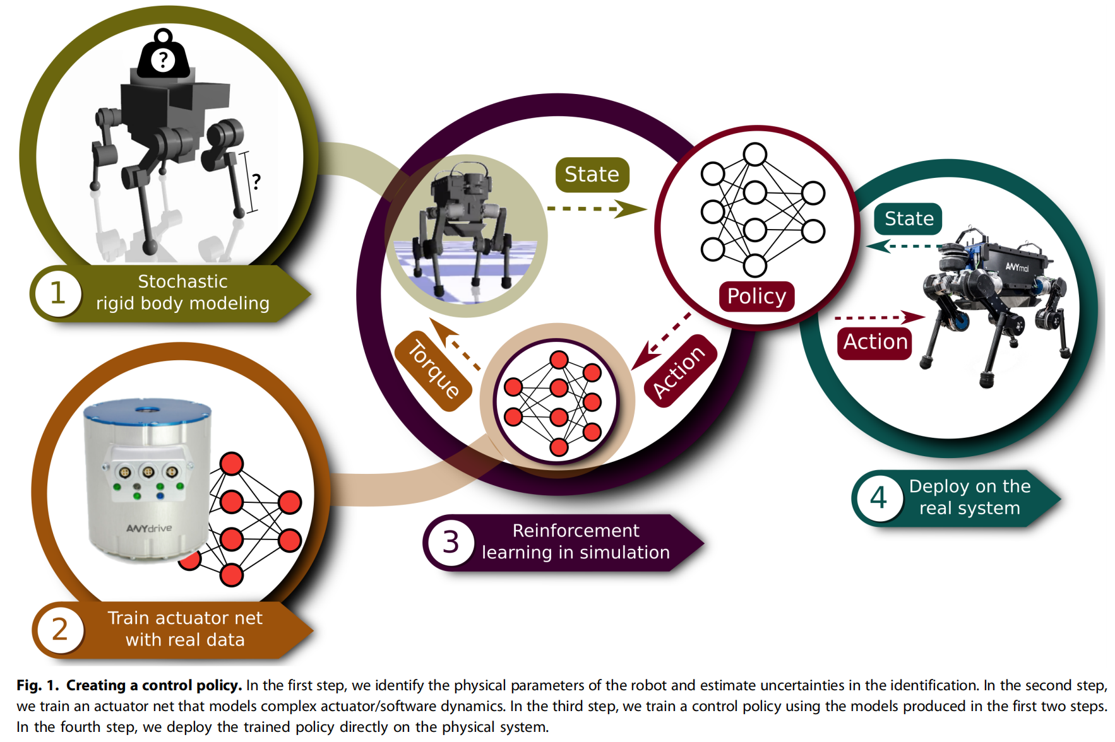
Method
Modeling rigid-body dynamics
Modeling the actuation
Reinforcement learning
Application
Notes:
Method的总起页
在method这一节中，我们将介绍对刚体动力学和对驱动数据的建模方法、在训练过程中会用到的强化学习模型，以及本项目机器人的应用。

Slide 11
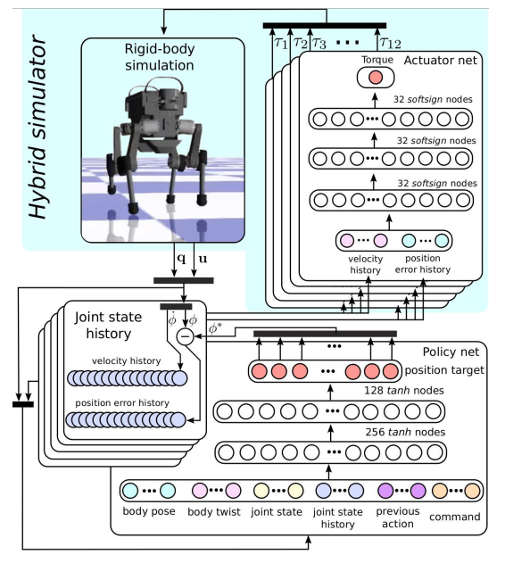
Method
Modeling rigid-body dynamics
Build a sumulation platform
Intermittent contacts?
Inertial properties of links?
using rigid body contact solver
robustifying the policy by training with 30 different ANYmal models with stochastically sampled inertial properties
Notes:
机器人控制流程由左图所示。
输入给定的关节扭矩和当前状态，刚体模拟器会处理并输出下一关节状态，包括关节速度和关节位置误差。关节位置误差等于target位置减去当前位置。这些输出的关节状态会记录在一个有限的buffer里，供后续使用。
控制策略由具有两个隐藏层的多层感知器实现，将当前状态和状态历史的观察映射到联合位置目标。最后，致动器网络将关节状态历史和关节位置目标映射到12个关节扭矩值，这些扭矩值回到起点，输入给刚体模拟器。周而复始。
接着我们继续描述每一组件的细节。
为了在合理的时间内有效地训练复杂的策略并将其传递到现实世界，我们需要一个快速准确的仿真平台。步行机器人面临的最大挑战之一是间歇性接触的动力学。为此，我们利用了前一项工作中提出的刚体接触求解器[41]。该接触求解器采用完全尊重库仑摩擦锥约束的硬接触模型。这种建模技术可以准确地捕捉一组刚体与其环境进行硬接触的真实动力学。
links的惯性特性是由CAD确定的，由于之后还要为机器人安装电缆和电子设备，预估会有20%的误差。为了解决这种建模不准确的问题，我们通过使用30个不同的具有随机采样惯性性质的ANYMAL模型进行训练，使策略更加稳健。通过添加噪声，对质心位置、连杆质量和关节位置进行随机化。

Slide 12
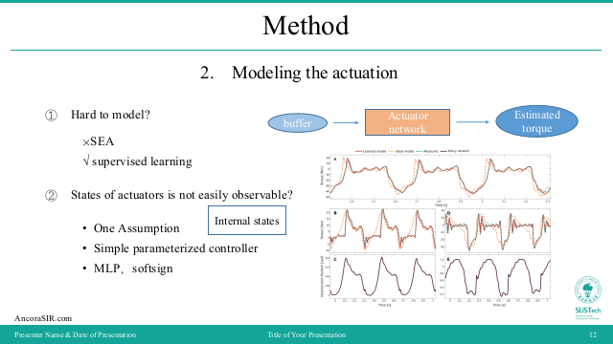
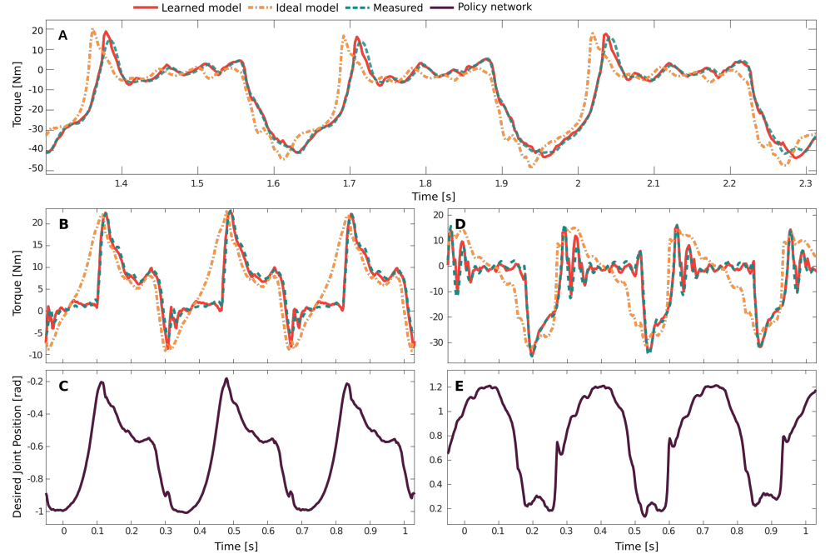
Method
2. Modeling the actuation
Actuator network
Estimated torque
Hard to model?
States of actuators is not easily observable?
buffer
×SEA
√ supervised learning
Internal states
One Assumption
Simple parameterized controller
MLP
Notes:
致动器是腿式系统的重要组成部分。快速、强大、重量轻、精度高的执行器通常可转换为动态、多功能和灵活的机器人。大多数腿由液压致动器[51]或带齿轮的电机[3]驱动，有些甚至包括专用的机械柔顺性[5，52]。这些致动器有一个共同点，即非常难以精确建模。它们的动力学涉及非线性和非光滑耗散，它们包含级联反馈回路和许多甚至无法直接观察到的内部状态.
Gehring等人广泛研究了SEA致动器建模。SEA模型包括近一百个必须从实验中估计或从数据表中假设正确的参数。此过程容易出错且耗时。此外，许多制造商没有对其产品提供足够详细的描述，因此，分析模型可能不可行。为此，我们使用监督学习来获得动作-扭矩关系，该关系包括一个控制回路中的所有软件和硬件动力学。更准确地说，我们训练一个执行器网络，该网络根据位置误差（从命令位置减去实际位置）和速度的历史来计算关节处的估计扭矩。在这项工作中，我们假设致动器的动力学相互独立，因此我们可以分别学习每个致动器的模型。这种假设可能对其他类型的驱动无效。例如，具有单个公共蓄能器的液压执行器可能表现出耦合的动态特性，而单个大型网络（将多个执行器组合在一起）可能更为理想。
致动器的状态只能部分观察到，因为致动器的内部状态（例如，内部控制器的状态和电机速度）无法直接测量。我们先给出一个假设，即可以训练网络来估计给定位置误差和速度历史的内部状态。
为了训练网络，我们收集了一个由关节位置误差、关节速度和扭矩组成的数据集。我们使用了一个简单的参数化控制器，以正弦波的形式生成脚的轨迹；使用反向运动学计算相应的关节位置。在数据收集过程中，脚不断地与地面接触或断开，因此产生的轨迹大致模拟了运动控制器跟踪的轨迹。为了获得丰富的数据集，我们使用了改变振幅（5-10cm）和频率（1-25 Hz）的脚轨迹，并在数据收集期间手动干扰机器人。我们发现，激励必须覆盖广泛的频谱范围，否则，即使在训练阶段，训练模型也会产生不自然的振荡。因为数据可以从ANYMALData上的12个相同致动器并行收集，数据收集时间只需不到4分钟。因此得到的数据包含超过一百万个样本。约90%的生成数据用于培训，其余数据用于验证。
最后，项目使用了MLP。执行器网络是一个多层感知器（MLP），具有3个隐藏层，每个层32个单元（图5，“执行器网络”框）。经过对两个常见的平滑和有界激活函数tanh和softsign进行测试后，我们选择了softsign激活函数，因为它计算效率高，并提供了平滑映射。评估所有12个关节的致动器网络需要12.2小时的softsign（，31.6小时的tanh）。两个激活函数导致了大致相同的验证误差（RMS值为0.7-0.8 Nm）。softsign的验证结果如图所示。经过训练的网络几乎完美地从验证数据中预测扭矩，而理想的致动器模型无法产生合理的预测。理想的致动器模型假设致动器内的所有控制器和硬件具有无限带宽和零延迟，即理想的致动器模型假设没有通信延迟，并且致动器可以立即产生任何命令。经过训练的模型在验证集上的平均误差与扭矩测量的解（0.2Nm）相差不远，并且远小于理想致动器模型的误差（3.55Nm）。在预测集上，其预测误差要更高，但仍远低于理想模型的预测误差（5.74 Nm）

Slide 13
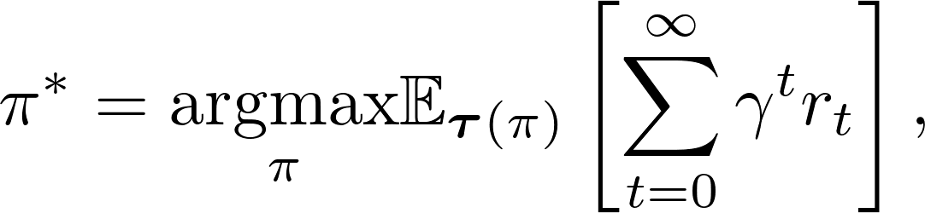
Method
Reinforcement Learning
Trust Region Policy Optimization(TRPO)
The agent selects actions according to a stochastic policy
Find a policy that maximizes the discounted sum of rewards over an infinite horizon
where γ ∈ (0, 1) is the discount factor, τ(π) is the trajectory distribution under policy π,
rt is the scalar reward,
Notes:
策略梯度方法博大精深，但策略梯度算法的硬伤就在于更新步长 α \alpha α 很难确定，当步长不恰当时，更新参数所对应的策略是一个更不好的策略，当利用这个更不好的策略进行采样学习时，再次更新的参数会更差，因此很容易导致越学越差，甚至崩溃学不到东西。TRPO(Trust Region Policy Optimization, 置信域策略梯度优化)算法是现OpenAI科学家John Schulman在2015年2月提出的一种策略优化算法，并且发表于《第31届ICML》顶会上，可以说是非常独特新颖，同时其在2016年的博士论文中将该算法作为第三章(page18-44)进行了单独阐述。
We represent the control problem in discretized time. At every
time step t the agent obtains an observation ot ∈ O, performs an
action at ∈ A, and achieves a scalar reward rt ∈ R. We refer to
reward and cost interchangeably, with cost being the negative
of the reward. We denote by Ot = h ot, ot−1, . . . , ot−hi
the tuple
of recent observations. The agent selects actions according to a
stochastic policy π(at|Ot), which is a distribution over actions
conditioned on the recent observations.
目的是找到一个
最大化折扣奖励的策略
无限的地平线上:

Slide 14
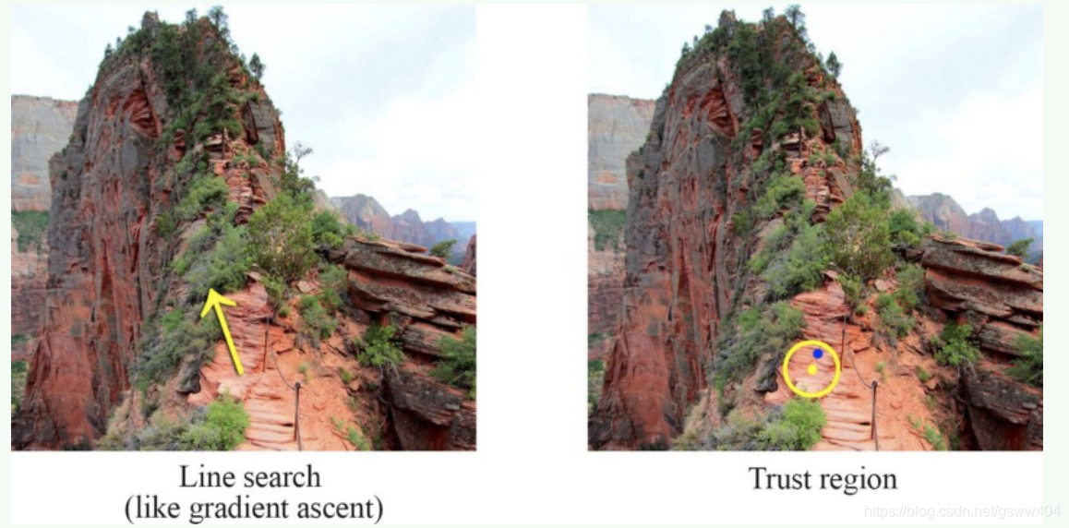
Method
Trust Region Policy Optimization(TRPO)
Notes:
在梯度上升法中，我们判断最陡峭的方向，之后朝着那个方向前进。但是如果学习率(learning rate，步长)太高的话，这样的行动也许让我们远离真正的回报函数( the real reward function )，甚至会变成灾难。在信任的区域之中，我们用 δ \delta δ 变量限制我们的搜索区域（置信区间），这样的区域可以保证在它达到局部或者全局最优策略之前，它的优化策略将会优于当前策略,结

Slide 15
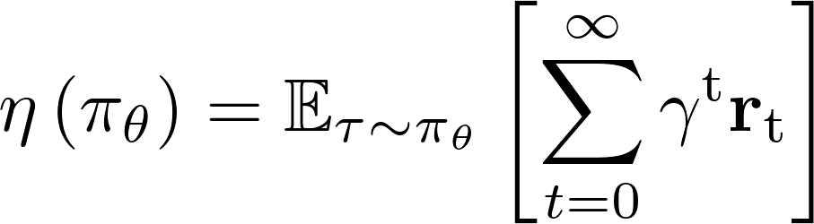
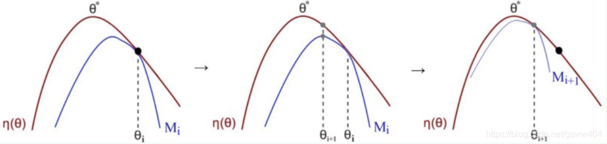
Method
Surrogate function
Notes:
这是对累计奖励函数做的期望，其中图中的C为常数，蓝色曲线M中的KL表示散度（后文解释)，对于每次迭代，我们发现Surrogate函数M(蓝线)有如下性质：
是 η \eta η 的下界函数
可用于估计当前策略的 折扣奖励 η \eta η
易于优化(我们将会把Surrogate函数近似估计为一个二次方程)
在每一次迭代之中，我们找到最佳的M点并且把它作为当前的策略。

Slide 16
Proposed Approach / Algorithm / Method
Further explaination of the title with supporting evidence
1-5 slides
Describe algorithm or framework (pseudocode and flowcharts can help)
What is the optimization objective?
What are the core technical innovations of the algorithm/framework?
Implementation details should be left out here, but may be discussed later if its relevant for limitations / experiments

Slide 17
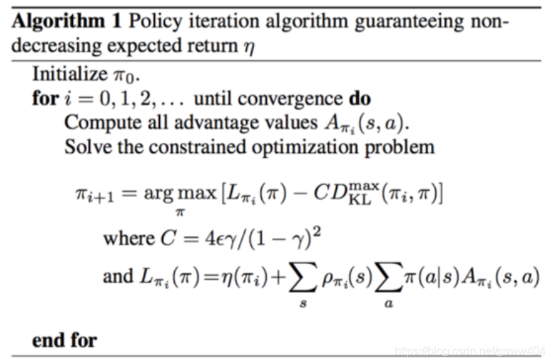
Method
iteration algorithm

Slide 18
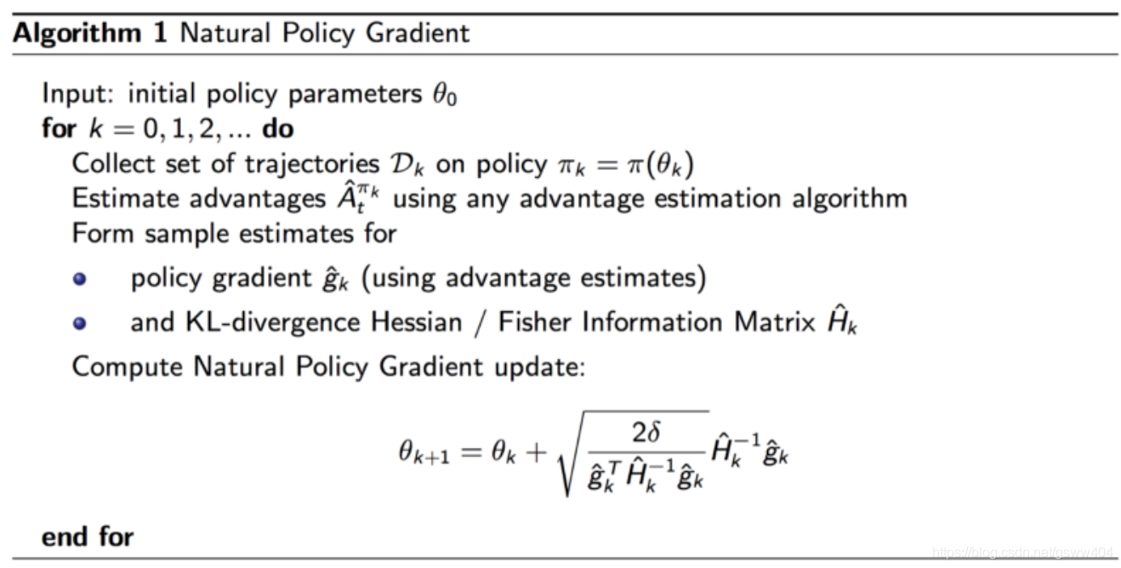
Method
natural policy gradien
Notes:
自然策略梯度的关键思想是保证了函数单调上升。它是Policy Gradient方法家族中的“用货币担保”的版本（笑）。简而言之，至少在理论上，任何策略策更新都将比之前的好。我们在这需要证明的是，基于优化M的新策略 可以保证在 η （实际预期回报）方面的表现优于之前的策略。由于策略的数量是有限的，持续更新策略最终能达到局部或全局最优。

Slide 19
Method
Application
Observation and action
The joint state history was essential in training a locomotion policy
Policy training details
MLP with two hidden layers, with 256 and 128 units each and tanh nonlinearity
Bounded activation functions, such as tanh, yield less aggres_x0002_sive trajectories
Deployment on the physical system

Slide 20
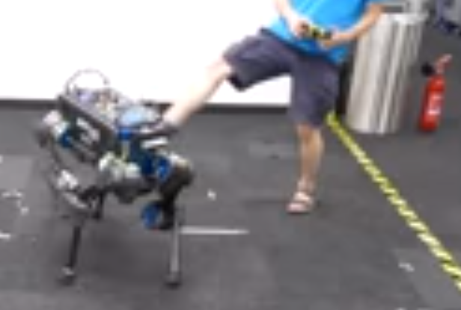
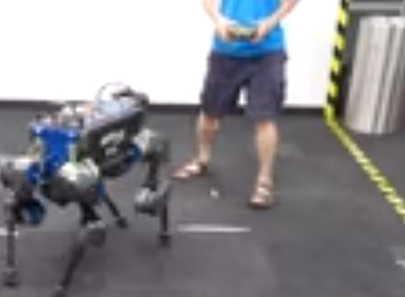
Experiment1
We first qualitatively evaluate this learned locomotion policy by giving
random commands using a joystick. Additionally, the robot is disturbed during
the experiment by multiple external pushes to the main body.
The result show experiment without a single failure, which manifests the
robustness of the learned policy.
Notes:
我们进行了通过操作杆发出随机命令来测试运动，在加入多次外部扰动的情况下也没有出现失误

Slide 21
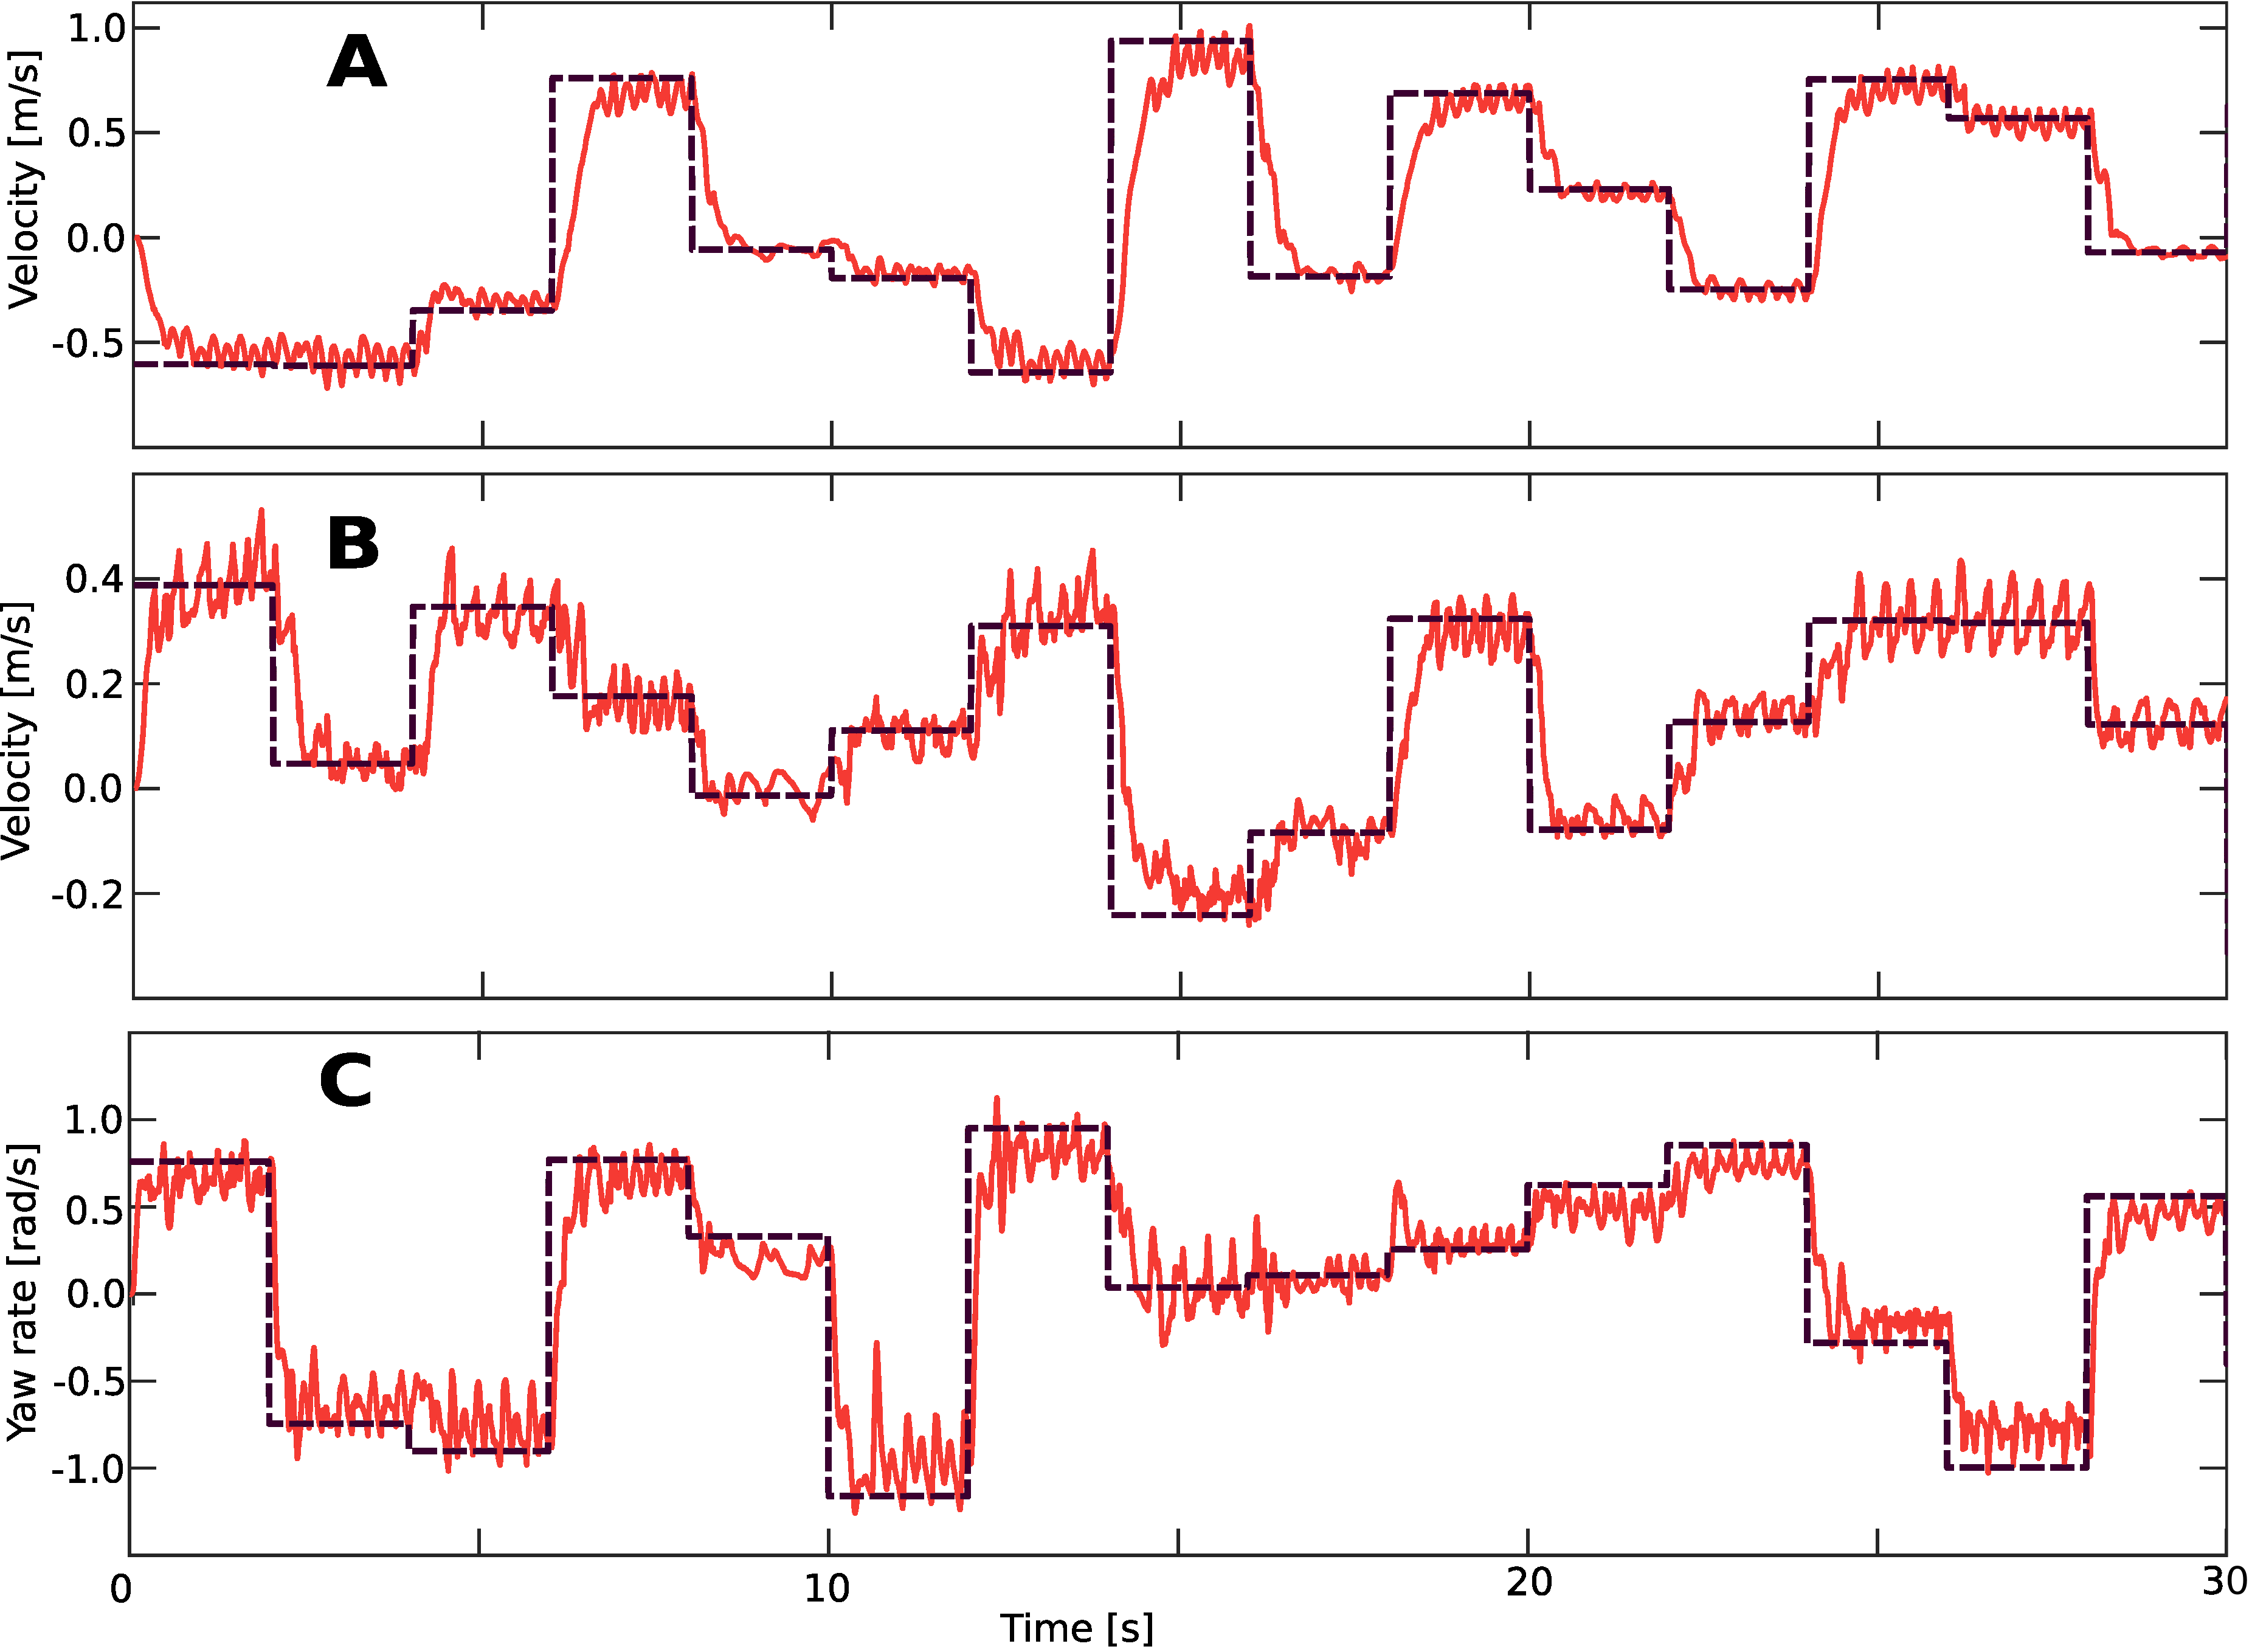
Experiment 2
Next, we quantitatively evaluate this learned locomotion
policy by driving the robot with randomly-sampled commands
The base velocity plot is shown in fig. S1. The average linear velocity error
was 0.143 m/s and the average yaw rate error was 0.174 rad/s.
Notes:
每隔两秒发出一次命令，共15次，线速度偏差为0.143 m/s ，偏航率为0.174 rad/s

Slide 22
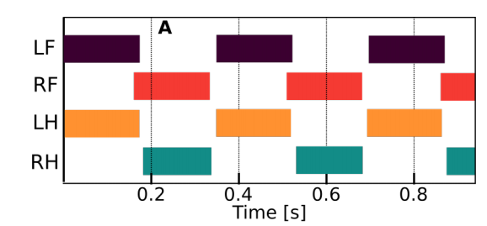
Experiment 3
We now compare the learned controller to the best performing
existing locomotion controller available for ANYmal
Movie S3 illustrates the experiments for both the
learned policy and the model-based policy.
The control performance was also evaluated and compared in
forward running. To this end, we sent a step input of four different
speed commands (0.25, 0.5, 0.75, and 1.0 m/s) for 4.5 s each.
The results, including a comparison to the prior method , are shown in Fig. 2.
https://youtu.be/aqVPyIgZ15M
Notes:
与ANYmal比较，在相同的命令配置文件下，基于模型的控制器的跟踪误差以线速度比我们学习的控制器高约95%，比偏航率高约60%。此外，我们学习的控制器平均使用了更少的扭矩

Slide 23
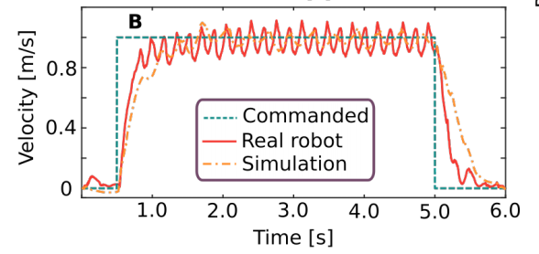
Experiment 3
Figure 2B shows the velocity tracking accuracy of the policy both in
simulation and on the real robot. Note that the oscillation of the
observed velocity around the commanded one is a well-known
phenomenon in legged systems, including humans [43]. In terms
of average velocity, the learned policy has an error of 2.2 % on
the real robot, 1.1 % higher than in a simulation.

Slide 24
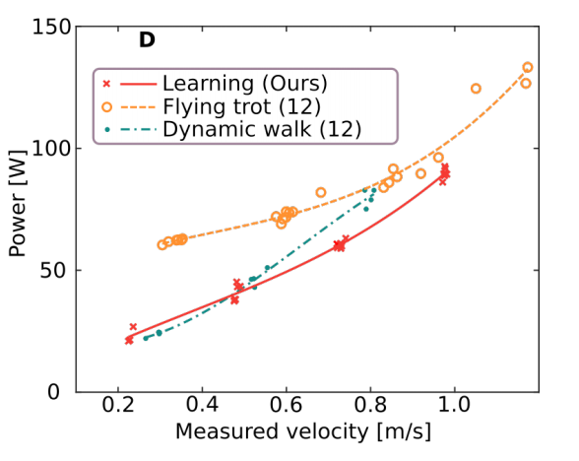
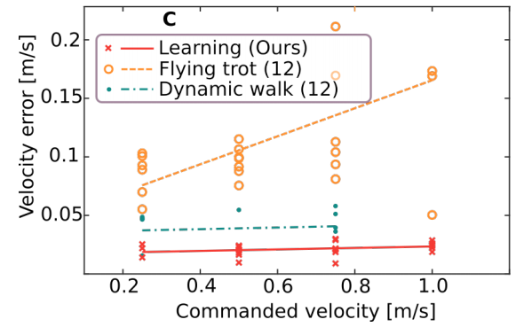
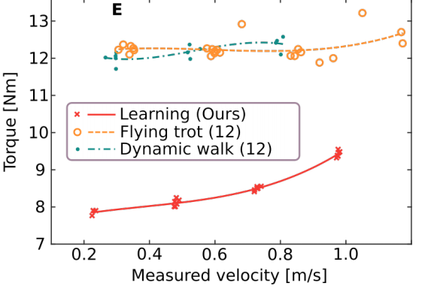
Experiment 3
Figure 2C, 2D, and 2E compare the performance of the learned controller
to the approach of Bellicoso et al. in terms of accuracy and efficiency
Notes:
我们比较了图2c中不同命令速度下的速度误差。对于所有的指令速度，学习到的控制器比之前的控制器更精确：与动态横向行走相比是1.5到2.5倍，与飞行小跑相比是5到7倍，图二d表示机械功率输出作为测量速度的函数。图2e绘制了测量的平均转矩大小与测量速度的关系

Slide 25
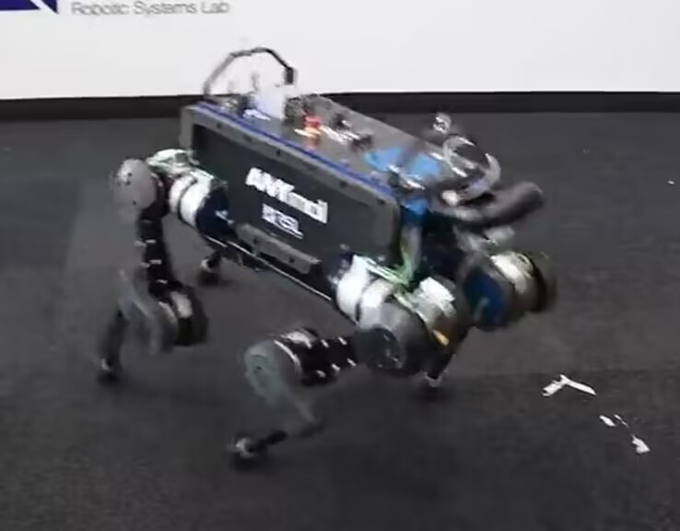
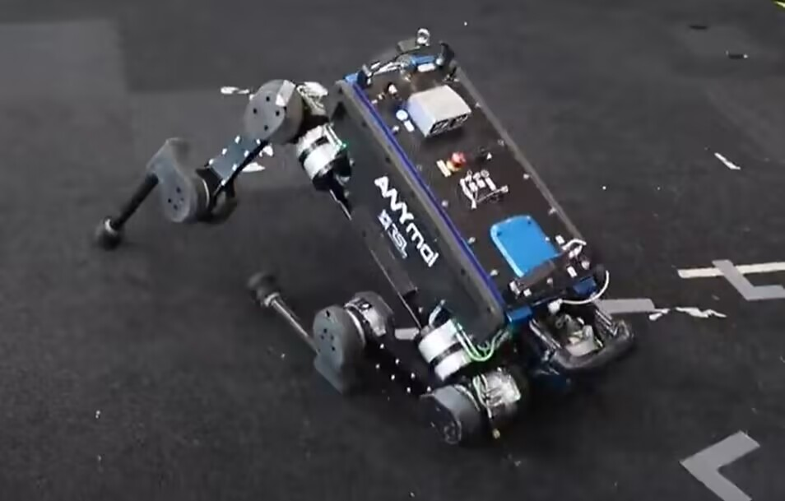
Experiment 4
Next, we compare our method to ablated alternatives: training with an
ideal actuator model and training with an analytical actuator model.
We observed violent shaking of the limbs, probably due to not
accounting for various delays properly. Even though the analytical model contains multiple delay sources that are tuned using real data, accurately modeling all delay sources is complicated when the actuator has limited bandwidth
Notes:
与消融的替代方案进行比较：使用理想的执行器模型进行训练，可能是由于没有正确地解释各种延误。尽管分析模型包含多个使用真实数据进行调谐的延迟源，但当执行器的带宽有限时，准确地建模所有延迟源是很复杂的

Slide 26
Experiment 5
High-speed locomotion
The current speed record on ANYmal is 1.2 m/s and has been set using the flying trot
gait . Although this may not seem high, it is 50 % faster thanthe previous speed record
on the platform . Such velocities are challenging to reach via conventional controller
design while respecting all limits of the hardware.
We have used the presented methodology to train a high speed locomotion controller.
This controller was tested on the physical system by slowly increasing the commanded
velocity to 1.6 m/s and lowering it to zero after 10 meters. The forward speed and joint
velocities/torques are shown in Fig. 3.
Notes:
通过将指令速度缓慢提高到1.6 m/s，并在10米后降至零。前进速度和关节速度/力矩如图3所示

Slide 27
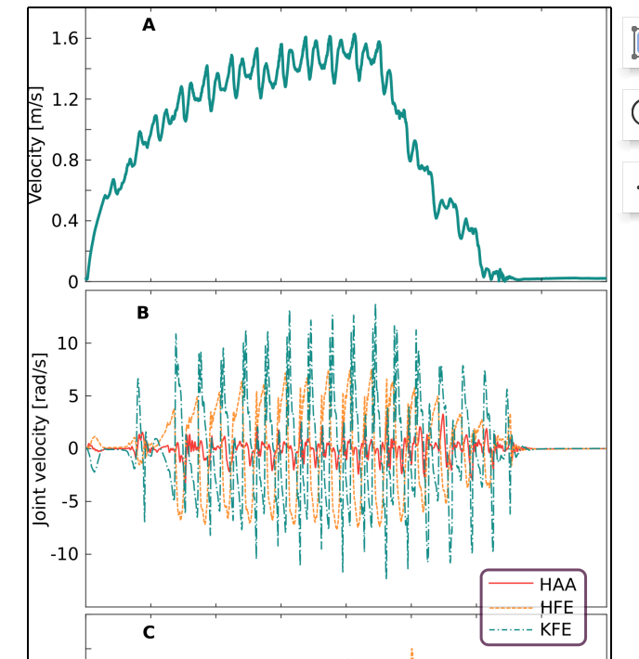
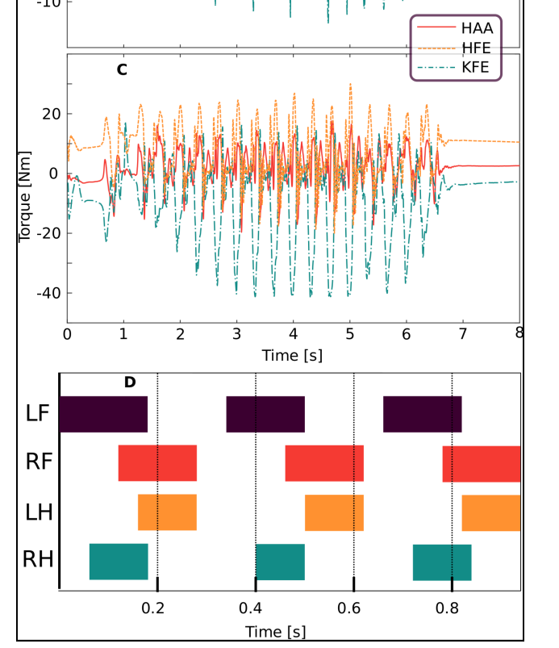
Experiment 5
Fig. 3. Evaluation of the trained policy for high-speed loco_x0002_motion. (A) Forward velocity of ANYmal. (B) Joint velocities.(C) Joint torques. (D) Gait pattern. The abbreviations stand for
Left Front (LF) leg, Right Front (RF) leg, Left Hind (LH) leg,and Right Hind (RH) leg, respectively

Slide 28
Experiment 5
Even state-of-the-art methods cannot limit the actuation during planning due to limitations
of their planning module. Modules in their controllers are not aware of the constraints in
the later stages and, consequently,their outputs may not be realizable on the physical system
in Fig. 3D is distinct from the one exhibited by the command-conditioned locomotion
controller. It is close to a flying trot but with significantly longer flight phase and asymmetric
flight phase duration.. This is not a commonly observed gait pattern in nature and we suspect
that it is among multiple near-optimal solution modes for this task.

Slide 29
Experiment 6
Recovery from a fall
Using the presented methodology, we trained a recovery policy and tested
it on the real robot.
In all tests, ANYmal successfully flipped itself upright. An example motion
is shown in Fig. 4. These agile and dynamic behaviors demonstrate that our
approach is able to learn performant controllers for tasks that are difficult or
impossible to address with prior methods.

Slide 30
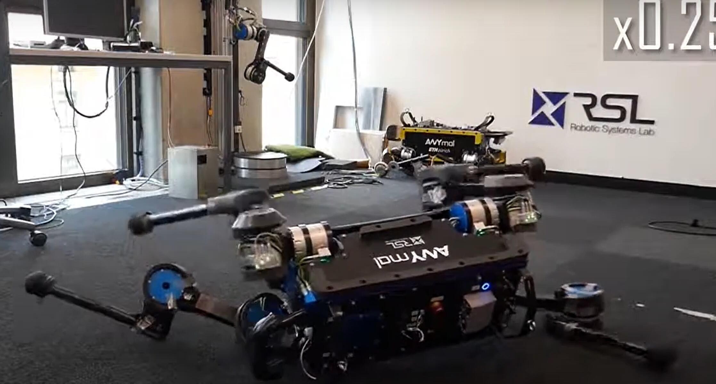
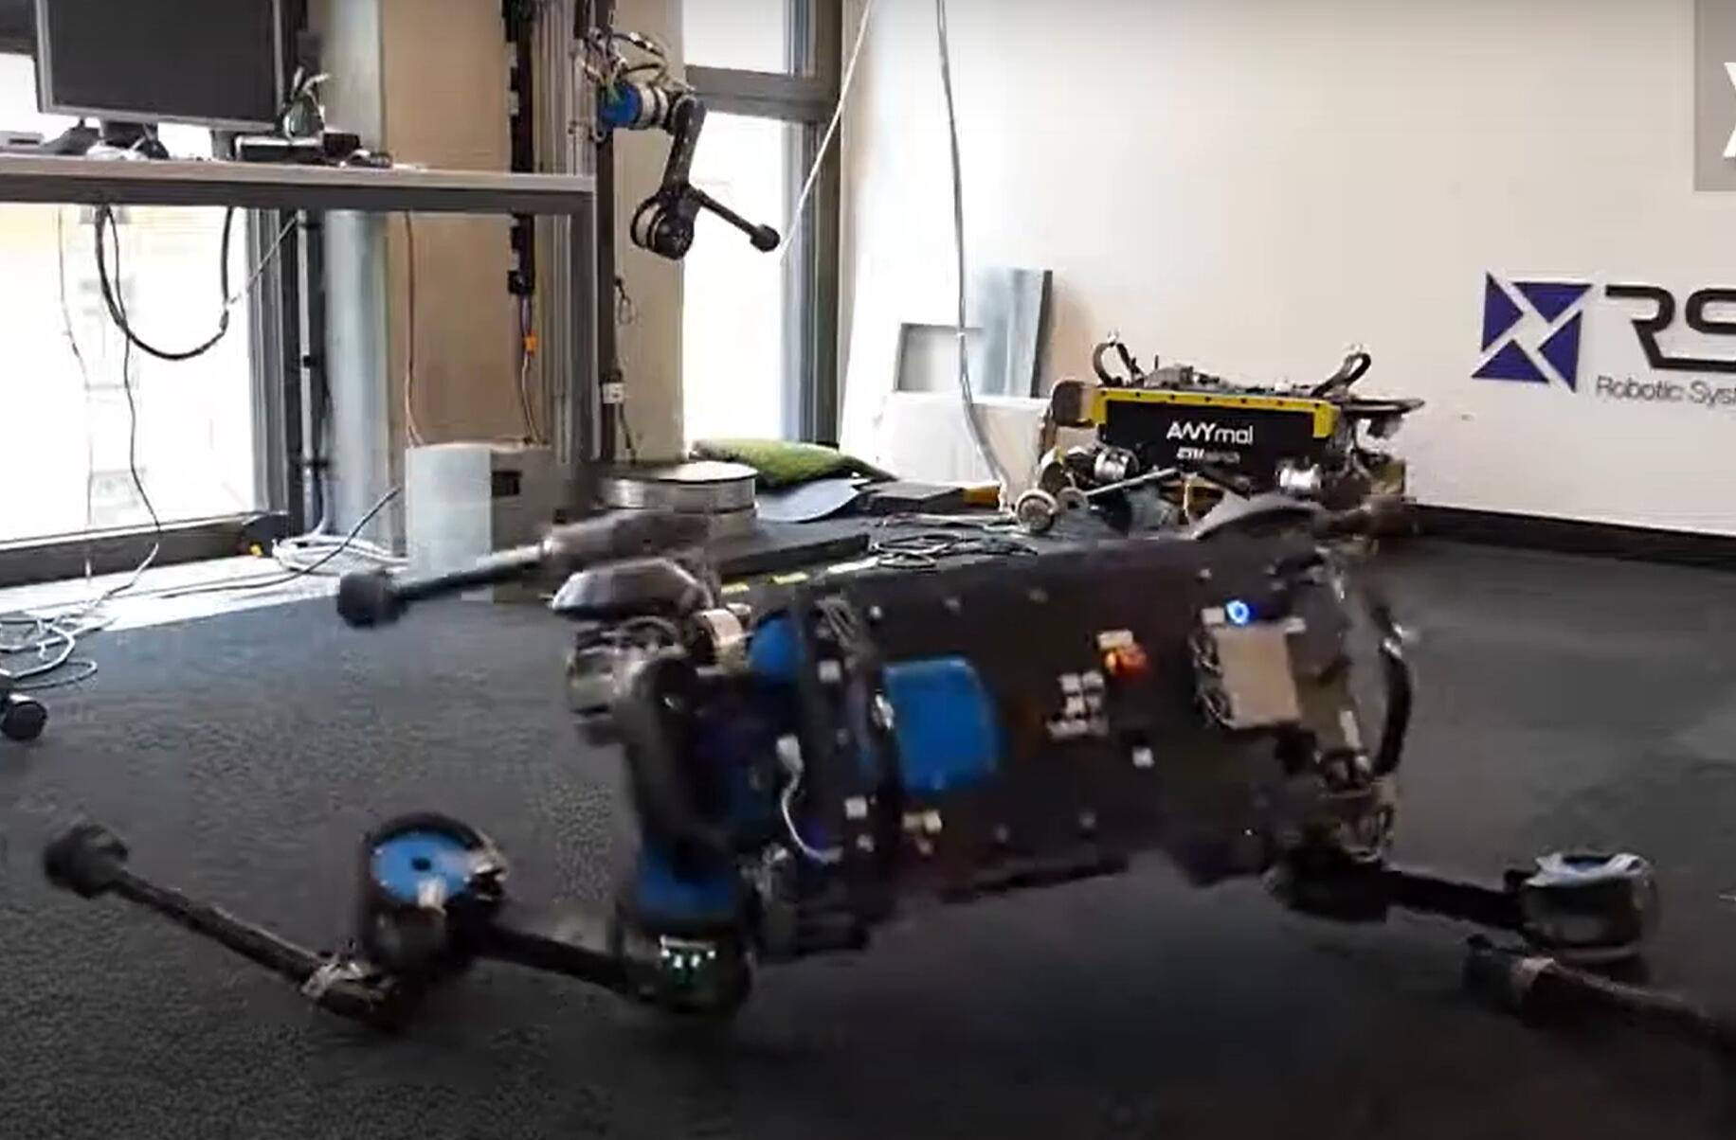
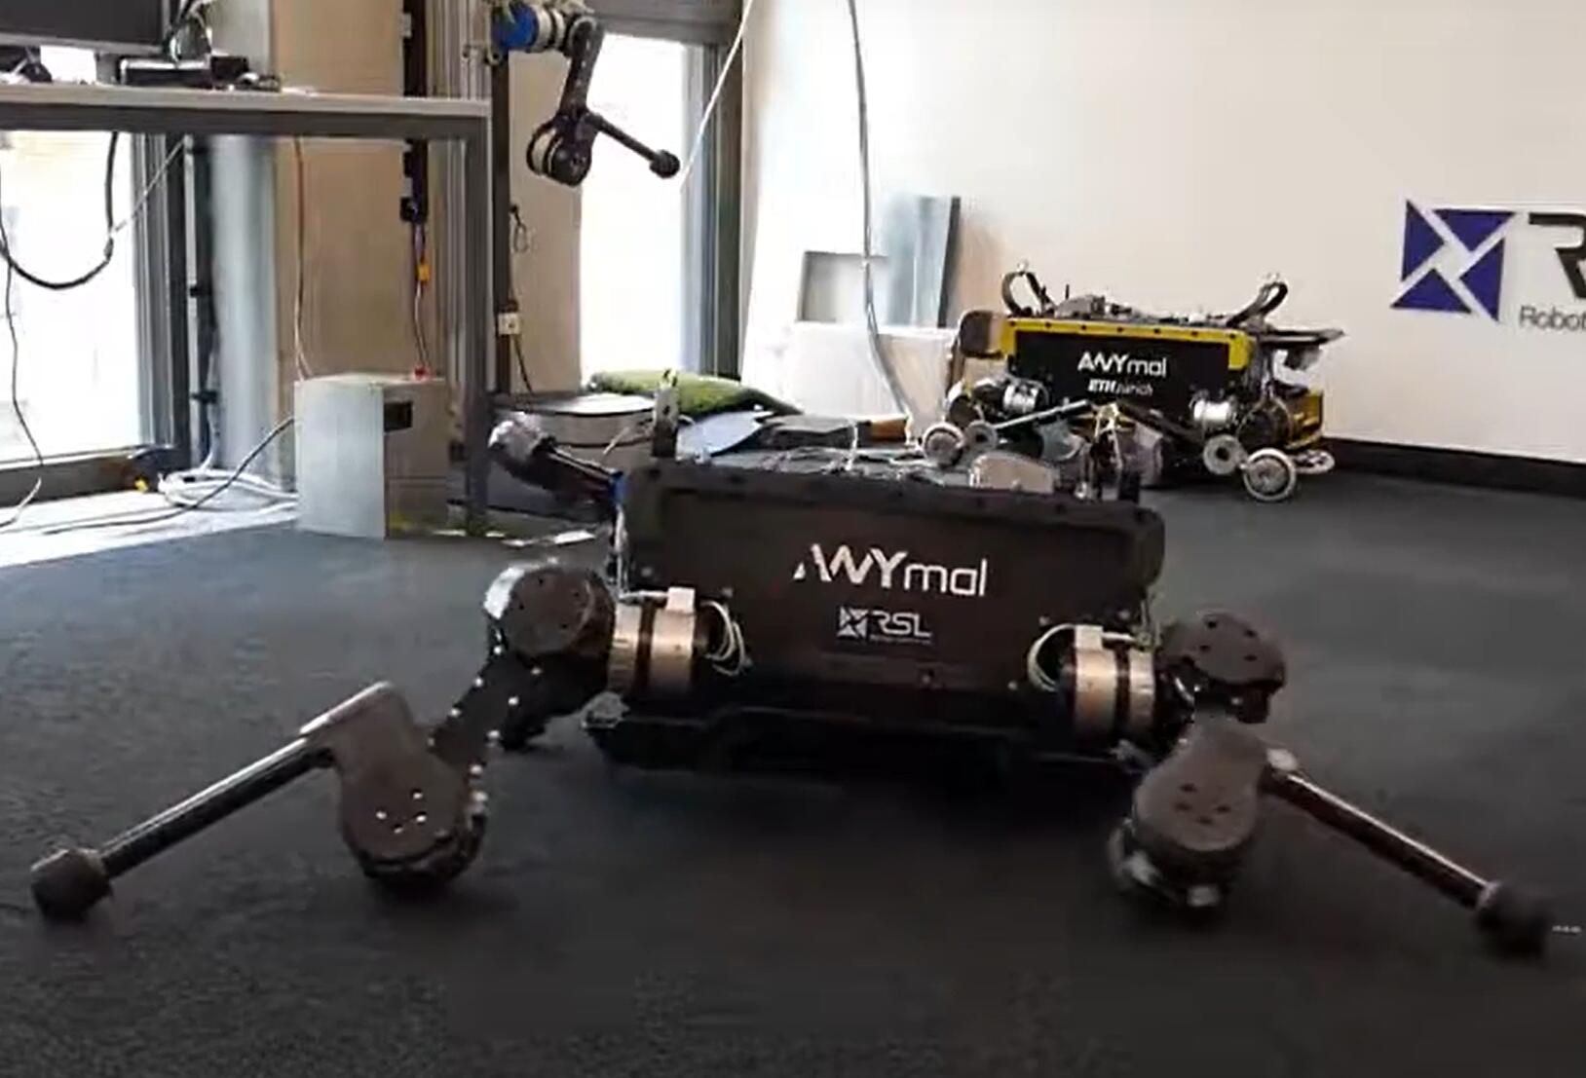
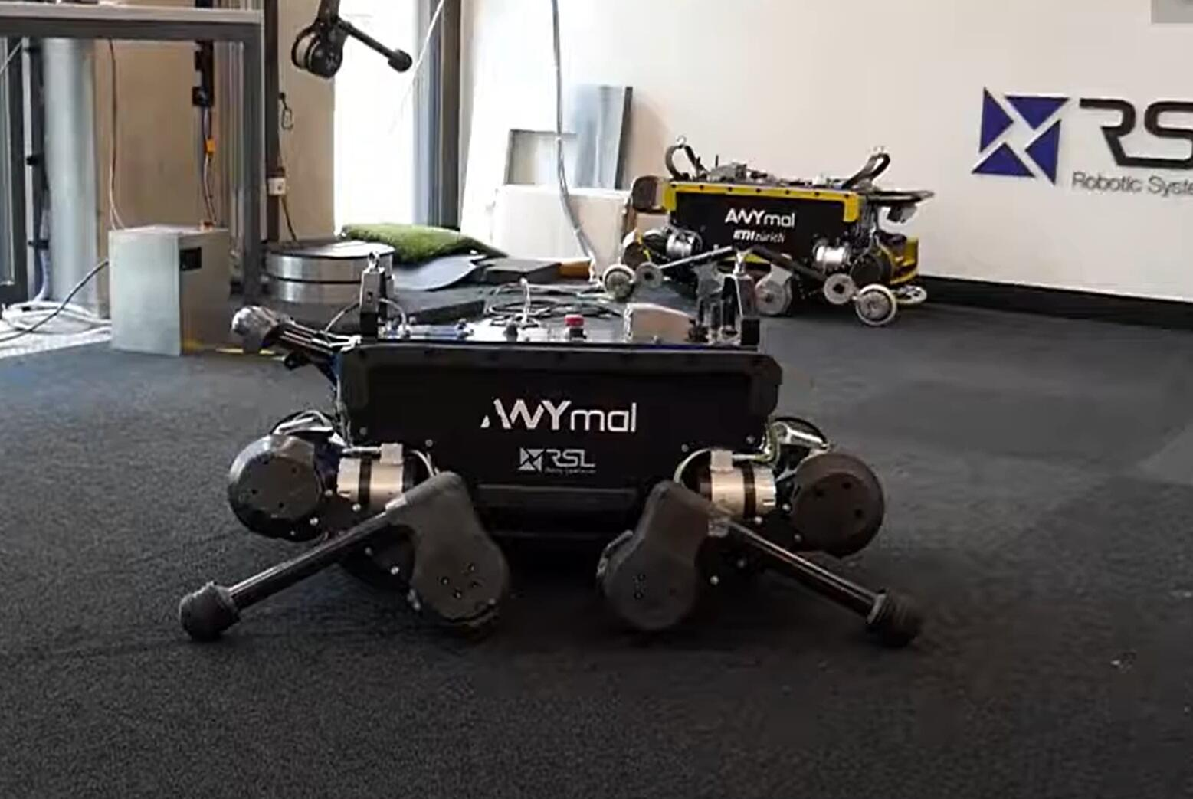
Experiment 6
Recovery from a fall

Slide 31
Discussion
Outstanding:
A more economical and convenient way to control.
The simulation and learning framework used can be applied to any rigid body system, making it more versatile.
In summary, such a framework can be applied to the development of complex functions for rigid-body robots in more complex and challenging environments

Slide 32
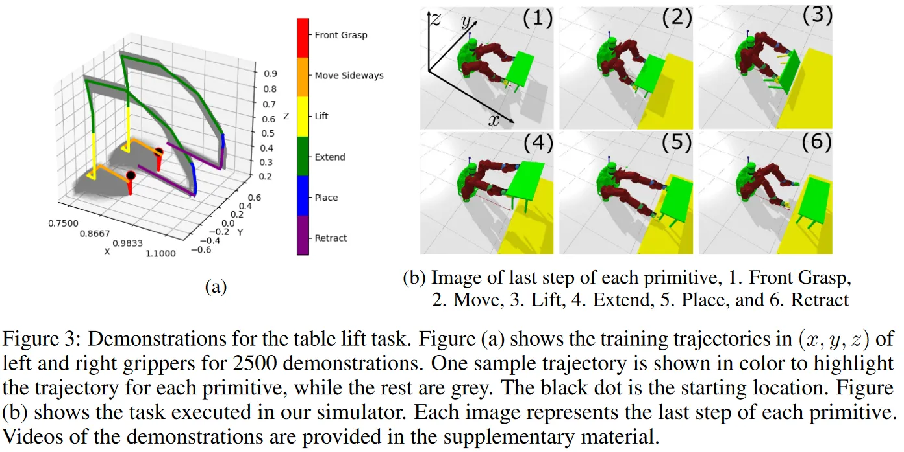
Discussion

Slide 33
Limitations and future work
Model accuracy: Despite efforts to accurately model the physical components and drive systems of the robot, discrepancies may still exist between the model and the actual system. This can lead to poor performance and safety issues if not properly addressed.
Time and resource intensive: Modeling the physical components and drive systems of a robot can be a time-consuming and resource-intensive process, especially for complex robots like ANYmal. This can lead to longer and more costly development times.
Difficulty in modeling certain components: Certain physical components, such as deformed objects or assemblies with complex geometry, may be difficult to model accurately using CAD software. This can lead to errors in the model and affect performance.

Slide 34
Limitations and future work
Complexity of drive systems: Certain types of drive systems, such as hydraulic drives with coupled dynamics, may be difficult to model accurately using drive networks. This can lead to performance degradation and safety issues.
Limited adaptability: Models are often based on assumptions and may not be able to adapt to changes in robot design or environment. This may limit the flexibility of the robot and require further modeling work in the future.
A single neural network trained in a single training session exhibits a single aspect of behavior that cannot be generalized across multiple tasks. Introducing hierarchical structures in policy networks can remedy this and is a promising avenue for future work.

Slide 35
Summary
Main convern: How to construct a more general and easy-tuning controller of a robot.
Limits: Complicate models result in time consuming and lots of constrains
State of art: The most novelty of this method is the use of a four-step approach that integrates physical parameter identification, actuator modeling, and policy training to create a control policy for a physical system.
This method enables the creation of control policies that can operate directly on the physical system, improving the accuracy and effectiveness of the control while reducing the need for calibration or fine-tuning of the control policy.

Slide 36
SUSTech Design + Learning Lab
陈逸飞 方艺钧
杨德宇 宁晨辉 朱思颖

