Slide 1
Histograms of Oriented Gradients for Human Detection
Presenter: Qirong Shen, Mingyu Zhou, Zimeng Wang, Qian Liu, Junzhe Wen

Slide 2
Motivation and Main Problem
Further explaination of the title with supporting evidence
High-level description of problem being solved
Find a robust visual objection recogition feature sets and raised the Histograms of Oriented Gradients (HOG) descriptors
Researchers showed that the HOG descriptors is more significant than existing feature sets of human detection experimentally
Adopting linear SVM based human detection as a test case

Slide 3
Motivation and Main Problem
Further explaination of the title with supporting evidence
Why is the problem important?
Its significance towards general-purpose robot autonomy
• The new approach that HOG+SVM become the foundation of the fellowing algorithem for its success in human detection
Its potential application and societal impact of the problem
• Its high sensitivity to the outline and shape of the object appearances a good ability to recognise the human, vehicle and road marking. This is significant for the automatic drive.

Slide 4
Motivation and Main Problem
Further explaination of the title with supporting evidence
The role of the AI and machine learning in tackling this problem
• Support Vector Machine (SVM) is used in the case of human detedction. The last step is to train the classifier, use SVM to train the previously extracted image feature vector from HOG than find an optimal hyperplane as the decision function, and get the target training model.
• Good use of linear SVM as a baseline classifier make the study efficient and simple

Slide 5
Limitations of Prior Work
Further explaination of the title with supporting evidence
The paper’s related work is a good start, but there may be others
There are a few relevant papers on human detection
What is the key limitations of prior work(s)?
They use more complex achitecture with mutiple detection windows. in contrast, HOG algorithem uses a simpler architecture with a single detection window, but appears to give significantly higher performance on pedestrian images

Slide 6
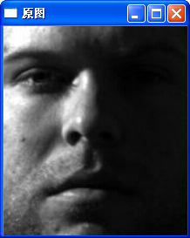
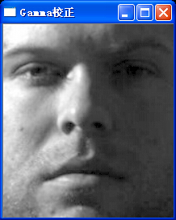

Implementation
Gamma Transformation
Reduce effect of difficult illumination

Slide 7
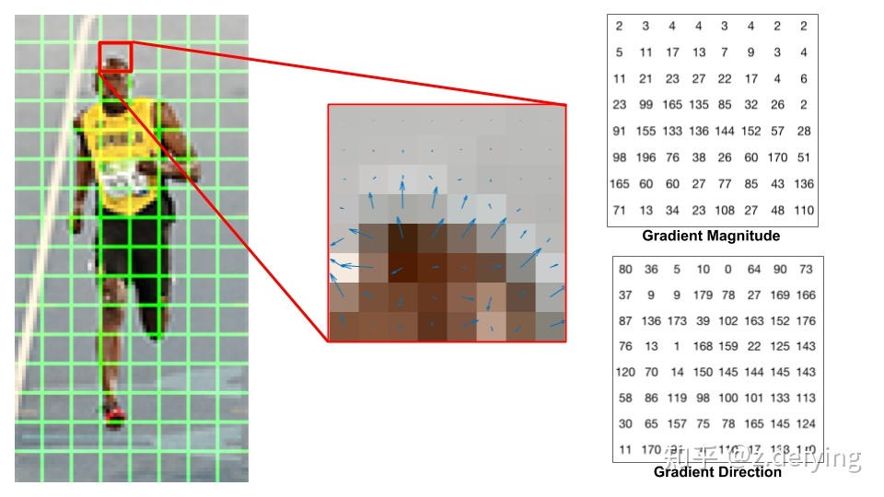
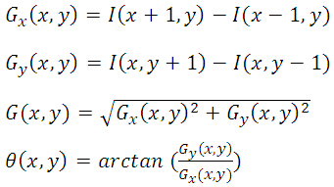
Implementation
Gradient
Calculate the gradient and direction

Slide 8
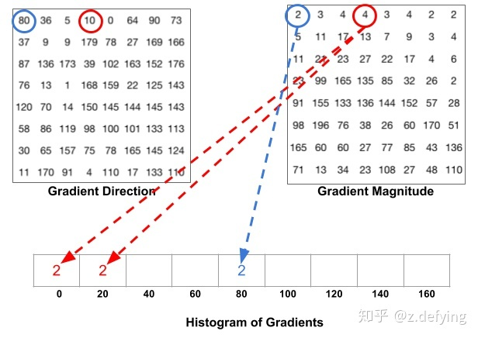
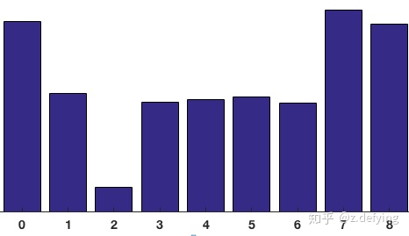
Implementation
Histogram

Slide 9
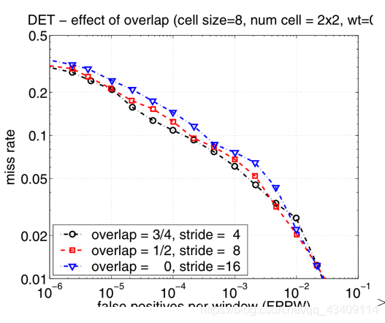
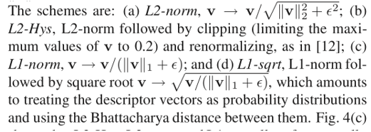
Implementation
Normalization

Slide 10
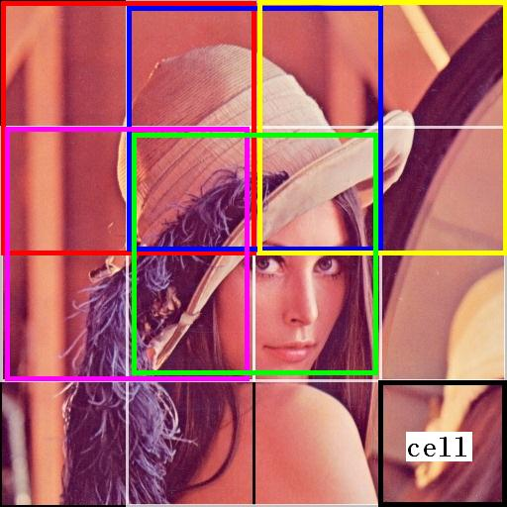
Implementation
Feature Detection + SVM

Slide 11
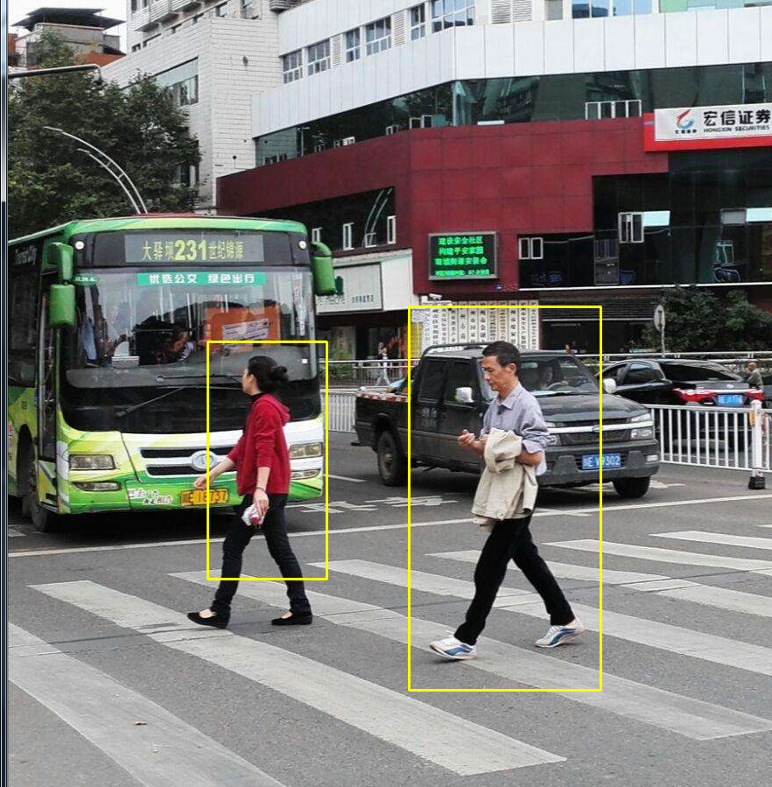
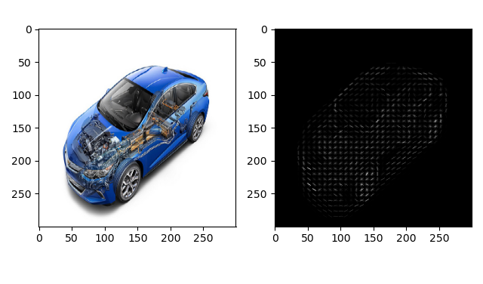
Result

Slide 12
Experimental Setup
Further explaination of the title with supporting evidence
Datasets
A well-established MIT pedestrian database
containing 509 training and 200 test images of pedestrians in city scenes
A new dataset‘INRIA’
significantly more challenging
containing 1805 images of human from a varied set of personal photos
standing people r in any orientation and against a wide
variety of background image including crowds.

Slide 13
Experimental Setup
Further explaination of the title with supporting evidence
Methodology
Positive training sets
1239 of the images with their left-right reflections (2478 images in all)
Negative training sets
A fixed set of 12180 patches sampled randomly from 1218 person-free training photos
‘hard examples’+inintial 12180sets to re-traine

Slide 14
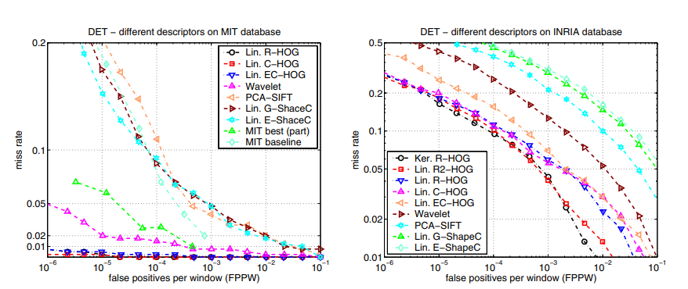
Experimental Results
Further explaination of the title with supporting evidence

Slide 15
Discussion of Results
Further explaination of the title with supporting evidence
HOG-based detectors showed near-perfect oseparation on the MIT test set
HOG-based detectorsat gived least an order of magnitude reduction in FPPW (false positives per window) on the INRIA test set

Slide 16
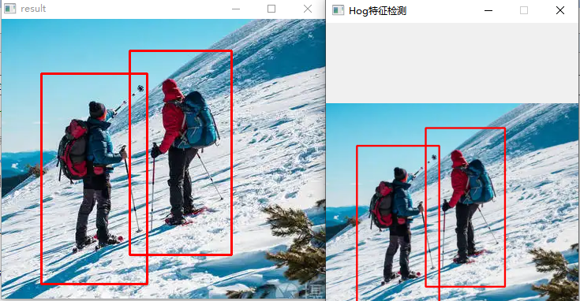
Future Work for Paper / Reading
Further explaination of the title with supporting evidence
OpenCV library provides a built-in implementation of the HOG algorithm
called cv2.HOGDescriptor
This implementation follows the same principle as the HOG algorithm proposed by Dalal and Triggs and provides an efficient and easy-to-use way to apply the HOG algorithm in pedestrian detection, face detection, and other applications

Slide 17
Extended Readings
Further explaination of the title with supporting evidence
K. He, G. Gkioxari, P. Dollar, and R. Girshick, "Mask R-CNN"
a. This paper introduces a novel network architecture based on the Region-based Convolutional Neural Network (R-CNN) framework that can simultaneously perform object detection and instance segmentation.
b. The significance of this paper lies in proposing an efficient and accurate method for object detection and instance segmentation, which can be widely applied in computer vision fields, including autonomous driving, medical image processing, and robotics.
c. This paper is relevant to our research as it introduces a new deep learning technique that can be combined with HOG features and SVM classifiers to improve the accuracy of human detection.

Slide 18
Extended Readings
Further explaination of the title with supporting evidence
A. Bochkovskiy, C.-Y. Wang, and H.-Y. M. Liao, "YOLOv4: Optimal Speed and Accuracy of Object Detection"
a. This paper presents a novel object detection framework, You Only Look Once (YOLO) v4, which combines various techniques such as network architecture design, data augmentation, and post-processing to improve the speed and accuracy of object detection.
b. The significance of this paper lies in proposing an efficient and accurate method for object detection, which can be applied in fields such as autonomous driving, security monitoring, and robotics.
c. This paper is relevant to our research as it provides a new object detection technique that can replace the HOG features and SVM classifiers approach to improve the accuracy and speed of human detection.

Slide 19
Summary
Further explaination of the title with supporting evidence
Main Problem
The article proposes a method for human detection using histograms of oriented gradients (HOG) and support vector machines (SVMs).
Innovation of methods
(a) the use of local image gradients to encode human appearance
(b) the use of SVMs for efficient and accurate classification of image patches
Apply
HOG-based method achieves state-of-the-art performance in human detection

Slide 20
Thanks for listening
Name:Qirong Shen, Mingyu Zhou, Zimeng Wang, Qian Liu, Junzhe Wen
Affiliation:SUSTCH
Supervisor：Chaoyang Son
Contact:12010311@mail.sustech.edu.cn

