Slide 1
Decentralized Multi-Agent Pursuit Using Deep Reinforcement Learning
Presenter: Liu Xinzi
2023.4.24

Slide 2
How to achieve efficient pursuit of moving targets
A high-level description of the problem to be solved
With multiple-pursuers, decentralized systems are beneficial to avoid single points of failure. Classical algorithms for decentralized multi-agent pursuit often assume omnidirectional pursuers, derive the local interaction rules from simple geometry and do not learn or adapt to evader behavior. For multi-agent teams consisting of wheeled robots or fixed-wing airplanes, the non-holonomic kinematic constraints on the motion also need to be considered.

Slide 3
How to achieve efficient pursuit of moving targets
Its significance and application to general robot autonomy
In a specific environment, it can optimize the way of cooperation between multiple robots and improve efficiency. The specific scenario of capturing a finite speed but faster evader with multiple, non-holonomic pursuers in a bounded arena without obstacles.
In the field of military air force, it can optimize the combat efficiency of UAV and other military aircraft and improve the combat capability

Slide 4
How to achieve efficient pursuit of moving targets
The role of artificial intelligence and machine learning in solving this problem
Using deep reinforcement learning for pursuing an omnidirectional target with multiple, homogeneous agents that are subject to unicycle kinematic constraints. They use shared experience to train a policy for a given number of pursuers, executed independently by each agent at run-time.
Most approaches to date did not consider real-world limitations such as local measurements and non-holonomic motion constraints and did not offer a thorough analysis of the system on operational metrics.

Slide 5
No classical approaches in the literature
Real-world limitations
Deep Reinforcement Learning (DRL) has also been successfully applied to multi-agent pursuit-evasion, however, most approaches to date did not consider real-world limitations such as local measurements and non-holonomic motion constraints and did not offer a thorough analysis of the system on operational metrics.

Slide 6
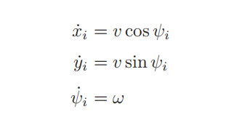
THE PURSUIT-EVASION SCENARIO
Easy to transplant to the real world
Multiple homogeneous, slower pursuers chasing a single, faster target. We consider a trial successful if, at any point during the trial, the distance between the evader and at least one of the pursuers is less than a given collision radius (d_{i,T} < d_{cap}). If the target is not captured within a fixed time then the trial is considered unsuccessful. In addition, collision of pursuers are not considered as failure, but this is avoided by defining a value function during training.
The motion of the target is unconstrained, but the linear velocity of the pursuers are assumed to be constant and the angular velocity is variable within a certain range.
All pursuers are exactly the same, each pursuer has global information (relative position of other pursuers and target)

Slide 7

DEEP REINFORCEMENT LEARNING FOR PURSUIT
Adopted algorithm and modeling the problem
As the Deep RL algorithm, use Twin Delayed Deep Deterministic Policy Gradient approach (TD3), which is an improvement over DDPG , designed to reduce the overestimation of the value function.
For each number of agents training a different policy, which results in a total of nmax policies, where nmax is the maximum number of pursuers that been analyzed.
The task for a single pursuer is formulate to be a Markov Decision Process (MDP) defined by tuple {S, A, R,P, γ}where s_{t} ∈ S, a_{t} ∈ A, r_{t} ∈ R are state, action and reward observed at time t, P is an unknown transition probability from s_{t} to s_{t+1} taking a_{t}, and γ is a discount factor. The DRL goal is to maximise the sum of future rewards

Slide 8
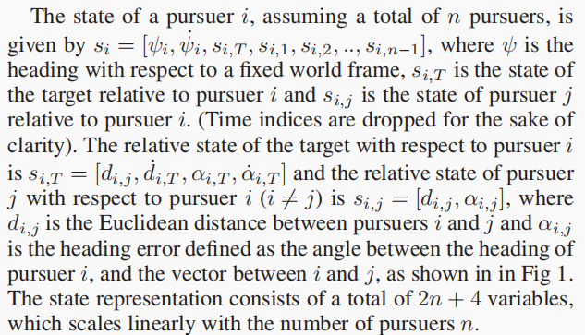
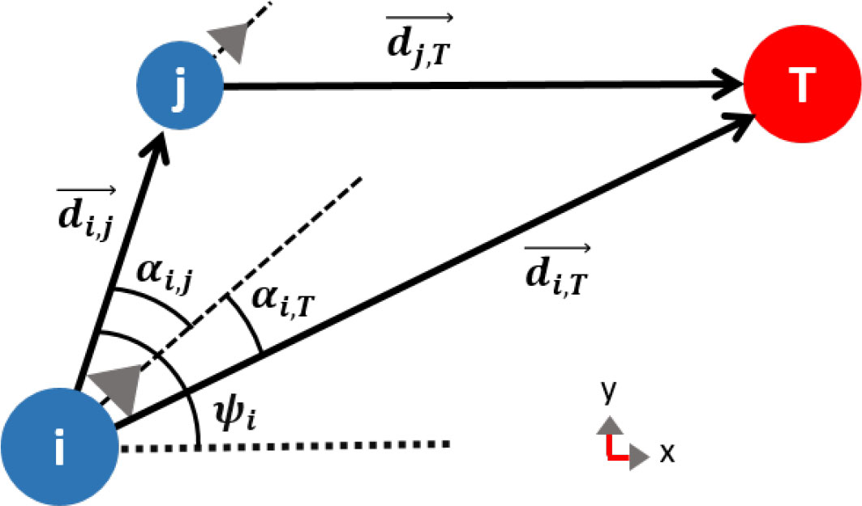
DEEP REINFORCEMENT LEARNING FOR PURSUIT
State representation
As neural networks typically are not permutation invariant when operating on sets, so they assign j values for each observation by sorting each other pursuer with respect to their relative angle α.

Slide 9
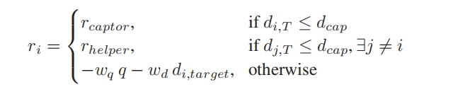

DEEP REINFORCEMENT LEARNING FOR PURSUIT
Reward Structure
At each time step, each agent individually receives a reward designed to incentivize the capture of the evader and encouragea good formation of pursuers.
The formation score is a scalar number in the range [0,2], which provides a metric for evaluating the fitness of a formation of the pursuers (lower is better). The formation score(q) is defined as:
where d_{iT} denotes a unit vector pointing in the direction from agent i and the target, the closest agent to the target is defined as agent 0. When the agents are close to the target, the reward is dominated by the formation score; when the agents are far from the target, the reward is dominated by the distance to the target.
If the target is captured at a time step, then the pursuer who captures the evader receives the reward r_{captor}, while the rest of the agents receive r_{helper}, such that r_{captor} > _{rhelper}.

Slide 10
DEEP REINFORCEMENT LEARNING FOR PURSUIT
Curriculum Learning
This letter apply a curriculum for learning by starting from an easier version of the task and gradually increasing the difficulty until the actual difficulty is achieved.
The capture radius varys by starting from a large radius, then gradually making it smaller. This encourages agents to not adopt a straightforward chasing tactic at the beginning of learning but to form more sophisticated behaviors, which could be transferred to smaller capture radii.

Slide 11
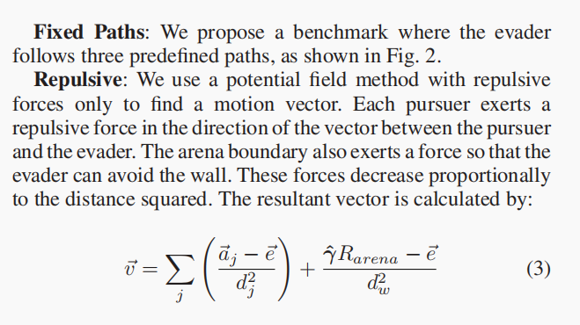
Experimental Initial
1. Multi-Agent Deep Reinforcement Learning：
We consider all agents to be homogeneous which allows us to use shared experience to train all agents. This allows the agents
to train faster, as well as gathering more information from every step in the environment. All agents are governed with the same
policy, however, at each time step the agents use their local observations to individually takeactions, resulting in a decentralized
system.
(1) persuer :Timeout = 500 , Vp=10pixels, The number of pursuers n varied between 1 and 8, initialized at random positions
within a circular area with a radius of 100 pixels
(2) evader: Ve=0~20pixels initialized at a random position between the arena boundary and an inner circle with a radius
of 300 pixels

Slide 12
Experimental Initial
2. state representation:

Slide 13
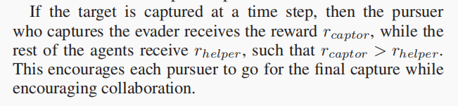
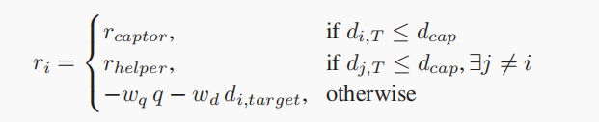
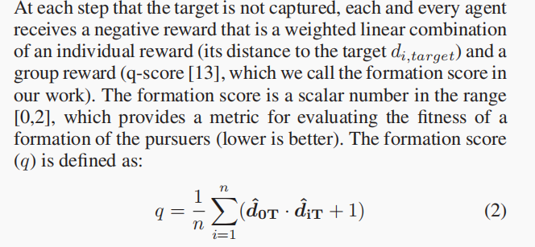
Experimental Initial
3. reward structure:

Slide 14
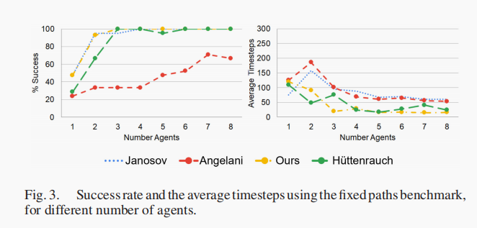
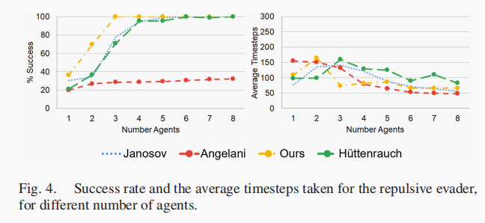
Experimental Results(Their)

Slide 15
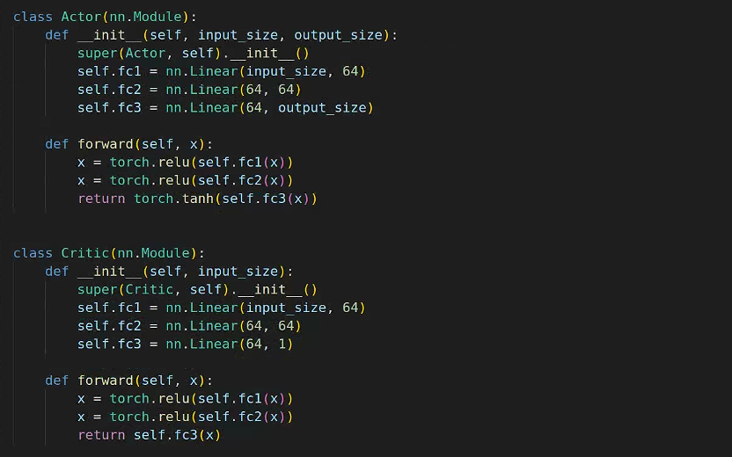
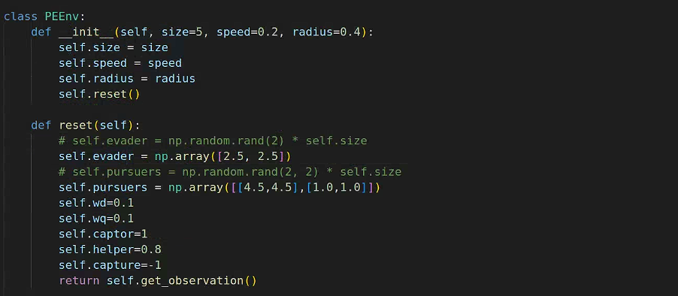
Experimental Results(Our)

Slide 16
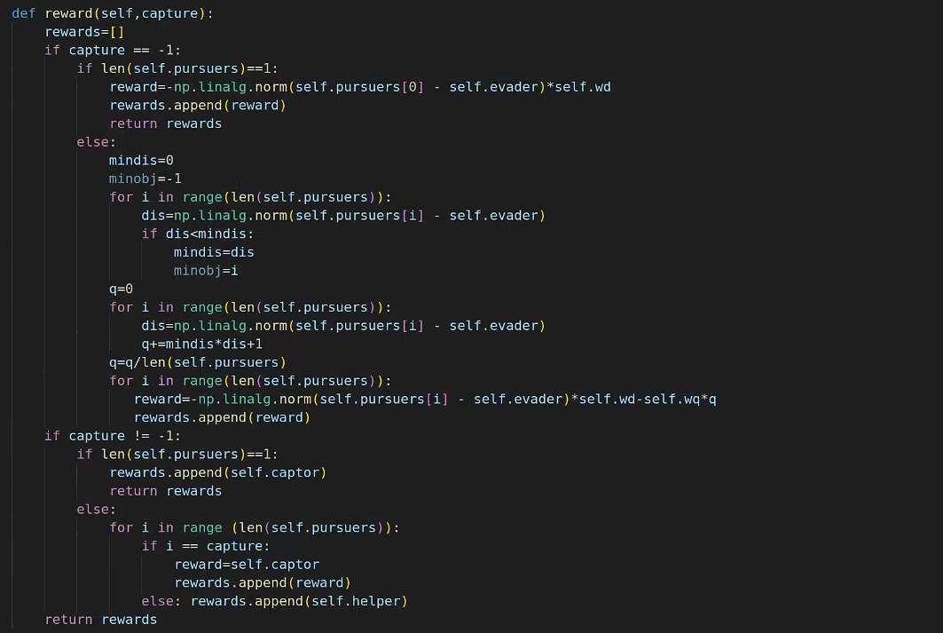
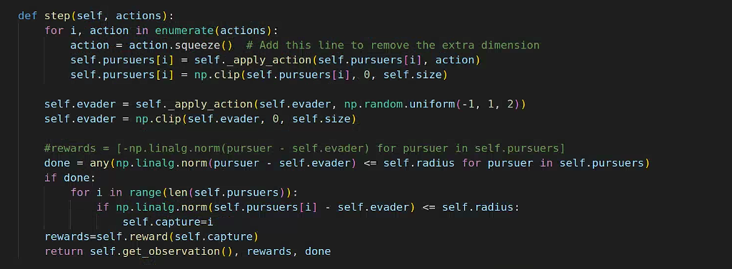
Experimental Results(Our)

Slide 17
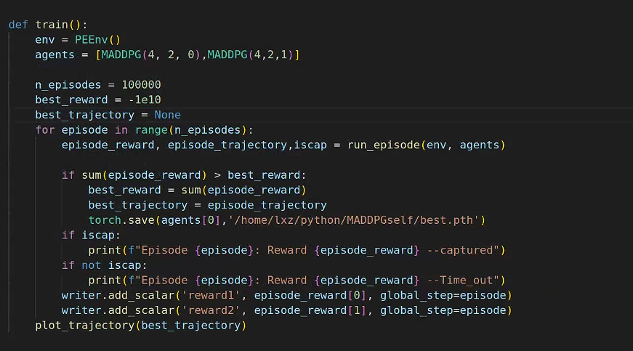
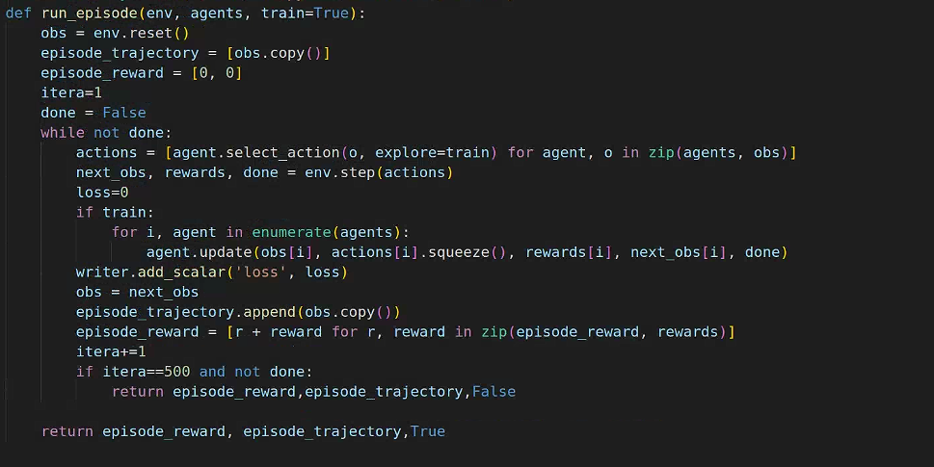
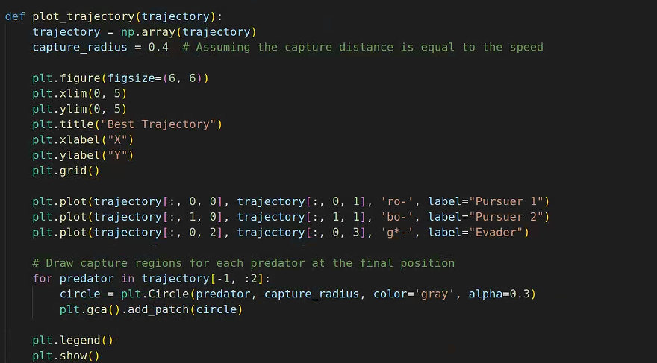
Experimental Results(Our)

Slide 18
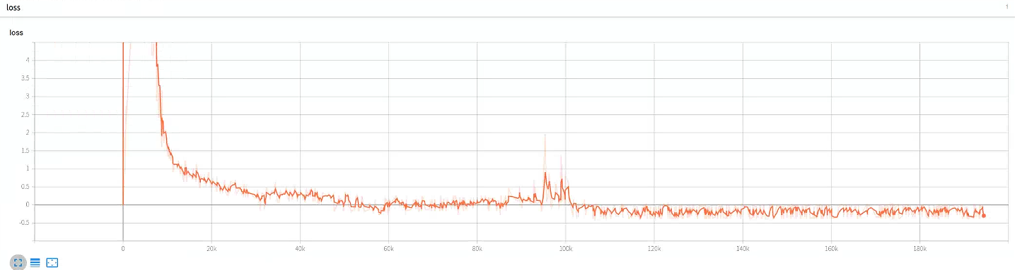
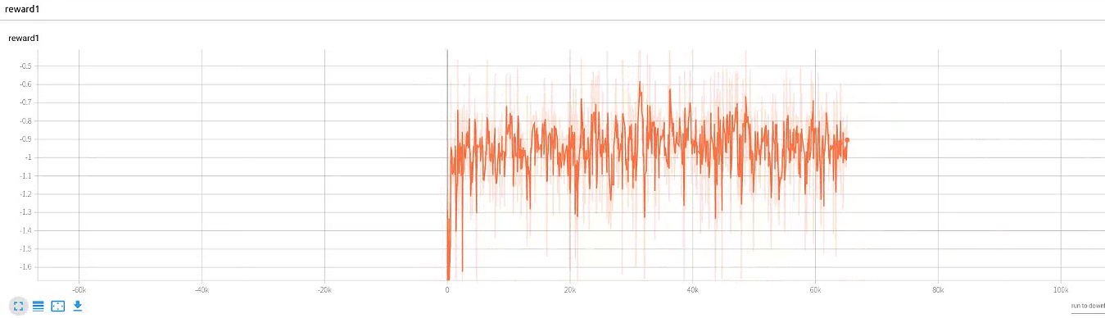
Experimental Results(Our)

Slide 19
Discussion of Results
Our results show that multi-agent pursuit benefits from curriculum learning and a reward based on
agent formation, which we borrowed from the group-pursuit literature

Slide 20
Critique / Limitations / Open Issues
Further explaination of the title with supporting evidence
1、The key limitations of the proposed approach should be the limitation of the current
work related with the need to train a network for each number of observable agents.
Yet this can be partially mitigated by using the same network and fixing the number of
observable pursuers.
2、The current application is restricted to 2D motion because of the existance of
representational singularities
3、As we have mentioned before, most approaches to date did not consider real-world
limitations suchas local measurements and non-holonomic motion constraintsand did not
offer a thorough analysis of the system on operationalmetrics.

Slide 21
Future Work for Paper / Reading
Further explaination of the title with supporting evidence
The possibility of realizing fixed-size state representation for neighboring agents
Maybe by using deep sets , mean embeddings or making use of Graph Neural Networks
Others :
1、Exploring scenarios with numerous evaders
2、Integrating smarter evader strategies by using the idea of safe-reachability
3、Implementing the evader as an RL agent and training both the evader and pursuer simultaneously

Slide 22
Extended Readings
Further explaination of the title with supporting evidence
1、M. Hüttenrauch, A. Šoši´c, and G. Neumann, “Deep reinforcement learning for swarm systems,” J. Mach. Learn. Res., vol. 20, no. 54, pp. 1–31, 2019.
2、M. Zaheer, S. Kottur, S. Ravanbakhsh, B. Poczos, R. R. Salakhutdinov,and A. J. Smola, “Deep sets,” in Proc. Adv. Neural Inf. Process. Syst.,2017, pp. 3391–3401.
3、J. Zhou et al., “Graph neural networks: A review of methods and applica_x0002_tions,” 2019, arXiv:1812.08434.
4、 A. Pierson, Z. Wang, and M. Schwager, “Intercepting rogue robots: An algorithm for capturing multiple evaders with multiple pursuers,” IEEE Trans. Robot. Autom. Lett., vol. 2, no. 2, pp. 530–537, 2017.
5、 Z. Zhou, W. Zhang, J. Ding, H. Huang, D. M. Stipanovi´c, and C. J.Tomlin, “Cooperative pursuit with voronoi partitions,”Automatica, vol. 72, pp. 64–72, 2016.

Slide 23
Summary
Further explaination of the title with supporting evidence
Problem the reading is discussing
The specific meaning, related principles, applications and prospects of DRL method
Why is it important and hard
Simulation experiments show that our approach, applied to non-holonomic agents, outperforms the state-of-the-art in heuristic multi-agent pursuit methods and a recent DRL based approach
What is the key limitation of prior work
The key limitations of the proposed approach should be the limitation of the current work related with the need to train a network for each number of observable agents

