Slide 1
Multi-view self-supervised deep learning framework for solving 6D pose estimation problem
Presenter:Ren Shize
Li Zhidong
Jiang Meng
Zeng Yuqi
Zhao Xuda
2023.3.2

Slide 2
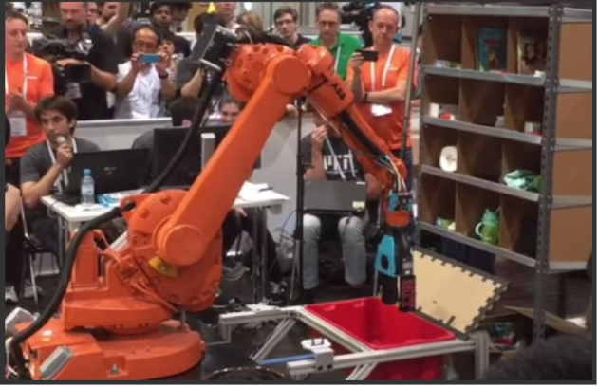
Motivation and Main Problem
The description of problem being solved
Robot warehouse automation has attracted significant interest in recent years, perhaps most visibly in the Amazon Picking Challenge (APC）.Amazon, in collaboration with the academic community, has led a recent effort to define two such tasks: 1) picking an instance of a given a product ID out of a populated shelf and place it into a tote; and 2) stowing a tote full of products into a populated shelf.

Slide 3
Motivation and Main Problem
Why is the problem important?
A fully autonomous warehouse pick-and-place system requires robust vision that reliably recognizes and locates objects amid cluttered environments, self-occlusions, sensor noise, and a large variety of objects. That's a huge improvement to general-purpose robot autonomy
Warehouse automation technologies, satisfying the growing demand of e-commerce and providing faster, cheaper delivery.

Slide 4
Motivation and Main Problem
Technical challenges arising from the problem
Cluttered environments: shelves and totes may have multiple objects and could be arranged as to deceive vision algorithms (e.g., objects on top of one another).
Self-occlusion: due to limited camera positions, the system only sees a partial view of an object.
Missing data: commercial depth sensors are unreliable at capturing reflective, transparent, or meshed surfaces, all common in product packaging.
Small or deformable objects: small objects provide fewer data points, while deformable objects are difficult to align to prior models.
Speed: the total time dedicated to capturing and processing visual information is under 20 seconds

Slide 5
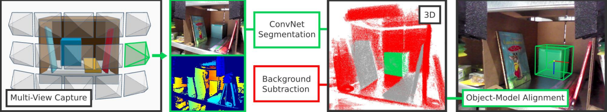
Motivation and Main Problem
The role of the AI and machine learning in tackling this problem
In the proposed approach, we segment and label multiple views of a scene with a fully convolutional neural network, and then fit pre-scanned 3D object models to the resulting segmentation to get the 6D object pose.

Slide 6
Motivation and Main Problem
High-level idea of why prior approaches didn’t already solve
While the 2015 APC winning team used a histogram backprojection method with manually defined features, recent work in computer vision has shown that deep learning considerably improves object segmentation
In pose estimation,existing frameworks such as LINEMOD or MOPED work well under certain assumptions such as objects sitting on a table top with good illumination, but underperform when confronted with the limited visibility, shadows, and clutter imposed by the APC scenario.

Slide 7
Context / Related Work / Limitations of Prior Work
Other papers and key limitations
Zhang, H., Long, P., Zhou, D., Qian, Z., Wang, Z., Wan, W., . . . Pan, J. (2016). DoraPicker: An autonomous picking system for general objects. Ithaca: Cornell University Library, arXiv.org. Retrieved from https://www.proquest.com/working-papers/dorapicker-autonomous-picking-system-general/docview/2077047016/se-2
The perception method proposed in this paper currently has a low precision for transparent or reflective objects as they are invisible to our RGBD camera.
If the target object is very close to other objects, the robot may simultaneously pick up the target object with a non-target item. This is because our current pipeline does not have a scheme to separate them. In addition, while picking up a very large object from the bin as shown in Figure 10(b), the robot may get stuck inside the bin.
Again, for our current method, we require the target object to be not occluded by other objects. If most part of the target object is not observed by our RGBD sensor, the perception component will fail to detect and locate the object.

Slide 8
Problem Setting
Key definitions
1.Multi-view Self-supervised Deep Learning:
A type of machine learning technique that uses multiple views of the same object to train a deep learning model in a self-supervised manner, without the need for explicit annotation or labeling of the data.
2.6D Pose Estimation:
6D Pose Estimation refers to the process of estimating the 3D position and orientation of an object in a 3D space relative to a camera. The 6Dpose estimation problem is challenging because it requires precise and accurate localization of the object in a 3D space.
3.RGB-D data:
RGB-D data refers to a type of data that contains both color (RGB) and depth (D) information of a scene or object. RGB-D data is typically captured using specialized sensors such as Microsoft&apos;s Kinect or Intel&apos;s RealSense cameras, which use structured light or time-of-flight technology to capture depth information.
4.Fully Convolutional Networks:
Fully Convolutional Networks (FCNs) are a type of deep neural network architecture that is commonly used for image segmentation tasks.

Slide 9
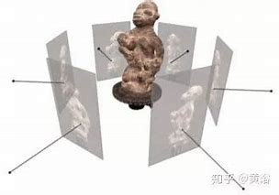
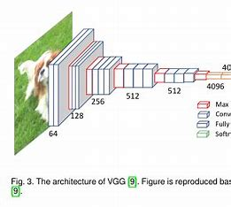
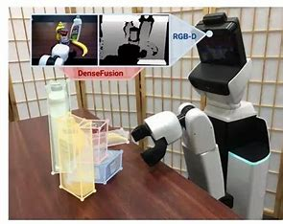
Proposed Approach / Algorithm / Method
Multi-view self-supervised deep learning framework for solving 6D pose estimation problem
Multi-view image generation
self-supervised learning
pose estimation

Slide 10
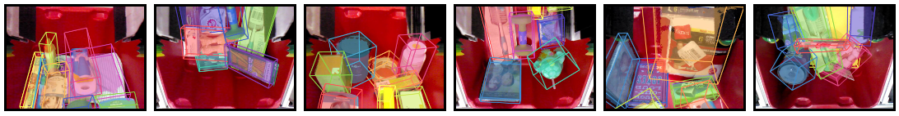
Proposed Approach / Algorithm / Method
Multi-view image generation
Capture a set of multi-view images of objects from multiple perspectives.
Then, the images were preprocessed, including background removal, alignment, and cropping.
Next, they used this preprocessed set of images to perform self-supervised learning. Specifically, they used images from different views to construct a self-supervised task for each object.

Slide 11
Proposed Approach / Algorithm / Method
Self-supervised learning
In a pair of images from different views, one image is used as the "query image" and the other as the "positive sample". Then, by rendering the query image using a 3D model, a "synthetic image" is obtained as the "negative sample".
Next, the three images are input into the deep neural network for training, with the goal of minimizing the distance between the positive and negative samples.
During the training process, they used some techniques to improve the training effect, including image enhancement, loss function design, and weight sharing.

Slide 12
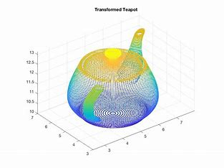
Proposed Approach / Algorithm / Method
pose estimation
During the training process, they employed several techniques to enhance the training effectiveness, including image augmentation, loss function design, and weight sharing. They also utilized Iterative Closest Point (ICP) algorithm to optimize the pose estimation results, which eventually led to the final 6D pose estimation outcome.

Slide 13
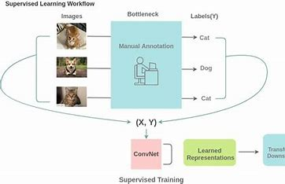
Theory
Self-supervised learning
Self-supervised learning is a machine learning technique that learns representations from unlabeled data without requiring manual annotation. The theory of self-supervised models involves designing appropriate tasks or objective functions for the model to learn useful feature representations.
Common self-supervised learning include predicting
missing parts, rotation prediction, colorizing images,
etc.
In these tasks, the model generates additional
information or labels from the input data and uses
it to train the model.
The advantage of self-supervised models is that they can use unlabeled data for training, reducing the need for labeled data. Additionally, self-supervised models can learn from a wider range of data sources, improving the model's generalization performance.

Slide 14
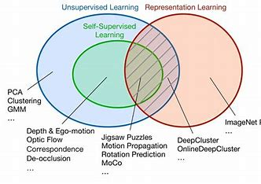
Theory
Self-supervised learning
However, the training process of self-supervised models also faces some challenges. For example, how to design effective self-supervised tasks, how to balance the model's training across different tasks, and how to use the results of self-supervised training for downstream tasks. These issues require in-depth research and practice.

Slide 15
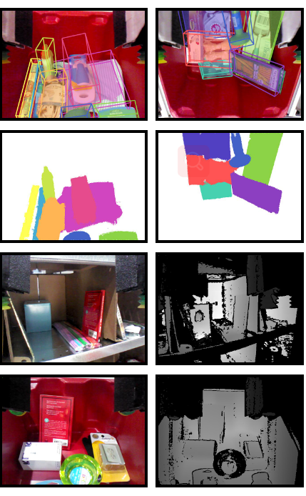
domains and baseline
vision system
A robust multi-view vision system to estimate the 6D pose of objects;
A self-supervised method that trains deep networks by automatically labeling training data;
A benchmark dataset for estimating object poses.
self-supervised method
benchmark dataset

Slide 16
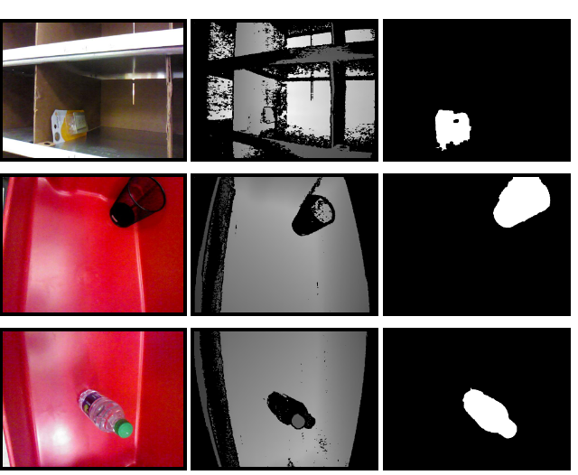
domains and baseline
Object segmentation:extend the state-of-the art deep learning architecture used for image segmentation.
Pose estimation: The first aligns 3D CAD models to 3D point clouds with algorithms,The second uses more elaborated local descriptors.
Benchmark for 6D pose estimation: produce a large benchmark dataset with scenarios from APC 2016.
Notes:
Object segmentation: In this work, we extend the state-of-the art deep learning architecture used for image segmentation to incorporate depth and multi-view information.
Pose estimation: The first aligns 3D CAD models to 3D point clouds with algorithms such as iterative closest point [9]. The second uses more elaborated local descriptors such as SIFT keypoints [10] for color data or 3DMatch [11] for 3D data.
Benchmark for 6D pose estimation: To properly evaluate our vision system independent from the larger robotic system, we have produced a large benchmark dataset with scenarios from APC 2016 with manual labels for objects’ segmentation and 6D poses. Previous efforts to construct benchmark datasets include Berkeley’s dataset [15] with a number of objects from and beyond APC 2015 and Rutgers’s dataset [16] with semi-automatically labeled data.

Slide 17
evaluate their approach
They evaluate variants of their method in different scenarios in the benchmark dataset to understand :
(1) how segmentation performs under different input modalities and training dataset sizes
(2) how the full vision system performs.

Slide 18
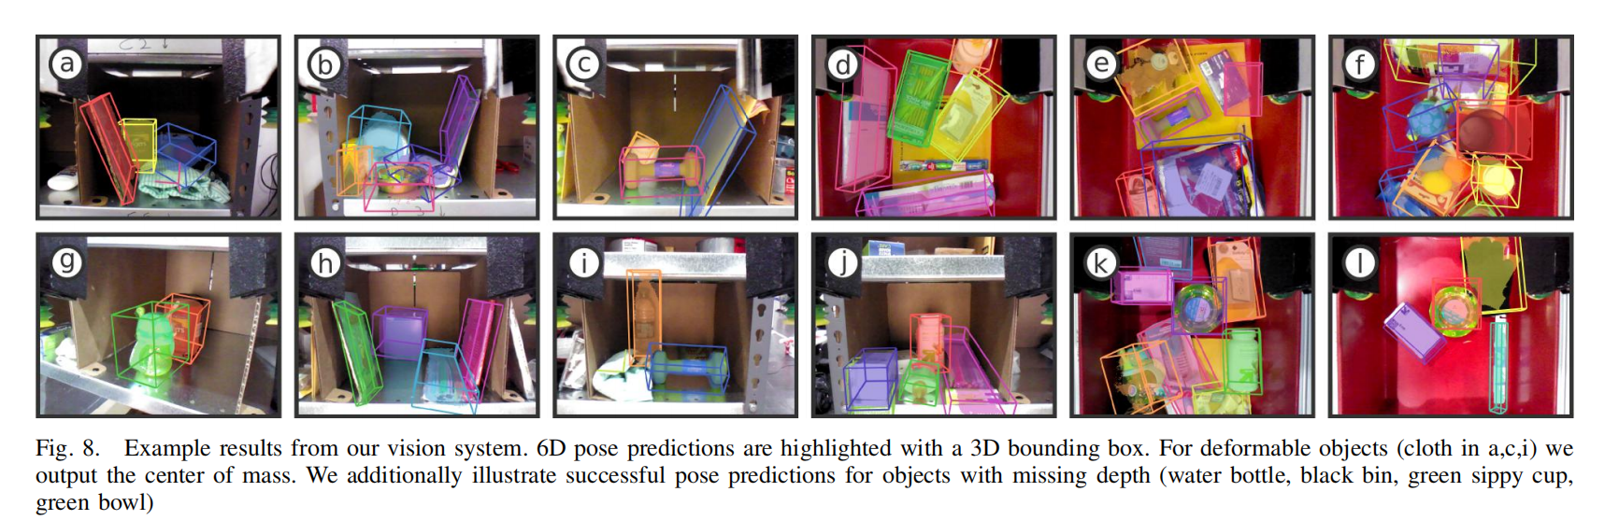
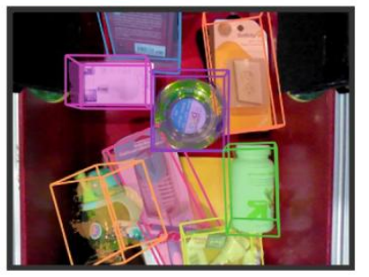
the quantitative and qualitative results
Among them,this figure clearly shows the power of this visual ability. In such a cluttered environment, the new visual algorithm can accurately and efficiently identify different objects. This vision algorithm estimates the 6D poses of objects robustly under challenging scenarios.

Slide 19
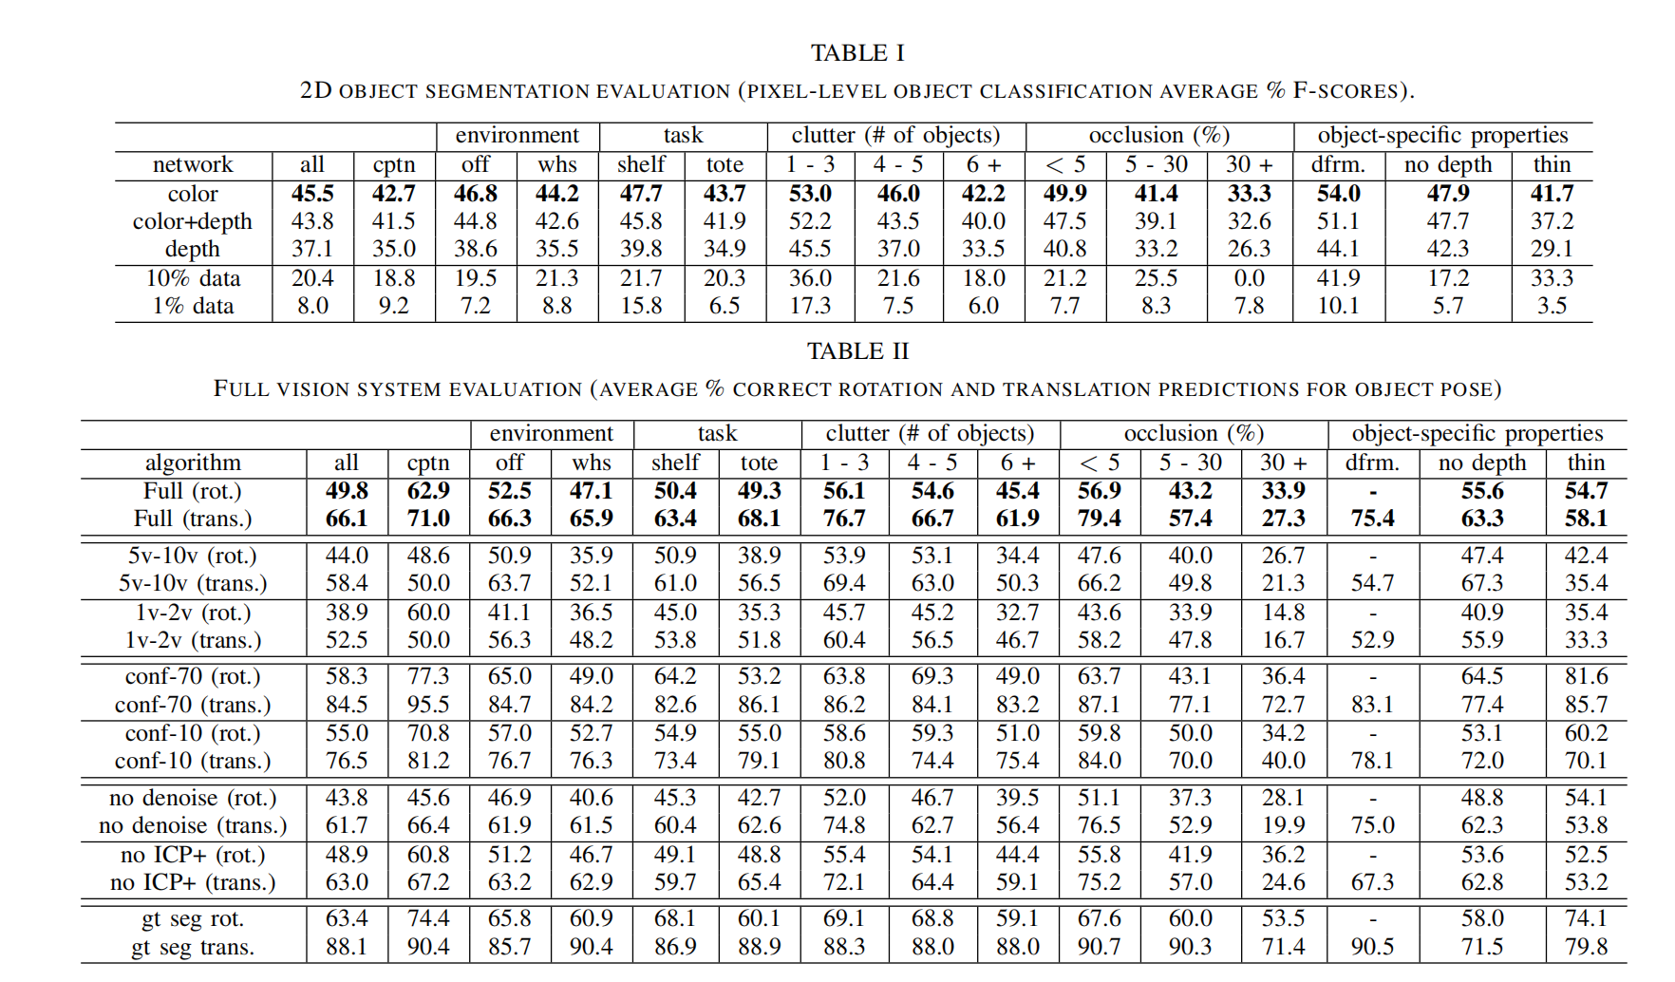
the quantitative and qualitative results

Slide 20

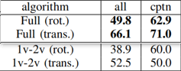
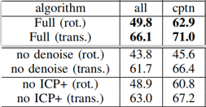

Discussion of Results
Conclusions and Insights
The conclusions drawn by the author are:
Multiple views robustly address occlusion and heavy clutter in the warehouse setting.
Contrast between the performance of the algorithm using a single view of the scene, versus multiple views of the scene.
The denoising step proves important for achieving good results.
Without the pre-processing steps to ICP, we observe a drop in prediction
The volume of training data is strongly correlated with performance.

Slide 21
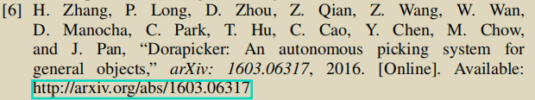

Discussion of Results
Supports
The results and references support the conclusion well.
The results support the conclusion by the experimental statistics. The previous page showed that the conclusions and insights are drawn from the tables, which include detailed data to fully support the conclusion.
The reference we chose did not show statistics, but there are some statements that support the conclusion. “Again, for our current method, we require the target object to be not occluded by other objects. If most part of the target object is not observed by our RGBD sensor, the perception component will fail to detect and locate the object.” This means the application of the multiple views that increased the accuracy of clutter and occlusion is critical.

Slide 22
Discussion of Results
Critique and Limitations
The usage scenarios of the paper is in the Amazon Picking Challenge, so the limitation of the technology is transparent: it should not cost much. However, it is a huge project to set quantities of cameras is the warehouse. Also, it requires a large amount of training data to train the deep neural network.
Apart from this, the amount of computation should be brought into account. In this paper, they just take the shelf and the tote. However, in real case, there must be countless objects should be recognized and predicted. Therefore, the amount of computation would be astonishing.

Slide 23
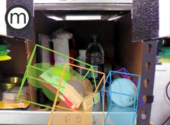
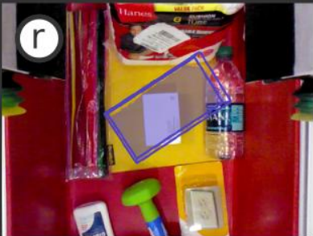
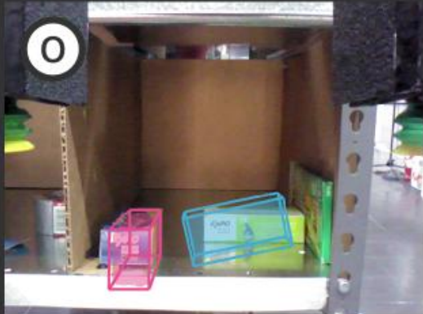
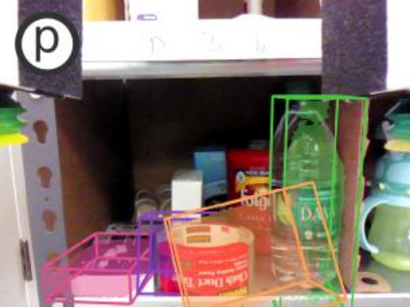
Future Work for Paper / Reading
Interesting Questions:
FCN(Fully Convolutional Network) may be incomplete:
under heavy occlusion or clutter or poor illumination(m, p)
Objects color textures are confused with each other. (r)
Model fitting for cuboid objects often confuses corner alignments. (o)

Slide 24
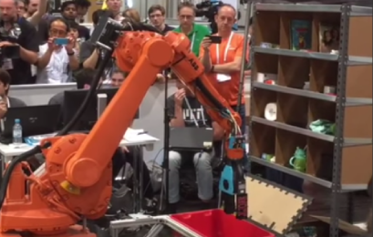
Future Work for Paper / Reading
How to Improve:
Make the most out of every constraint:
Using bin and shelf mode
The volume of training data is strongly correlated with performance
Designing robotic and vision systems hand-in-hand:
Robotic arms allow us to precisely fuse multiple views and improve performance in cluttered environments
Configure different sensing for different effectors.

Slide 25
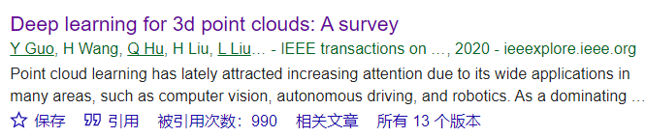
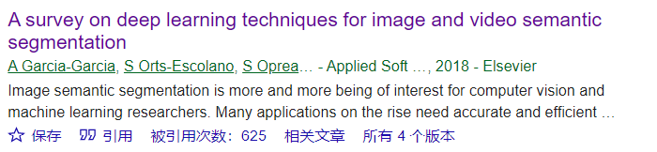
Extended Readings
Papers that use this paper as a reference:
(1)3D Point Clouds:
Guo, Y., Wang, H., Hu, Q., Liu, H., Liu, L., & Bennamoun, M. (2020). Deep learning for 3d point clouds: A survey. IEEE transactions on pattern analysis and machine intelligence, 43(12), 4338-4364.
(2) Segmentation & Deep Learning for Image and Video:
Garcia-Garcia, A., Orts-Escolano, S., Oprea, S., Villena-Martinez, V., Martinez-Gonzalez, P., & Garcia-Rodriguez, J. (2018). A survey on deep learning techniques for image and video semantic segmentation. Applied Soft Computing, 70, 41-65.

Slide 26
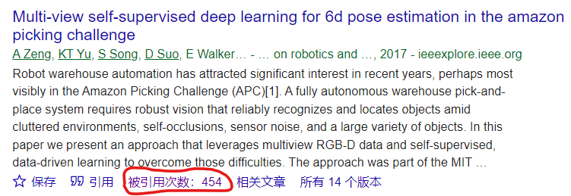
Extended Readings
How to find:
Web of Science(IF 影响因子): https://www.webofscience.com/wos/woscc/basic-search
Dimensions: https://app.dimensions.ai/discover/publication
PubMed: https://pubmed.ncbi.nlm.nih.gov/
Google Scholar: https://scholar.google.com/

Slide 27
Summary
Mainly discuss:
multi-view self-supervised deep learning approach for 6D pose estimation
Why important and hard:
Fully autonomous warehouse pick-and-place system require robust vision, where the environment is complex
Key limitation of prior work:
constrain of data set, limitation of supervised learning method, deficiency of pose optimization algorithm
Key insights of the proposed work:
make the most out of constraint, integrated design of visions and robots
Demonstrate by this insight:
increased the accuracy of clutter and occlusion is critical

Slide 28
Thank you for listening!
Reporters:
Ren Shize
Li Zhidong
Jiang Meng
Zeng Yuqi
Zhao Xuda

Slide 29
Q & A

