Slide 1
Dynamic Graph CNN for Learning on Point Clouds
Presenters: Long Jiajun, Zhang Ximan, Zheng Yikai, Luo Jie and Sinrithy Vong
Date: March 30, 2023

Slide 2
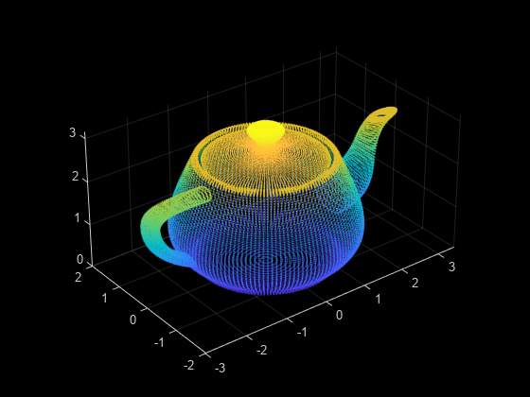
Motivation and Main Problem
Point Cloud:
Definition: a discrete set of data points in space to represent a 3D shape or object
Problem: inherently lack topological information
Application: Indoor navigation, self-driving vehicles, robotics, and shape synthesis and modeling
CNN: a class of artificial neural network most commonly applied to analyze visual imagery

Slide 3
Problem Setting
EdgeConv:
Suitable for CNN-based high-level tasks on point clouds including classification and segmentation
Captures local geometric structure while maintaining permutation invariance
Key contributions of their work in the paper:
Introduce EdgeConv
Show that this model can learn to semantically group points by dynamically updating the graph from layer to layer
Demonstrate that EdgeConv can be integrated into multiple existing pipelines for point cloud processing
Do extensive analysis and testing on EdgeConv and show its performance on benchmark datasets
Release codes to the public

Slide 4
Related Work and Limitations of Prior Work
Hand-Crafted Features: use various algorithms on the information present in the image itself (edges and corners detection)
Deep Learning on Geometry: use emerging techniques that generalize neural networks to Euclidean and non-Euclidean domains
Geometric Generative Models: attempt to generalize models such as autoencoders, variational autoencoders (VAE) and generative adversarial networks (GAN) to the non-Euclidean setting
Key limitation of prior work: treat each point independently, thereby ignoring local geometric information

Slide 5
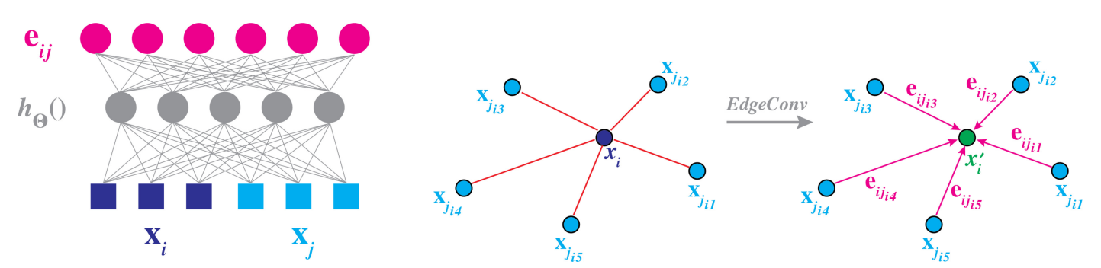
Edge Convolution

Slide 6
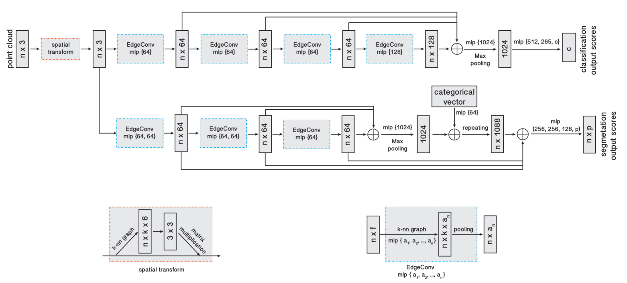
Edge Convolution

Slide 7








Edge Convolution
an asymmetric edge function
Standard convolution
used in PointNet
adopted by Atzmon et al.
only local information

Slide 8
Dynamic graph update
1. With dynamic graph updates, the receptive field is as large as the diameter of the point cloud, while being sparse.
2. Compute a pairwise distance matrix in feature space and then take the closest k points for each single point

Slide 9


Properties
Permutation Invariance
Translation Invariance

Slide 10
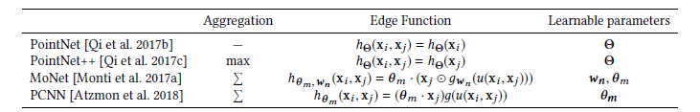
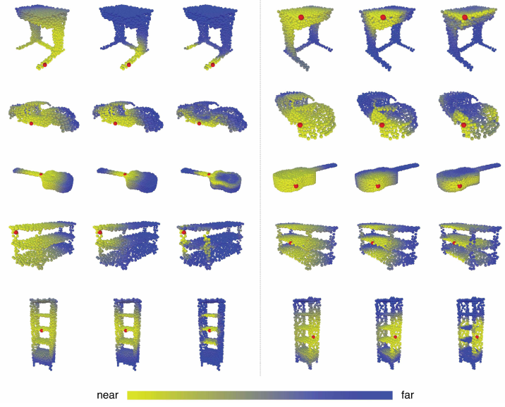
Comparison to existing methods

Slide 11
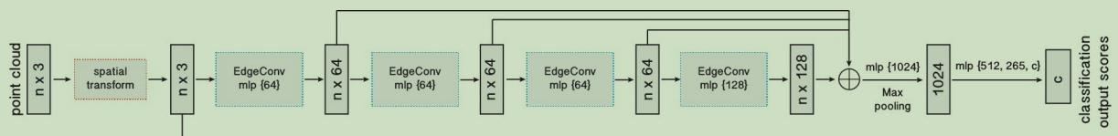
Evaluation
1.Classification
Data source: ModelNet40 [Wu et al. 2015]
Augment the data by randomly scaling objects and perturbing the object and point locations.
Architecture:
The model architectures used for classification
nx3,nx64......: 边缘特征响应/边缘特征
Max pooling：取局部接受域中值最大的点
Notes:
In this section, The article evaluated the models constructed using EdgeConv
for different tasks: classification, part segmentation, and semantic
segmentation. It visualize experimental results to illustrate
key differences from previous work
The first mission is classification, this is the model architectures used for classification.
The model architectures used for classification:
Before we start, first let me introduce some knowledge:
The EdgeConv block takes a tensor of shape n × f as input, computes edge features for each point by applying a multi-layer perceptron
(mlp)with the number of layer neurons defined as {a1, a2, ..., an }, and generates a tensor of shape n × an after pooling among neighboring edge features.
About spital transform: For a neural network for image classification, we hope that it can identify images of different sizes, perspectives, and shapes within the same category. A simple idea is to add images of various sizes and angles during training, allowing the model to learn to distinguish the same type from different angles. Another idea is that before the model learns to classify images, these images are rotated and scaled to the appropriate size for training, which can reduce the workload of classification, this is what spital transform do.
Then we look at the model:
The classification model takes n points as input, after doing the spital transformation, it calculates an edge feature(边缘特征) set of size k for each point at an EdgeConv layer （计算边缘卷积层上的每个点的边缘特征集合, 即nx3，nx64, nx128......）,
then it aggregates features within each set to compute EdgeConv responses for corresponding point(对于每个对应点，聚合他
们的边缘特征并计算他们的边缘特征响应)
The output features of the last EdgeConv layer are aggregated globally（最后一个边缘卷积层的输出特征被全局聚合）(把之前有联系的全部加和起来)， to form an 1D global descriptor, which is used to generate classification scores for c classes.
--------------------------------------------------------------------------------------------------------------------------------
Before we start, first let me introduce some knowledge:
The EdgeConv block takes a tensor of shape n × f as input, computes edge features for each point by applying a multi-layer perceptron
(mlp)with the number of layer neurons defined as {a1, a2, ..., an }, and generates a tensor of shape n × an after pooling among neighboring edge features.
About spital transform: For a neural network for image classification, we hope that it can identify images of different sizes, perspectives, and shapes within the same category. A simple idea is to add images of various sizes and angles during training, allowing the model to learn to distinguish the same type from different angles. Another idea is that before the model learns to classify images, these images are rotated and scaled to the appropriate size for training, which can reduce the workload of classification, this is what spital transform do.
We use four EdgeConv layers to extract geometric features, and recompute the graph based on the features of each EdgeConv layer and use the new graph for next layer. The number k of nearest neighbors is 20 for all EdgeConv layers
Shortcut connections are included to extract multi-scale features and one shared fully-connected layer(1024) to aggregate multi-scale features, where it concatenate features from previous layers to get a 64+64+128+256=512 dimensional point cloud.
Then, a global max/sum pooling is used to get the point cloud global feature, after which two fully-connected layers
(512, 256) are used to transform the global feature.

Slide 12
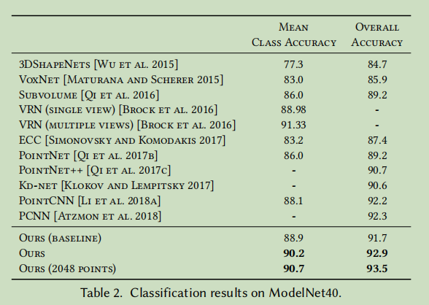
Evaluation
1.Classification
Training: momentum for batch normalization : 0.9 batch size : 32 momentum: 0.9.
Result:
Notes:
They use SGD with learning rate 0.1, and we reduce the
learning rate until 0.001 using cosine annealing . The momentum for batch normalization is 0.9, and
we do not use batch normalization decay. The batch size is 32 and
the momentum is 0.9.
The result they trained achieve the best mean class accuracy and the best overall accuracy

Slide 13
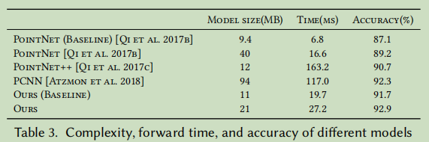
Evaluation
2.Model Complexity
Using the ModelNet40 [Wu et al. 2015] classification experiment
to compare the complexity of our model to previous state-of-the-art.
Model complexity: number of parameters Computational complexity:time consumed
Baseline: fixed k-NN graph
Notes:
They used the ModelNet40 [Wu et al. 2015] dataset in classification experiment in another article
to compare the complexity of our model to previous state-of-the-art.
And the result shows they have the best balance between the model complexity ,
computational complexity, and the resulting classification
accuracy.
They think their model is the best, synthesizely

Slide 14
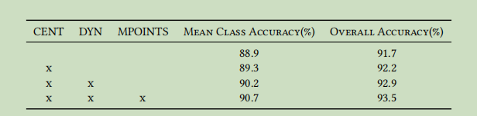
Evaluation
3.More experiments on dataset ModelNet40
Analyzing the effectiveness of different distance metric.
CENT: using concatenation of xi and xi − xj as the edge features rather than concatenating xi and xj
DYN:Dynamic graph recomputation instead of a fixed graph
MPOINTS:denoteing experiments with 2048 points
Notes:
They also experiment with various settings of their model on the ModelNet40 [Wu et al. 2015] dataset
This expriment is about analyzing the effectiveness of different distance metric.
They divided the images into three groups, and each group did different processing, including Centralization, Dynamic graph recomputation and
applying different number of midpoints.
Explicitly centralization
leads to about 0.5% improvement for overall accuracy. By dynamically updating
graph, there is about 0.7% improvement; Using more points further improves the
overall accuracy by 0.6%.

Slide 15
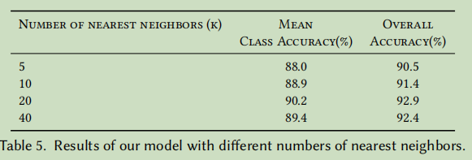
Evaluation
3.More experiments on dataset ModelNet40
Experimenting with different numbers k of nearest neighbors
Notes:
This is the expriment they apply different numbers of nearest neighbor,which is the number k of nearest neighbors is 20 for all EdgeConv layers
Both the accuracy improve with the numbers of nearest neighbors

Slide 16
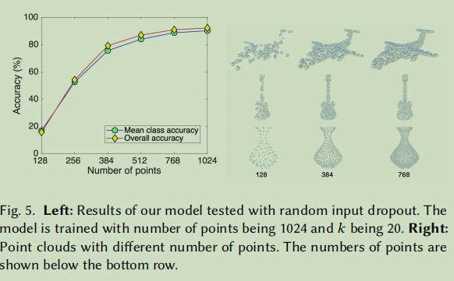
Evaluation
3.More experiments on dataset ModelNet40
The robustness of the model
Model trained with 1024 points and k=20. Simulate the environment that random input points drops out during testing.
Notes:
This is the expriment they test the robustness of their model
Even half of points is dropped, the model still
achieves reasonable results. With fewer than 512 points, however,
performance degenerates dramatically
The horizon axis is number of points, the vertical axis is accuracy

Slide 17
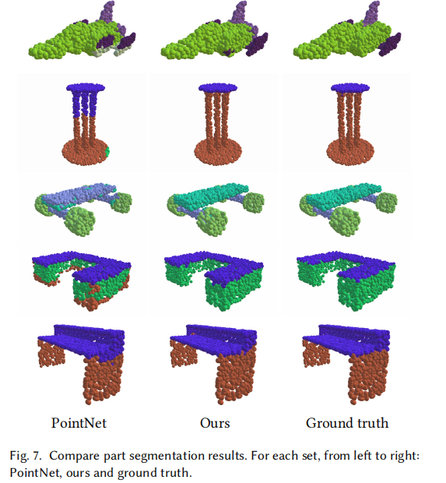
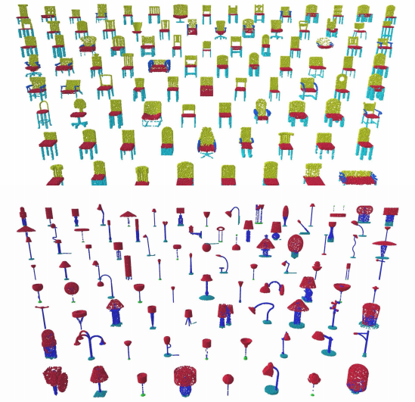
Part Segmentation
Notes:
零件分割：给定一个形状，分割出它的不同零部件。
上述提到的DGCNN算法会对形状的每个部分配以不同的颜色

Slide 18
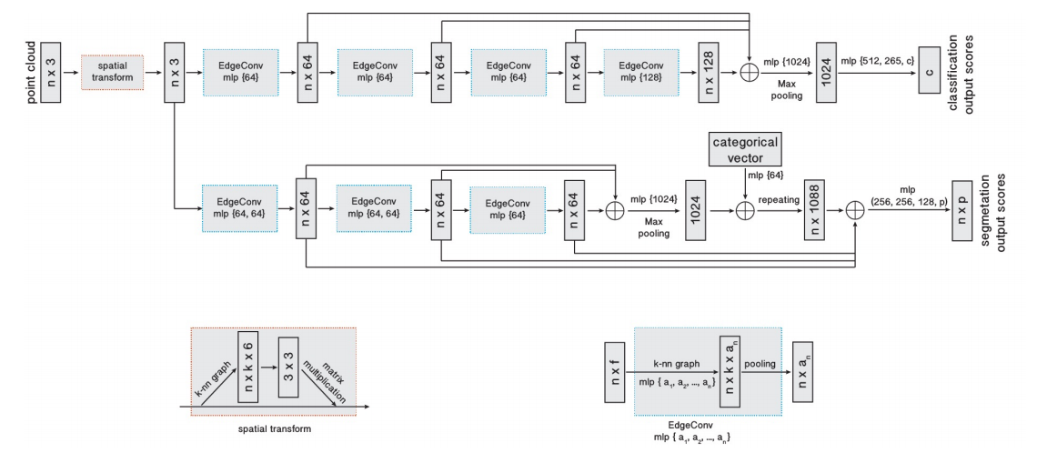
Data
scheme:train-validation-test split
dataset:ShapeNet part dataset
Architecture
Training
the same training setup as for our classification task was used.
Notes:
Data
通过扩展EdgeConv模型架构，用于在ShapeNet零件数据集上的零件分割任务
数据集分割方案为 训练集-验证集-测试集
训练集(train set)：用来估计模型；
验证集(validation set)：确定网络结构或者控制模型复杂程度的参数；
测试集(test set)：检验最终选择最优的模型的性能如何。
在这项任务中，点云集中的每个点都被几个预定义的类别标签所划分。
该数据集包含来自16个对象类别的16,881个3D形状，每种训练模型采集2048个点，大多数点集被标记为小于6个部分，最后将这些数据分为50个部分。
Architecture
在经过空间网络变换层后，通过3个Edgeconv层。一个共享全连接层聚合来自前一层的信息，残差网络用于将所有的EdgeConv的输出结果作为本地特征描述符包含在内，
最后三个共享全连接层对点态特征进行变换
After a spatial transformer network, three EdgeConv layers are used. A shared fully-connected layer (1024) aggregates information from the previous layers. Shortcut connections
are used to include all the EdgeConv outputs as local feature descriptors. At last, three shared fully-connected layers (256, 256, 128)are used to transform the pointwise features.
Training
训练方法采用SGD随机梯度下降法
从样本中随机抽出一组，训练后按梯度更新一次，然后再抽取一组，再更新一次，在样本量及其大的情况下，可能不用训练完所有的样本就可以获得一个损失值在可接受范围之内的模型了。
当我们使用梯度下降算法来优化目标函数的时候，当越来越接近Loss值的全局最小值时，学习率应该变得更小来使得模型尽可能接近这一点，而余弦退火（Cosine annealing）可以通过余弦函数来降低学习率。余弦函数中随着x的增加余弦值首先缓慢下降，然后加速下降，再次缓慢下降。
在零件分割任务中我们选取学习率为0.1，通过余弦退火的方式降低学习率至0.001，

Slide 19
Evaluation
Intersection-over-Union on points
The IoU of a shape is computed by averaging the IoUs of different parts occurring in that shape.
The IoU of a category is obtained by averaging the IoUs
of all the shapes belonging to that category.
The mean IoU (mIoU) is finally calculated by averaging the IoUs of all the testing shapes.
Notes:
评价指标IOU
IOU又称为交并比，通常被应用在目前目标检测算法的评价中，IOU值越高，说明算法对目标的预测精度越高
在零件分割实验中规定
一个形状的IOU是通过平均该形状的不同部分的IOUS来计算的
一个类别的IoU是通过将属于该类别的所有形状的IoU进行平均得到的
最后通过将所有测试形状的IoU平均来计算meanIoU

Slide 20
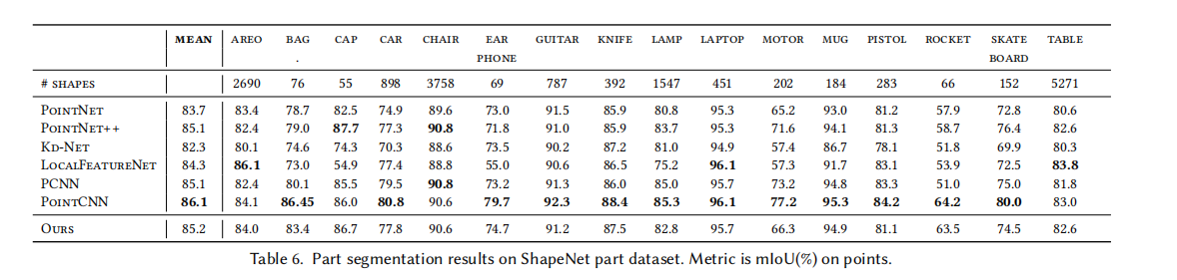
Results
Notes:
由上述表格可以看出文章采用的DGCNN方法在零件分割的效果较为突出，对于各种类型的模型得到的平均IOU值与各类型方法相比都具有不错的效果，
相较于PointCNN方法最后的平均IOU值较低，该方法在零件分割任务上具有一定优势

Slide 21
Future Work for Paper / Reading
Paper mentioned:
Incorporating fast data structures rather than pairwise to calculate the distance
Design non-shared transformer network
To more abstract point clouds – document retrieval/ image processing
Notes:
reduce uncertainty in the grasp estimate in a more
efficient way.

Slide 22
Future Work for Paper / Reading
Future work:
Our ideas：
Using this catching method in more specific situation(Ex, in sweeping robot, etc)
Revise the details to improve efficiency or scalability
Others’ ideas:
A Plug-and-Play for 3D Point Clouds
Unsupervised Structural Representation Learning of 3D Point Clouds.
Semi-supervised 3D shape segmentation with multilevel consistency and part substitution.

Slide 23
Extended Readings
Extended paper 1:
Point cloud completion via structured feature maps using a feedback network
Tackle the challenging problem of point cloud completion from the perspective of feature learning
Link: https://link.springer.com/article/10.1007/s41095-022-0276-6
From: Web of Science

Slide 24
Extended Readings
Extended paper 2:
MVGCN: Multi-View Graph Convolutional Neural Network for Surface Defect Identification Using Three-Dimensional Point Cloud
detect and classify surface defects using a 3D point cloud
The proposed approach consists of an unsupervised method for defect detection and a multi-view deep learning model for defect classification, which can keep track of the features from both defective and non-defective regions. We prove that the proposed approach is invariant to different permutations and transformations.
Link:https://asmedigitalcollection.asme.org/manufacturingscience/article/145/3/031004/1148268/MVGCN-Multi-View-Graph-Convolutional-Neural
From: Web of Science

Slide 25
Summary
Why?
inherently lack topological information
Limit:
treat each point independently
ignoring local geometric information
Innovative point:
(1) Suitable for CNN-based high-level tasks on point clouds including classification and segmentation
(2) Captures local geometric structure while maintaining permutation invariance
Proved:
(1) Demonstrate that EdgeConv can be integrated into multiple existing pipelines for point cloud processing
(2) Do extensive analysis and testing on EdgeConv and show its performance on benchmark datasets

