Slide 1
[Put-In-Box Task Generated from Multiple Discrete Tasks by a Humanoid Robot Using Deep Learning]
Presenter: [张子尚 包辰博 盛李杰 张中堂 程耀宇]
[2023/4/28]

Slide 2
Motivation and Main Problem
Further explaination of the title with supporting evidence
High-level description of problem being solved
How to design robots that can combine appropriate actions in a dynamic environment to complete a complex task that comprises multiple subtasks.
“As the number of situations and task types increase, it becomes extremely difficult to define the features and design appropriate motions for each condition.”
“Robot manipulation methods that can extract features easily, function in unknown situations, and generate and combine various tasks to suit changing work environments are desirable. ”

Slide 3
Motivation and Main Problem
Why is the problem important?
Its significance towards general-purpose robot autonomy
Nowadays, most factories are not fully automated. Typically, in a changing work environment, e.g., small quantity production lines for customizable products, people perform various complicated tasks because robot manipulation using a modeling approach often requires experts to manually extract environmental features for various conditions and plan corresponding motion trajectories. As the number of situations and task types increase, it becomes extremely difficult to define the features and design appropriate motions for each condition.

Slide 4
Motivation and Main Problem
Further explanation of the title with supporting evidence
Technical challenges arising from the problem
As the number of situations and task types increase, it becomes extremely difficult to define the features and design appropriate motions for each condition.
Hardcoded robot manipulations are often unstable in uncontrolled environments.
The role of the AI and machine learning in tackling this problem
DNNs(Deep neural network) can autonomously reduce high-dimensional data to low-dimensional data for feature extraction [1], and they can be used to classify unknown data from learned data [2]. These characteristics could be applied to extend robot manipulation by autonomously extracting environmental features and increasing generalizability.

Slide 5
Motivation and Main Problem
Further explanation of the title with supporting evidence
Key insights of the proposed work
I: Dimension reduction
II: Autonomously extracting environmental features
III: Generalizability

Slide 6
Problem Setting
Further explanation of the title with supporting evidence
Problem formulation, key definitions and notations
1. Deep neural networks (DNN), can autonomously reduce high-dimensional data to low-dimensional data for feature extraction, and they can be used to classify unknown data from learned data.
2. Recurrent neural networks (RNN), which are DNNs that use an internal memory to calculate the subsequent output from prior inputs, are used for predictive learning.

Slide 7
Context / Related Work / Limitations of Prior Work
Further explanation of the title with supporting evidence
Which other papers have tried to tackle this problem or a related problem?
The paper’s related work is a good start, but there may be others
C. Wei, Z. Ji and B. Cai, "Particle Swarm Optimization for Cooperative Multi-Robot Task Allocation: A Multi-Objective Approach," in IEEE Robotics and Automation Letters, vol. 5, no. 2, pp. 2530-2537, April 2020, doi: 10.1109/LRA.2020.2972894.
G. Yasuda, "Hierarchical and distributed implementation of synchronization and coordination for discrete event multiple robot systems," Proceedings of 2012 IEEE/ASME 8th IEEE/ASME International Conference on Mechatronic and Embedded Systems and Applications, Suzhou, China, 2012, pp. 302-307, doi: 10.1109/MESA.2012.6275579.
Hyun-Wook Jo, Jae-Ho Ahn, Jun-Sang Park, Jun-Han Oh and J. -T. Lim, "Task planning for service robots with optimal supervisory control," 2010 IEEE Conference on Robotics, Automation and Mechatronics, Singapore, 2010, pp. 303-308, doi: 10.1109/RAMECH.2010.5513172.

Slide 8
Context / Related Work / Limitations of Prior Work
Further explanation of the title with supporting evidence
Which other papers have tried to tackle this problem or a related problem?
What is the key limitations of prior work(s)?
(1) A previous study [4] focused on training multiple controllers and performing tasks in series; however, that study did not exploit visual inputs. Another study [3] focused on end-to-end visual servoing using RL. In that study, the robot demonstrated several types of task generation; however, the tasks were trained separately, i.e., multiple tasks were not trained simultaneously, and a switching phase was not considered.
(2) One study employed a low-cost robotic arm to generate multiple tasks using LSTM [7]; however, the transitions between tasks were not considered.
(3) For robot manipulation using predictive learning, several studies have trained multiple tasks simultaneously [5] [6]. Numerous tasks have been generated using a multimodal DNN that integrates image features with the joint angles of a robot [6]. However, even though these frameworks deal with multiple tasks, they use consumer-grade robots to perform simple tasks, such as moving a box or rolling a ball, and do not consider switching tasks or complex tasks.

Slide 9
Proposed Approach
Convolutional Autoencoder (CAE)
Usage: Extract the image features
Have features of both an AE and a CNN
Operate as an identity function using a bottleneck structure, which reduces the dimensionality of the original data and then reconstructs using convolutional and deconvolutional layers
The pooling layer removed for positional information
Trained using mean squared error with the optimizer for the Adam algorithm
Most dimensionally reduced data
Extracted feature

Slide 10
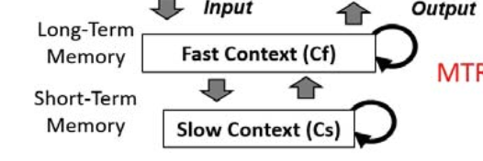


Proposed Approach
Multiple Timescale RNN
Aim: Simpler and more direct analysis of internal representation
RNNs can predict the next step from previous steps due to the existence of context layers.
Fast Context Layer Cf
More info from the current context
Proposed MTRNN
Small time constant
Slow Context Layer Cs
More info from the previous context
Large time constant
Input data
at t
MSE and the Adam optimizer
Predicted data
at t+1
Train MTRNN

Slide 11

Proposed Approach
Multiple Timescale RNN
Similar values for initial and final values of the contexts in order to switch among subtasks
Constraint:
Allows the network to form the strong attracting point, the point at which the internal states are likely to converge to and diverge from

Slide 12
Proposed Approach
Training Phase
Train CAE
Image data
Extracted image feature
Training data from human experimenter
Joint angle
MTRNN
Output
Concatenated data
Optimize weights using loss function

Slide 13
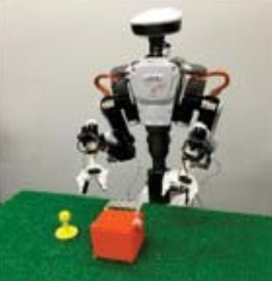
Proposed Approach
Motion Generation
Image data from Mounted Camera
CAE
Extracted image feature
Current joint angles
Movement of robot
Predicted joint angle
MTRNN
Concatenated data

Slide 14
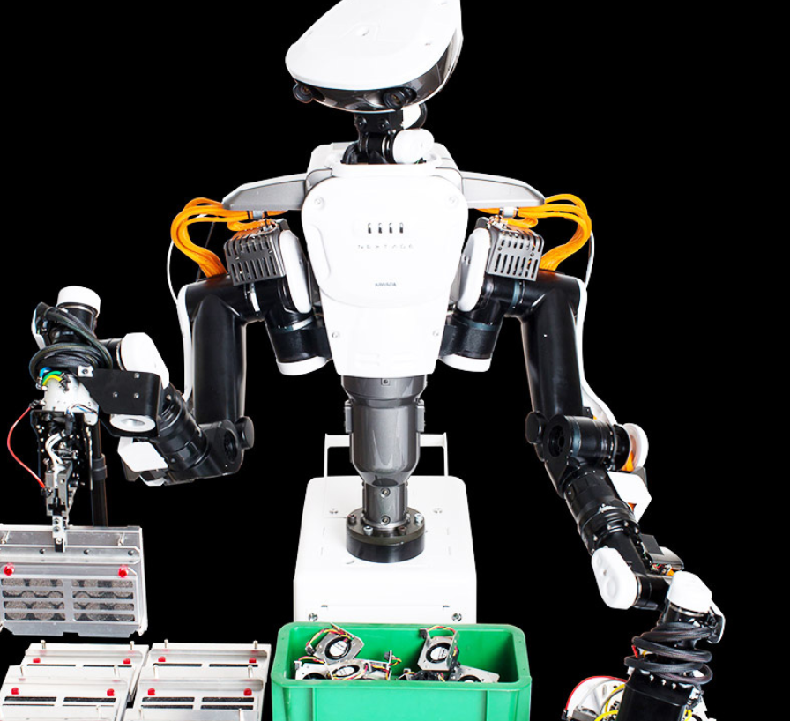
Experimental Setup
experimental evaluation setting
Nextage is a humanoid robot with a head-mounted camera and two arms, each Each arm has six degrees of freedom (DoF) and an additional gripper.
Nextage Open Robot from Kawada Robotics

Slide 15
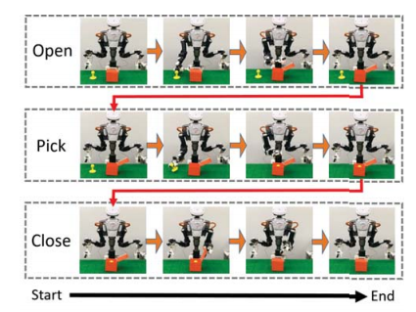
Experimental Setup
experimental evaluation setting
Open a box
Pick up an object and put it in the box
(3) Close the box
By combining these three subtasks, the robot performs a complete "put into the box" task. Each subtask is designed so that the robot's initial and final positions of the robot are the same, resulting in a smoother transition between each subtask. smooth transition between each subtask. In addition, since the initial and final positions of the robot and the MTRNN's initial and final internal states are the same, the only factor that causes the transition between subtasks is the image data. The only factor that causes the transition between subtasks is the difference in image data. Each subtask is trained separately and there is no relationship between the three subtasks.

Slide 16
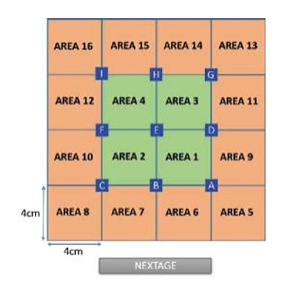
Experimental Setup
experimental evaluation setting
For the object manipulation, we divided the entire field into 16 squares (to facilitate robot positioning) and placed objects at each of the 9 intersections to complete the three operations described above, and each subtask was trained three times at these different locations.

Slide 17
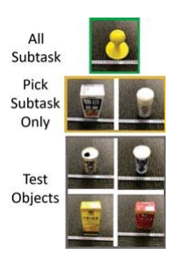
Experimental Setup
experimental evaluation setting
In addition, in the picking subtask, the robot was also trained to trained on two additional objects: a white pepper container and a white package of juice. For the test group, we also prepared a white steel can, a salt shaker, a yellow juice pouch and a red juice pouch to test the generality relative to the picked objects.

Slide 18
Experimental Setup
experimental evaluation setting
DataSet
The training data for the robot was created directly by the experimenter using a 3D mousethat the motion and image data are sampled simultaneously.
The images and joint angles of thetraining data were sampled at a rate of 5 frames per second, and each subtask took approximately 78 seconds were required.
The robot's camera captured a 64x64 pixel RGB image with the number of 12,288

Slide 19
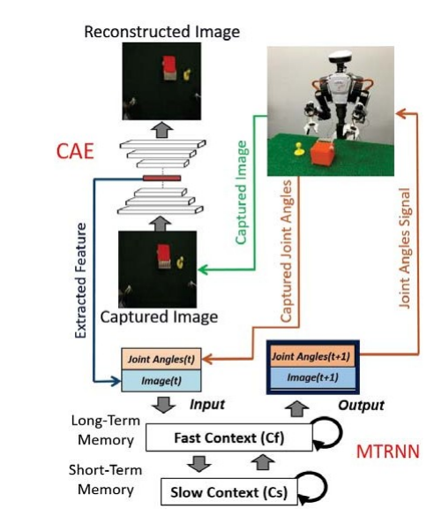
Experimental Setup
experimental evaluation setting
DataSet
The training data was processed by CAE to reduce its dimensionality to 20.
The TRNN training data are 20 raw image features with the robot arm and gripper's 14 joint angles connected to the data.
The training data for all subtasks data were looped three times, which means that the training data were prepared so that each sub-tasks were repeated three times to stabilize and smooth the output.

Slide 20
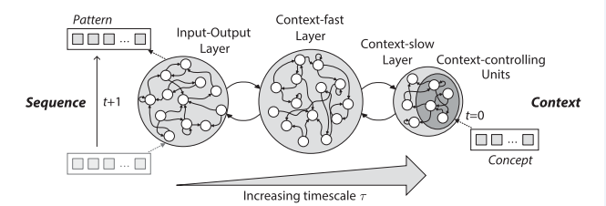
Experimental Setup
experimental evaluation setting
How to train
The overall MTRNN architecture with exemplary three horizontally parallel layers: input-output(IO), context-fast(Cf), and context-slow (Cs).
with increasing timescale t,where the Cs layer includes some context-controlling (Csc)units.
While the IO layer processes dynamic patterns over time, the Csc units at first time step (t=0)contain the context of the sequence, where a certain concept can trigger the generation of the sequence.

Slide 21
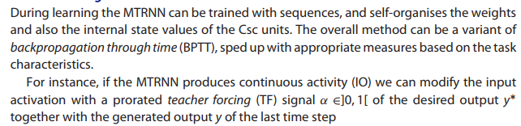

Experimental Setup
experimental evaluation setting
How to train

Slide 22
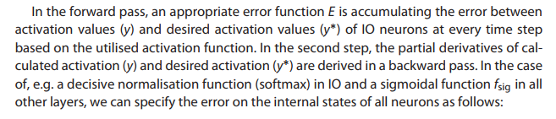
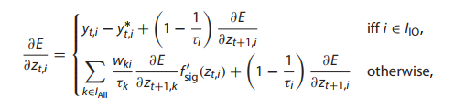
Experimental Setup
experimental evaluation setting
How to train

Slide 23

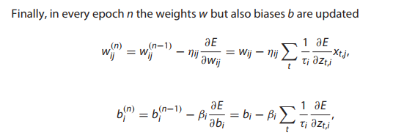
Experimental Setup
experimental evaluation setting
How to train

Slide 24
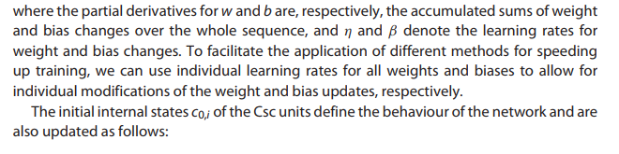
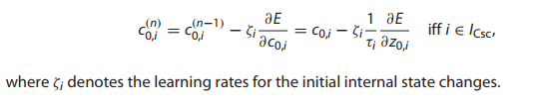
Experimental Setup
experimental evaluation setting
How to train

Slide 25
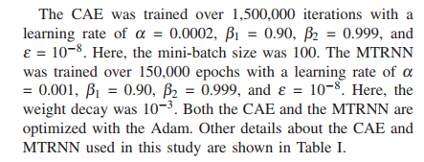
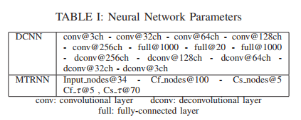
Experimental Setup
experimental evaluation setting
Network Parameters

Slide 26
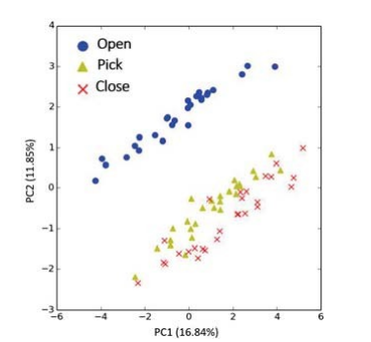
Experimental Results
Further explaination of the title with supporting evidence
Extraction of image features
From the data:
It is clear that the images of the first and second tasks are clearly separated, while the second and third tasks are aggregated together.
The reason for this problem may be that the object we are operating on is too small compared to the box we are placing, so the pickup and close box operations do not have a significant change on the overall image

Slide 27
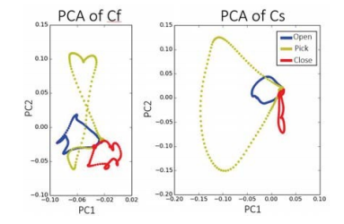
Experimental Results
Further explaination of the title with supporting evidence
Generate a complete set of complex movements
The results show that the contextual layers start and end with similar values, thus forming attraction points. Each subtask starts from the strong attraction point generated by the constraints of MTRNN attraction point and diverges from that point using the input difference of MTRNN.
Since the input difference at the beginning of each subtask is the image data, the data is used to disperse from the attraction point, generate motion corresponding to the image data, and converge to the attraction point.

Slide 28
Experimental Results
Further explaination of the title with supporting evidence
Generate a complete set of complex movements
Train patterns of multiple discrete actions with constraints that allow the robot to able to perform actions that are difficult when trained continuously. One advantage of this is the achievement of repetition capability, allowing the robot to repeat the same task in a shorter time period performing the same task repeatedly.

Slide 29
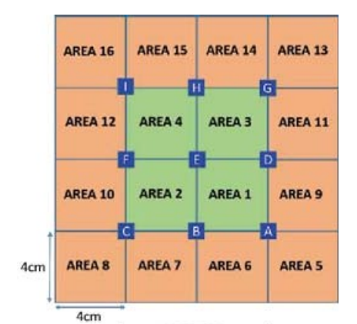
Discussion of Results
Further explaination of the title with supporting evidence
Task-specific experimental results
In the area shown in the figure, the robot performing the pick-up subtask was tested. Each area was tested five times with yellow stamped objects. The robot could pick up objects in zones 1 to 4 perfectly.
The robot was also able to pick up objects in zones 5 to 16, but failed in the attempt. The total assembly power for picking up objects in 16 zones power was 88.75% (80 attempts).

Slide 30
Discussion of Results
Further explaination of the title with supporting evidence
Generalization of tasks
CAE trained with only yellow stamps cannot clearly reconstruct other objects’ images, which affects the accuracy of robot motion generation. To confirm the CAE effectiveness, we tested the robot generation with all objects to pick subtasks.
The ability of the robot to generate the picking subtask was tested with all objects. For the red juice package, the robot could not identify when it needed to perform the pick subtask. Here, it generated the close subtask. For the
other objects, the robot generated the picking subtask, but failed to pick the untrained objects (it knocked them over with its paws).

Slide 31
Discussion of Results
Further explaination of the title with supporting evidence
Generalization of tasks
CAEs trained with other objects compared to those trained with only the yellow stamp object.
CAE can reconstruct other untrained objects more clearly and vividly than
objects. With the CAE trained with additional objects, the robot generated all objects for the pickup subtasks and was able to pick up objects without knocking them over.

Slide 32
Discussion of Results
Further explaination of the title with supporting evidence
Generalization of tasks
Although the robot was not trained to generate open or close subtasks with these objects, the robot succeeded in generating a complete boxing task for other objects trained with only the picking subtask. The complete boxing task was generated for other objects trained with only the picking subtask.
In addition, with the exception of the red juice bag, the robot could generate a complete boxing task for all untrained objects. robot can generate complete tasks for all untrained objects except the red juice bag. For this object, the robot successfully generated the opening and picking subtasks, but failed to convert them to but failed to convert to the closing subtask and repeated the picking subtask.

Slide 33
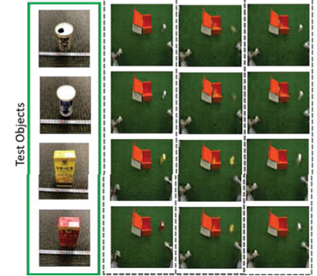
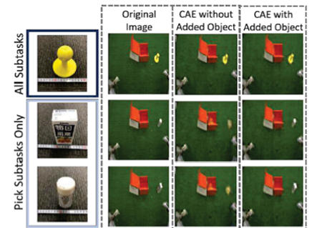
Discussion of Results
Further explaination of the title with supporting evidence
Generalization of tasks
Training with additional objects
CAE reconstructed the original image more accurately than other CAEs.

Slide 34
Critique
Based on
“a robot demonstration of a human operator using a 3d mouse controller”,
predictive learning models and deep neural networks (RNN)
enable it to perform
multiple short tasks and autonomously combine them
according to the situation to
generate composite tasks
Notes:
本篇论文的目标是
基于一个使用3d鼠标控制器的人类操作员的机器人演示，利用预测性学习模型和深度神经网络，使其可以执行多个短任务，并根据情况自主组合，生成复合的任务

Slide 35
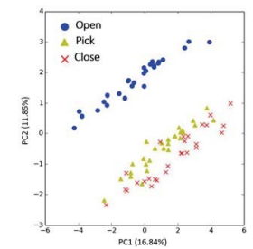
Critique
Previous research is clear,
learning and classifying previous research results
The selection of methods is appropriate,
and the advantages and limitations of each method are summarized
Good pointcut,
long complex tasks, separate training, highly constructive
The evaluation experiment design is quite corresponding,
“open pick close”
Notes:
1.前人成果研究很清楚，学习和分类了之前的研究成果
2.深度神经网络选取合适，总结了各个方法的优势及其局限性
3.切入点很好，执行复杂复合的长任务，分开训练，建设性很高
4.评估实验设计很对应，open pick close

Slide 36
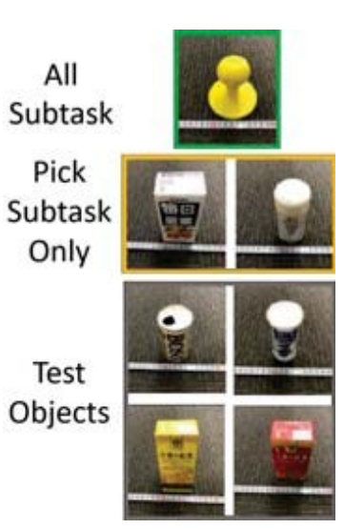
Limitations
There is something to be thought about in the practical application of the project
The connection of short tasks is relatively simple
(there is no problem that items are not easy to catch or throw, which disrupts the process).
Constraint strength and conditions can be increased
in constrained/unconstrained MTRNN to show more
For identifying objects and grasping paths,
the data of previous studies can be used for reference to improve efficiency
Notes:
1.对于短任务的连接较为简单（没有出现物品不好抓/抓起来不好扔这种破坏流程的问题）
2.可在约束/无约束的MTRNN里增加约束强度和条件，展示更多
3.对于识别物体和抓取路径，可借鉴前人资料，提高效率

Slide 37
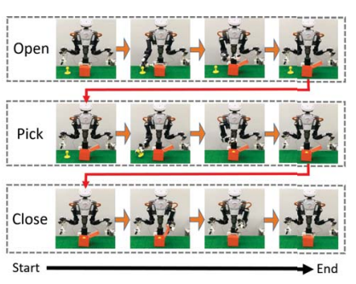
Future Work for Paper / Reading
A task robot capable of handling dynamic information and interference
Make task more difficult, and increase the number.
Study other advanced studies on short tasks,
optimize the learning process and results.
Change the relevance and connection,
and further discuss the switching ability of this method among subtasks
Let it handle series of different long tasks autoly
with enough training sets of short tasks
Optimize the process by algorithm, repeatability and sequencing,
Notes:
1.在put in box任务的每个环节提高难度，或增加短任务数量
2.结合其它在短任务上的先进研究，优化每一步的学习过程和结果
3.改变人物之间的相关度和连接关系，进一步讨论这种方法在子任务间的切换能力
4.在短任务训练集足够多的情况下，能否处理不同长任务的自主串联
5.A-B-C→A-A-A-A-C-B-A-A-C-C重复性和排序先后，通过算法优化流程

Slide 38
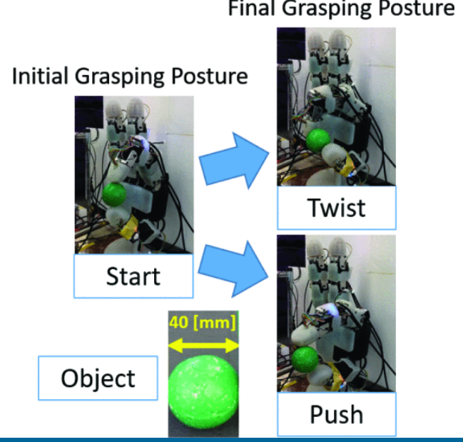
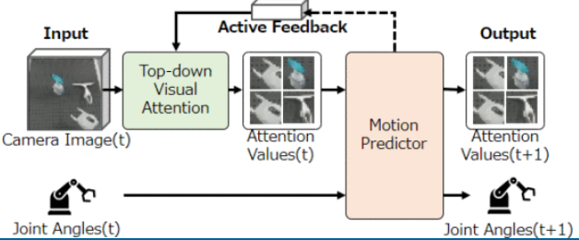
Future Work for Paper / Reading
A task robot capable of handling dynamic information and interference
Autopilot compressed images
Towel folding robot with six degrees of freedom
Improve the stability of cooperative robots based on human vision
Robot hand manipulation "Twist" and "Push"
Notes:
1.自动驾驶压缩图像
2.六自由度机器人叠毛巾
3.基于人类视觉帮助提高协作机器人稳定性
4.机器人手部操作“扭”和“推”
1.2022：In this study, we present an autonomous driving sys-tem that utilizes a binarized autoencoder implemented on a Field Programmable Gate Array (FPGA). The binarized autoencoder compresses the image into optimal features in this system. The recurrent neural network then determines the following control based on the feature values extracted from the autoencoder and the rotation speed of the motor. We reduced the model size by binarizing the autoencoder because of the limited on-chip memory of the FPGA. We implemented the system on an Ultra96-V2, a board with a programmable logic and processing system. The robot employing our implemented system exhibits robust control by recognizing the entire road marking and road edge line as a feature and drives autonomously along the specified route.
2. Various forms of human knowledge can be explicitly used to enhance deep robot learning from demonstrations. Annotation of subtasks from task segmentation is one type of human symbolism and knowledge. Annotated subtasks can be referred to as action labels, which are more primitive symbols that can be building blocks for more complex human reasoning, like language instructions. However, action labels are not widely used to boost learning processes because of problems that include (1) real-time annotation for online manipulation, (2) temporal inconsistency by annotators, (3) difference in data characteristics of motor commands and action labels, and (4) annotation cost. To address these problems, we propose the Gated Action Motor Predictive Learning (GAMPL) framework to leverage action labels for improved performance. GAMPL has two modules to obtain soft action labels compatible with motor commands and to generate motion. In this study, GAMPL is evaluated for towel-folding manipulation tasks in a real environment with a six degrees-of-freedom (6 DoF) robot and shows improved generalizability with action labels.
3. 2022：Sufficiently perceiving the environment is a critical factor in robot motion generation. Although the introduction of deep visual processing models have contributed in extending this ability, existing methods lack in the ability to actively modify what to perceive; humans perform internally during visual cognitive processes. This letter addresses the issue by proposing a novel robot motion generation model, inspired by a human cognitive structure. The model incorporates a state-driven active top-down visual attention module, which acquires attentions that can actively change targets based on task states. We term such attentions as role-based attentions, since the acquired attention directed to targets that shared a coherent role throughout the motion. The model was trained on a robot tool-use task, in which the role-based attentions perceived the robot grippers and tool as identical end-effectors, during object picking and object dragging motions respectively. This is analogous to a biological phenomenon called tool-body assimilation, in which one regards a handled tool as an extension of one’s body. The results suggested an improvement of flexibility in model’s visual perception, which sustained stable attention and motion even if it was provided with untrained tools or exposed to experimenter’s distractions.
4. Performing various in-hand manipulation tasks, without learning each individual task, would enable robots to act more versatile, while reducing the effort for training. However, in general it is difficult to achieve stable in-hand manipulation, because the contact state between the fingertips becomes difficult to model, especially for a robot hand with anthropomorphically shaped fingertips. Rich tactile feedback can aid the robust task execution, but on the other hand it is challenging to process high-dimensional tactile information. In the current paper we use two fingers of the Allegro hand, and each fingertip is anthropomorphically shaped and equipped not only with 6-axis force-torque (F/T) sensors, but also with uSkin tactile sensors, which provide 24 tri-axial measurements per fingertip. A convolutional neural network is used to process the high dimensional uSkin information, and a long short-term memory (LSTM) handles the time-series information. The network is trained to generate two different motions ("twist" and "push"). The desired motion is provided as a task-parameter to the network, with twist defined as -1 and push as +1. When values between -1 and +1 are used as the task parameter, the network is able to generate untrained motions in-between the two trained motions. Thereby, we can achieve multiple untrained manipulations, and can achieve robustness with high-dimensional tactile feedback.

Slide 39
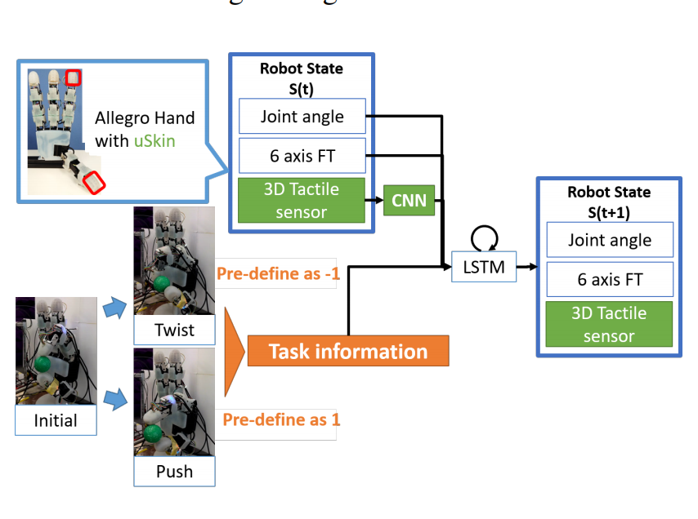
Extended Readings
Further explaination of the title with supporting evidence
Variable In-Hand Manipulations for Tactile-Driven Robot Hand via CNN-LSTM
in 2020 IEEE/RSJ International Conference on Intelligent Robots and Systems (IROS) October 25-29, 2020, Las Vegas, NV, USA (Virtual)
～ In this article, the author also used Predictive learning, which has a very different purpose and effect than the articles listed here.
～ In this article, the purpose of training is to be able to performing various in-hand manipulation tasks, without learning each individual task.
～ In the current paper we use two fingers of the Allegro hand, and each fingertip is anthropomorphically shaped and equipped not only with 6-axis force-torque (F/T) sensors, but also with uSkin tactile sensors, which provide 24 tri-axial measurements per fingertip. A convolutional neural network is used to process the high dimensional uSkin information, and a long short_x0002_term memory (LSTM) handles the time-series information. The network is trained to generate two different motions (“twist” and “push”). The desired motion is provided as a task_x0002_parameter to the network, with twist defined as -1 and push as +1. When values between -1 and +1 are used as the task parameter, the network is able to generate untrained motions in-between the two trained motions.

Slide 40
Summary
Further explaination of the title with supporting evidence
Problem:
  Subtask design, Switching among multiple tasks，The design of neural network
Importance ：
Adapt to various working environment, generate and combine various tasks
Key limitation of prior work：
  Few studies have addressed switching among mutiple tasks
Key insights of the proposed work:
propose a model that uses two DNNs to generate mul_x0002_tiple short discrete subtasks to
complete a longer target task.
What did they demonstrate by this insight:
With our model, the robot switches among short subtasks autonomously by recognizing images. Then, the robot executes the target task.

Slide 41
Reference
[1] G. Hinton and R. R. Salakhutdinov, “Science,” Science, vol. 313, no. July, pp. 504–507, 2006.
[2] A. Krizhevsky, I. Sutskever, and G. E. Hinton, “ImageNet Classification with Deep Convolutional Neural Networks,” Advances in Neural Information Processing Systems 25, pp. 1097–1105, 2012.
[3] S. Levine, C. Finn, T. Darrell, and P. Abbeel, “End-to-End Training of Deep Visuomotor Policies,” ArXiv:1504.00702, 2015.
[4] W. Han, S. Levine, and P. Abbeel, “Learning compound multi-step controllers under unknown dynamics,” IEEE International Conference on Intelligent Robots and Systems, vol. 2015-December, pp. 6435– 6442, 2015.
[5] Y. Yamashita and J. Tani, “Emergence of functional hierarchy in a multiple timescale neural network model: A humanoid robot experiment,” PLoS Computational Biology, vol. 4, no. 11, 2008. [16] K. Noda, H. Arie, Y. Suga, and T. Ogata, “Multimodal integration learning of robot behavior using deep neural networks,” Robotics and Autonomous Systems, vol. 62, no. 6, pp. 721–736, 2014.
[6] K. Noda, H. Arie, Y. Suga, and T. Ogata, “Multimodal integration learning of robot behavior using deep neural networks,” Robotics and Autonomous Systems, vol. 62, no. 6, pp. 721–736, 2014.
[7] R. Rahmatizadeh, P. Abolghasemi, L. Boloni, and S. Levine, “VisionBased Multi-Task Manipulation for Inexpensive Robots Using EndTo-End Learning from Demonstration,” arXiv:1707.02920, 2017.

Slide 42
SUSTech Design + Learning Lab
PowerPoint Template
Name
Affiliation
Supervisor
Contact

