Slide 1
More Than a Feeling:
Learning to Grasp and Regrasp
using Vision and Touch
Grasping:
Presenter: 王思源 苏兆文 林沛君 赵瑞涵 刘子羽
2023.3.2

Slide 2
Motivation and Main Problem
High-level description of problem being solved
The problem being solved is how a robot can learn to use tactile information to iteratively and efficiently adjust its grasp, as humans heavily rely on tactile feedback during the process of grasping an object, but most recent robotic grasping work has been based only on visual input, which cannot easily benefit from feedback after initiating contact.
Zhaowen Su & 2022.3.9
More Than a Feeling: Learning to Grasp and Regrasp using Vision and Touch

Slide 3
Motivation and Main Problem
Why is the problem important?
significance towards general-purpose robot autonomy
Grasping is a fundamental aspect of many tasks, and the ability to adjust grasp based on tactile feedback can greatly improve the success rate and efficiency of the task.
potential application and societal impact of the problem
By developing a method for integrating touch sensing into grasping, robots can become more versatile and adaptable, and can potentially perform a wider range of tasks in a variety of environments.
Zhaowen Su & 2022.3.9
More Than a Feeling: Learning to Grasp and Regrasp using Vision and Touch

Slide 4
Motivation and Main Problem
Technical challenges arising from the problem
the role of the AI and machine learning in tackling this problem
The authors propose a method based on learning an action-conditioned grasping model, which is trained end-to-end in a self-supervised manner using a robot to autonomously collect grasp attempts.
This approach allows the system to learn from its own experiences and adjust its behavior accordingly, leading to improved grasping performance over time.
In addition, integrating tactile sensing into the model needs advanced machine learning techniques to deal with the intermittent and changing tactile input. The authors use GelSight sensors to capture rich touch information, and their model incorporates this information robustly to the changing scene.
Zhaowen Su & 2022.3.9
More Than a Feeling: Learning to Grasp and Regrasp using Vision and Touch

Slide 5
Motivation and Main Problem
why prior approaches didn’t already solve? & Key insights
High-level idea of why prior approaches didn’t already solve
The incorporation of touch sensing into robotic grasping has been challenging due to hardware limitations such as sensor sensitivity and cost, as well as the difficulty of integrating tactile inputs into standard control schemes, so that the predominant input modalities currently used in the robotic grasping are vision and depth, which are not always precise and robust.
Key insights of the proposed work
An end-to-end action-conditional model that learns regrasping policies from raw visuo-tactile data
Zhaowen Su & 2022.3.9
More Than a Feeling: Learning to Grasp and Regrasp using Vision and Touch

Slide 6
Problem Setting
Problem formulation, key definitions and notations
Problem formulation
  Incorporating vision and touch sensing into action-conditional models.
  Develop a learning-based approach to further improve the grasping performance.
Key definitions
  Regrasping: Adjusting its grip if necessary to achieve a better grasp
  End-to-End: A system designed to work seamlessly from start to finish.
  Action-Conditioned: Takes into account the current conditions or environment and adjusts its actions accordingly to achieve a desired outcome.
Zhaowen Su & 2022.3.9
More Than a Feeling: Learning to Grasp and Regrasp using Vision and Touch

Slide 7
Related Work & Limitations of Prior Work
Learning to Grasp
Analytic grasping models
"Robot grasp synthesis algorithms: A survey" (Shimoga. 1996)
"Data-driven grasping" (Goldfeder and Allen. 2011)
"From caging to grasping" (Rodriguez, Mason and Ferry. 2012)
Visual Data-driven approaches
"Learning to grasp using visual information" (. 1996)
"Deep learning for detecting robotic grasps" (Lenz, Lee and Saxena. 2015)
"Leveraging big data for grasp planning" (Kappler, Bohg and Schaal. 2015)
"Deep learning a grasp function for grasping under gripper pose uncertainty" (Johns, Leutenegger and Davison. 2016)
Model misspecification and unmodled factors reduce the actual performance
A limited ability to reason about contact forces, pressures, and compliance.
Most of these methods rely on selecting grasp configurations in advance, before coming into contact with the target object
5

Slide 8
Related Work & Limitations of Prior Work
Tactile Sensors in Grasping
The use of tactile sensors on grasp
"Assessing grasp stability based on learning and haptic data" (Bekiroglu, Laaksonen, Jorgensen, Kyrki and Kragic. 2011)
"Stable grasping under pose uncertainty using tactile feedback" (Dang and Allen. 2016)
Model-based methods for integating visual and tactile information
"Learning to assess grasp stability from vision touch and proprioception" (Bekiroglu. 2012)
"Robotic grasping using visual and tactile sensing" (Guo, Sun, Yang and Xi. 2017)
regrasping policy
"Self-supervised regrasping using spatio-temporal tactile features and reinforcement learning" (Chebotar, Hausman, Su, Sukhatme and Schaal. 2016)
Only to estimate the stability of an ongoing grasp, not produce a stable new one
depend on the accurate models of the robots and objects to grasp
require the data collection to be on-policy and to be intertwined with the policy update
More Than a Feeling:Learning to Grasp and Regraspusing Vision and Touch
5

Slide 9
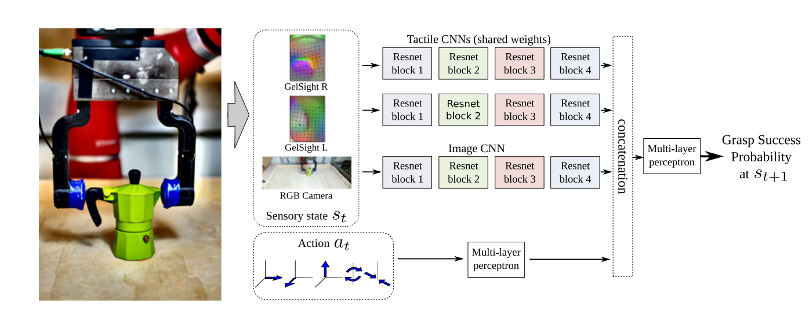
Proposed Approach
Generation of the prediction model
Action-conditioned visuo-tactile model network architecture
More Than a Feeling:Learning to Grasp and Regraspusing Vision and Touch
5

Slide 10
Peijun Lin & 2022.3.9
More Than a Feeling:Learning to Grasp and Regraspusing Vision and Touch

Slide 11
Proposed Approach
Innovation of the framework and Algorithm
Exploit vision and tactile feedback to produce a stable new grasp
Learn entirely end-to-end from raw inputs, so it does not require any prior model or transition function.
Utilize an action-conditioned model not a policy, which can match any data collected and adapt to a different objective at evaluation time.
More Than a Feeling:Learning to Grasp and Regraspusing Vision and Touch
5

Slide 12
Theory
Markov decision process (MDP)
The Markov decision process (MDP) is a mathematical model of sequential decisions and a dynamic optimization method.
A Markov decision process is a 4-tuple(S,A,P_{a},R_{a}), where:
  S is a set of states called the state space,
  A is a set of actions called the action space(alternatively, A_{s} is the set of actions available from state S),
  P_{a}(s, s’) = Pr(s_{t+1} = s’ | s_{t} = s, a_{t} = a) is the probability that action a in state s at time t will lead to state s’ at time t + 1,
  R_{a}(s, s’) is the immediate reward (or expected immediate reward) received after transitioning from state s to state s’ , due to action a.
Notes:
本文的抓取策略用到了马尔可夫决策过程(MDP)，用于选择最优的下一步抓取动作。马尔可夫决策过程是一种数学框架，用于描述具有随机性和时序性的决策问题。S是状态空间，描述所有可能状态的集合；A是动作空间，描述可以采取的所有动作的集合；P_{a}是转移概率，描述t时刻，在状态s下采取某个动作a后，在t+1时刻进入下一个状态s’的概率分布；R_{a}是奖励函数，描述在一个状态下采取某个动作，状态由s进入s’后获得的即时奖励。

Slide 13
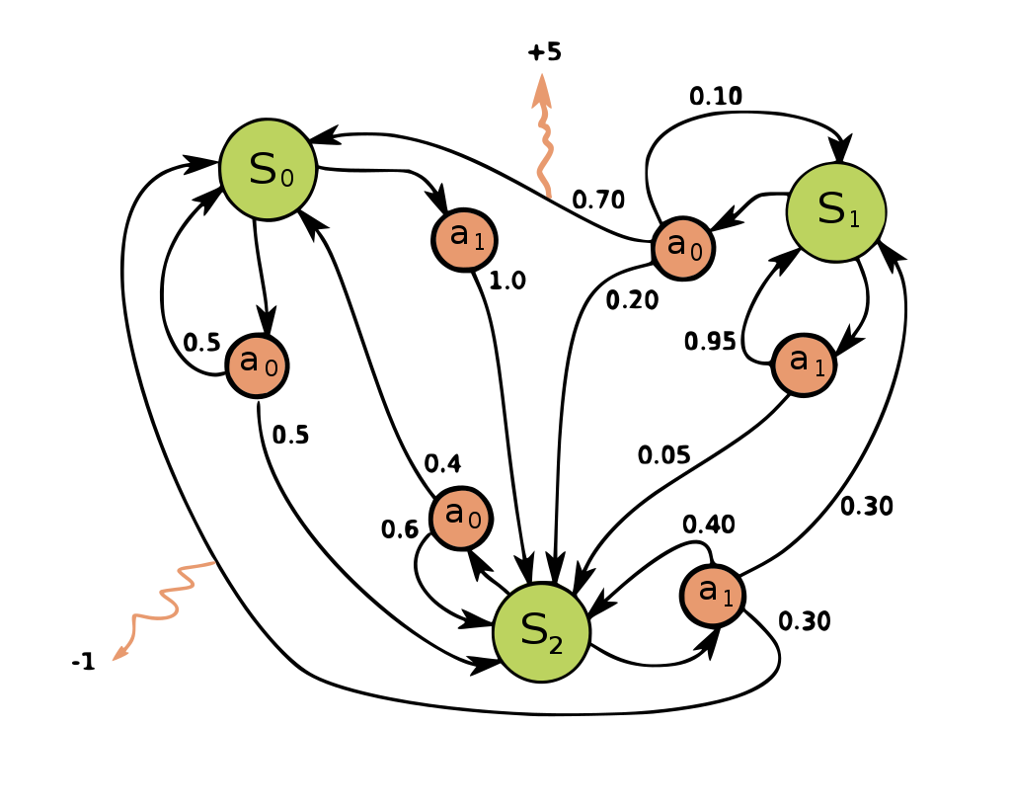
Theory
Markov decision process (MDP)
Given the robot’s current visuo-tactile observations s_{t} at time t, and an action a, we predict the probability that, after applying the action, the gripper will be in a configuration that leads to a successful grasp at time t + 1.
the action that maximize the expected probability of success of the grasp
a_{t} = arg max_{a} f(s_{t} , a)
Notes:
文中将夹取视为一个马尔可夫决策过程，给定机器人在时间t的通过视觉与触觉传感器获得状态信息st，和一个动作a，我们预测在应用该动作后，在t + 1时刻成功抓取的的概率。
训练的模型就是为了预测不同动作对应的夹取成功率。为了使夹取的成功率最大化，文章中通过随机采样潜在的动作a，用训练好的模型预测每个动作成功的概率，选取成功概率最大的动作。我们使用它来选择在执行动作后最大限度地提高把握成功的预期概率的动作

Slide 14
Theory
K-fold cross-validation
Why K-fold cross-validation?
To evaluate the performance of some model on a dataset, we need to measure how well the predictions made by the model match the observed data. The most common way to measure this is by using the mean squared error (MSE)。
The test MSE gives us an idea of how well a model will perform on data it hasn’t previously seen.
The drawback of using only one testing set is that the test MSE can vary greatly depending on which observations were used in the training and testing sets.
Notes:
在验证模型时用到了k-fold 交叉验证的方法。
一般在验证某个模型在数据集上的表现时，我们需要衡量模型做出的预测与观测数据的匹配程度。最常用的测量方法是使用均方误差(MSE)。测试MSE让我们了解了一个模型在以前没有见过的数据上的表现。但是使用单一测试集存在一个缺点，有关测试集的信息会“泄漏”到模型中，评估指标就不是真实的反映模型泛化性能，导致在测试集上出现过度拟合的风险。

Slide 15
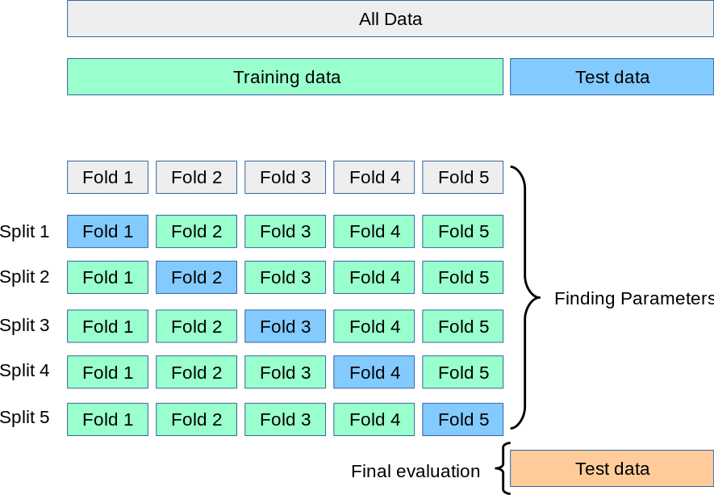
Theory
K-fold cross-validation
How to do K-fold cross-validation
Notes:
步骤1:随机将数据集分为k组，或“折叠”，大小大致相等。
步骤2:选择一个折叠作为保留设置。在剩下的k-1次折叠上拟合模型。计算在褶皱中观测到的测试MSE。
第三步:重复这个过程k次，每次使用不同的集合作为坚持集。
步骤4:计算整体测试MSE为k个测试MSE的平均值

Slide 16
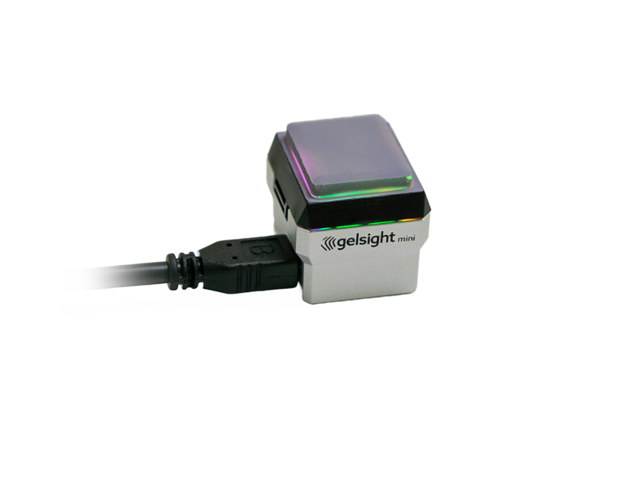
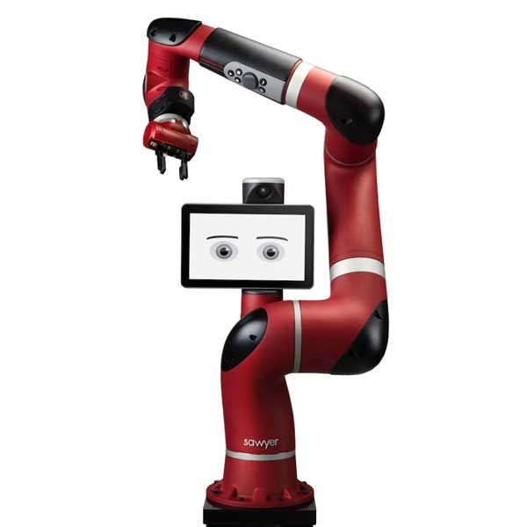
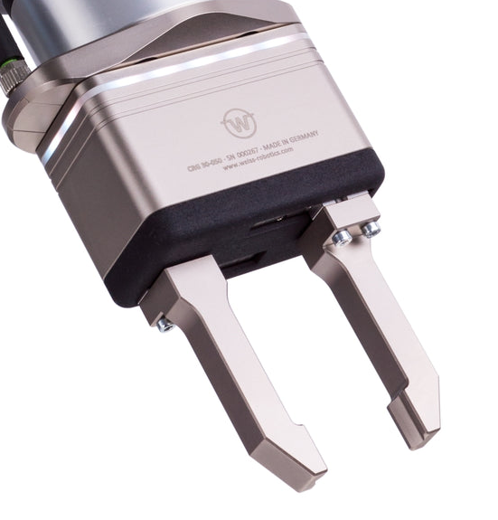
Experimental Setup
Hardware setups
7-DoF Sawyer arm
Weiss WSG-50 parallel gripper
GelSight sensors
Notes:
实验主要用到的硬件有7自由度的机械臂，平行的夹爪，Gelsight触觉传感器，此外还有一个kinect相机，用于得到RGBD数据。

Slide 17
Experimental Setup
Data Collection
In each trial, depth data from the front Kinect was used to approximately identify the starting position of the object and enclose it within a cylinder.
Set the end-effector (x, y) coordinates to the position of the center of the cylinder plus a small random perturbation, and set its height to be a random value between the floor and the height of the cylinder.
Moreover, the orientation φ and the gripping force F are randomized .
After moving to the chosen position and orientation, the gripper close and attempt to lift the object and wait in the air for 4s. If the object was still in the gripper at the end of this time, the robot would place the object back at a randomized position, and a new trial would start.
Notes:
首先是确定开始夹取物体的起点，实验中使用Kinect相机的深度数据，将物体拟合成一个圆柱体，将夹爪的坐标系的x,y坐标放在圆柱体的中心，并加入一些随机的扰动，z坐标为地面到物体高度之间的随机值。此外，夹爪的初始朝向与施加的力也是随机的。在移动到指定的位置后，开始夹取，若成功夹取且在空中停留4s，夹爪将物体随即放回并开始新的夹取。

Slide 18
Experimental Setup
Data Collection
The labels for this were also automatically generated using deep neural network classifiers trained to detect contacts using the raw GelSight images observed.
Additional manual labeling on a small set of samples were performed, for which the automatic classification was borderline ambiguous, or in the rare cases when a visual inspection would indicate a wrong label.
As the gripper moves from one position to another, the locations that it moves to along the way can provide additional data points for training.
6450 grasping trials from over 65 training objects are collected, and the datasets contains 18070 examples.
Notes:
因为用到的是自监督的学习模型，数据的标签，就是输出结果由深度神经网络分类器自动产生；但在一些分类的界限不清晰，或是分类器给出了错误标签的情况下，标签由人工标出。在夹爪运动的过程中，路点也可以提供额外的数据，通过这种方式，可以增加样本数。总共在65个抓取对象上进行了6450次实验，生成了18070个样本。

Slide 19
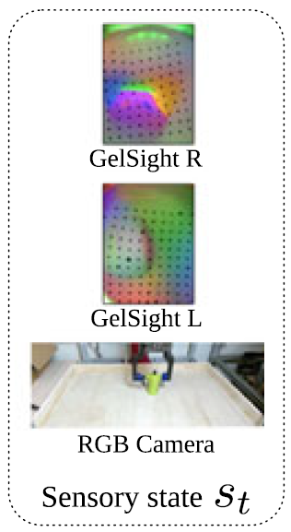
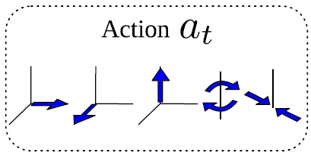
Experimental Setup
Datasets
Raw visuo-tactile observations s are acquired from tactile sensors and the RGB camera. Each action a directs the gripper to a new pose relative to its current pose.
let o(s_{t} , a) ∈ {0, 1} be the binary grasp outcome at time t + 1 resulting from executing action a from grasp state s_{t}: if o(s, a) is 1, the grasp is successful.
At training time, the robot performs random trials to collect state-action-outcome tuples (s_{i} , a_{i}, o_{i}) ∈ X.
Notes:
实验的数据集由当前状态s包括深度相机与触觉传感器采集的图像信息，将夹爪导向相对于当前姿态的新姿态的动作a，以及二元的夹取结果o组成。其中o表示在st状态下，执行动作a_{t}，t+1时刻的输出结果，1表示夹取成功。某个时刻下的状态、动作、及对应的输出组成数据集中的一个样本。

Slide 20
Experimental Evaluation
Model Evaluation
Question1: Can the model successfully learn to predict future grasp success for novel objects?
Question2：Whether the model learns to use actions to predict future outcomes, conditional on a relative adjustment from the current grasp?
Evaluate by comparing the performance of a number of variations of the current model, though K-fold(K = 3) cross-validation, using the dataset of grasps.
Notes:
在文中，对训练好的模型提出了两个问题，1是训练好的模型是否能预测对新物体夹取的成功率？因为有可能这个模型在现有数据集上的表现很好，但是对于数据集以外的情况表现得不是很好。2是该模型是否习得了通过当前动作，对未来输出做出调整。实验中通过比较当前模型的许多变体的性能，运用了交叉验证的方式验证模型不同模型的性能。

Slide 21
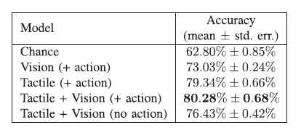
Experimental Evaluation
Model Evaluation
TABLE I
K-FOLD (K = 3) CROSS-VALIDATION ACCURACY OF THE DIFFERENT MODELS TRAINED WITH 18,070 DATA POINTS
Models：
  This model
  This model without action
  Vision-only
  Tactile-only
Notes:
Model without action:an unconditional model,没有计算不同动作所带来的概率。
状态信息只有视觉的模型、状态信息只有触觉的模型。
通过比较发现拥有所有信息的模型确实在性能上优于其他模型，
验证了模型能够成功地评估不同行为的重要性，以及触觉信息的存在对模型的性能是有提升的。

Slide 22
Experimental Evaluation
Robot Grasp Evaluation
Evaluated the learned models on the robot, testing the robot grasp a given object after executing a series of regrasp actions, Each grasp begins by randomly sampling an end-effector position and angle, used in data collection.
Compare this model with the vision-only variant of the model, then use the learned models to select the next grasp, by solving the optimization equation.
The optimization is performed by randomly sampling 4900 actions, plus 100 additional actions sweeping over the grasping force interval.
Moreover, if the predicted grasp success probability is above the desired threshold(0.9), the re-grasp also includes lifting the object.
Notes:
接下来评估模型在机器人上的性能，每次夹取的开始位置是用于数据收集时的末端执行器位置，测试机器人在执行一系列反复夹取后夹起物体（因为起始位置可能不是最优或不能加起物体，需要反复调整）。
在这个评估中，只与用单一视觉信息训练的模型进行对比，因为夹爪起始位置并没有与物体接触，对于单一触觉信息的模型不公平。优化策略采用前文提到的选择最大夹取成功率的动作实现。
此外，如果预测的抓取成功概率高于期望的阈值(0.9)，则重新抓取还包括举起物体，没有超过该阈值视为没有成功夹起物体。

Slide 23
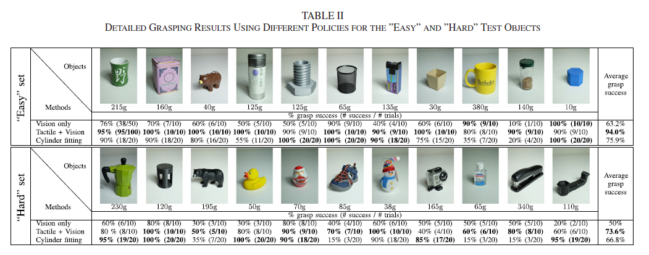
Experimental Evaluation
Robot Grasp Evaluation
Baseline：also evaluated against an approach that fits a cylinder around the object using depth data and subsequently attempt to grasp the centroid of the object using a constant grasping force of 10 N.
Notes:
将以圆柱拟合的模型作为baseline，采用10N的恒力夹取圆柱体中心位置。
测试中将物体分为难易两组，可以看到在两组中，触觉-视觉结合的模型的夹取成功率是最高的，而且触觉夹取模型在柔软物体抓取方面性能提升最大。

Slide 24
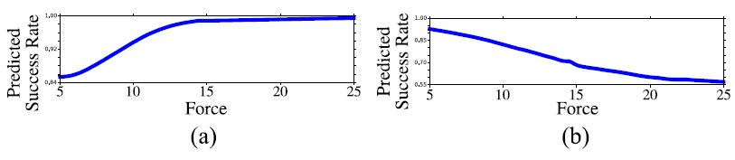

Experimental Results
We now examine qualitatively: what strategies has our model learned and what behaviors does it produce?
Grasping Force
(a) Stable grasp.
(b) Unstable grasp.
The model learned that, when stably in contact with the object, there is a correlation between force applied and success rate. However, for unstable grasps, the model learned that increasing the grasp force might misplace the object and result in an unsuccessful grasp.

Slide 25
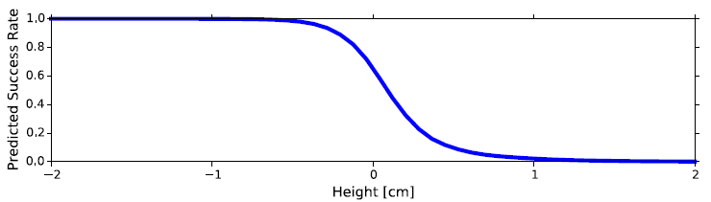
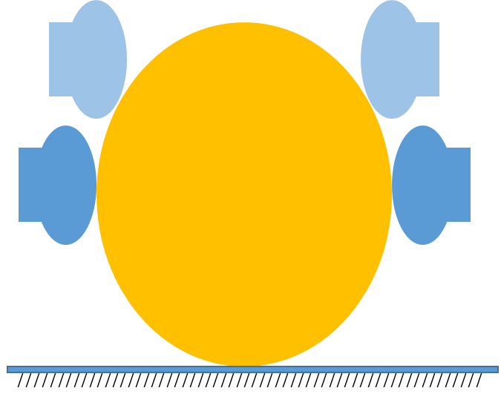
Experimental Results
We now examine qualitatively: what strategies has our model learned and what behaviors does it produce?
Grasping Force
Height and Center-of-Mass
Example of predicted grasp success rate varying the height of the fingers.
The model learned that decreasing the height of the fingers generally increases the success rate.

Slide 26
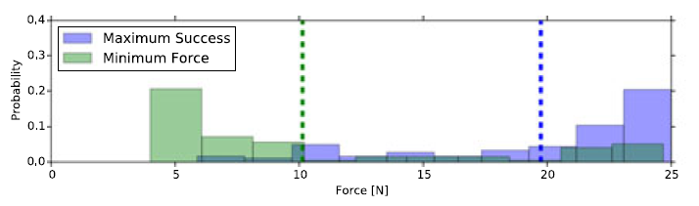
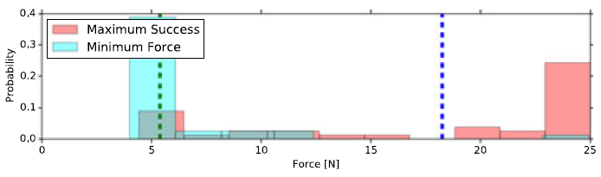
Experimental Results
We now examine qualitatively: what strategies has our model learned and what behaviors does it produce?
Grasping Force
Height and Center-of-Mass
Minimum Force Grasp
We typically do not use the strongest grasp possible, but rather employ the minimum amount of contact force, out of consideration for energy consumption and object fragility
(a) Although the success rates for the two Tactile+Vision policies are similar (95% maximum success vs 94% minimum force), the mean force applied is significantly reduced when using the minimum force policy (10 vs 20 N).
(b) The success rates for the Vision only policies is lower at 76%, but again the mean force applied is significantly reduced when using the minimum force policy (6 vs 18 N).
Histogram and mean of the forces applied in the successful grasps.

Slide 27
Discussion of Results
Strengths and weaknesses:
Minimize the applied forces while maintaining a high success rate
  Exploit the visuo-tactile action-conditioned model to minimize the applied forces while maintaining a high success rate.
Compliant, small and irregular objects.
  Based on these experiments, the largest improvements in performance of the model seem to happen in the presence of compliant objects, and objects where it is difficult to visually ascertain a good grasp, such as small or irregular objects.

Slide 28
Discussion of Results
Strengths and weaknesses:
Complex:
  The controller requires both visual and tactile operation and is complicated to design
High-bandwidth:
  The input information required by the controller is visual and tactile information.
  Both visual and tactile information are large matrix and high frequency data

Slide 29
Critique / Limitations / Open Issues
Limitations and solutions：
The action-conditioned model only makes single-step predictions, and does not perform information-gathering actions
We can use reinforcement learning models based on policy gradient algorithms to enable robots to acquire more information through perception and exploration while executing actions
Only consider relatively coarse actions
A model using fine-grained actions could more delicately manipulate the object before the grasp, and potentially react to slippage during the lift-off, however, it also increases the computing resource consumption and bandwidth requirements.

Slide 30
Prospect for Future Work
Future work that could be built on?
Action-conditional model and tactile sensing give better adaptivity and evolvability than traditional vision-based grasping.
The ability of data gathering actions during grasping helps model evolution, similar to what Tesla is doing to enhancing their auto-driving algorithm.
Work of fine-grained and continuous control loop could be built onto the action-conditional model for future work. (potentially using torque control)
* : personal idea

Slide 31
Prospect for Future Work
Future work that could be built on?
4. Use proper optimization algorithms to reduce computational cost during grasping. (for example, applying PSO to optimize decision making process when grasping)*
5. Introduce “human in the loop” into training dataset, and invent an interactive method for human to “teach”, which may be helpful for the trained model to refer to human’s tricks to grasp things.*
* : personal idea
Siyuan Wong & 2022.3.9

Slide 32
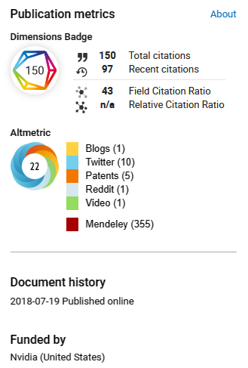
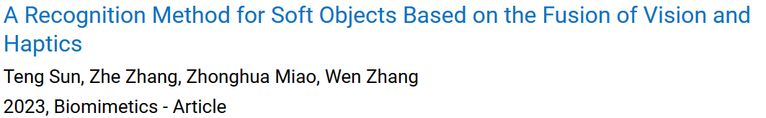
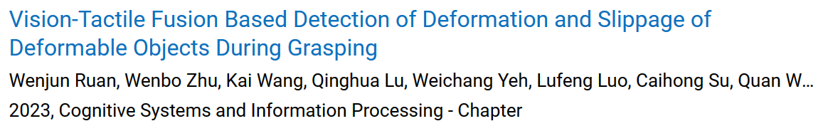
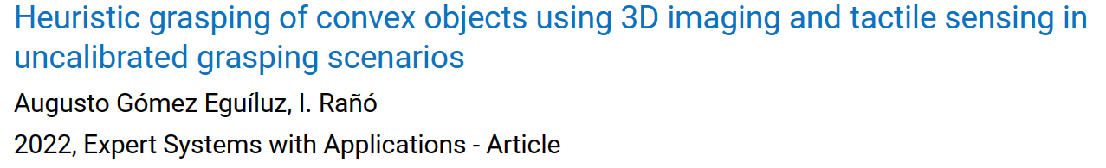
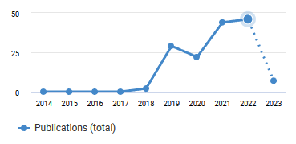
Extended Readings
Some later papers that go further from this: Dimensions
Sources of this paper:
More Than a Feeling: Learning to Grasp and Regrasp Using Vision and Touch | IEEE Journals & Magazine | IEEE Xplore
Siyuan Wong & 2022.3.9

Slide 33
Summary
Main problem:
Learning grasping and re-grasping skills using visual and tactile senses.
Why significant and hard?
- Multiple senses help robots grasp better; Using iterative method is more adaptive.
- Hardware limitations and the difficulty of multi-variable data fusion
Key limitations of prior work:
- Poor model universality and transferabllity, limited data fusion skill.
Key insight:
- Multiple-sensing and proper data fusion give better ability to grasp
- Action-conditional models help robots to "think about the future"
Siyuan Wong & 2022.3.9

Slide 34
Thanks！

