Slide 1
Point Cloud Based
Reinforcement Learning for Sim-to-Real and Partial Observability in Visual Navigation
Presenter:王鑫怡、邱望弘杰、张郁洁、黄宝仪、倪健翔
2023.3.27

Slide 2
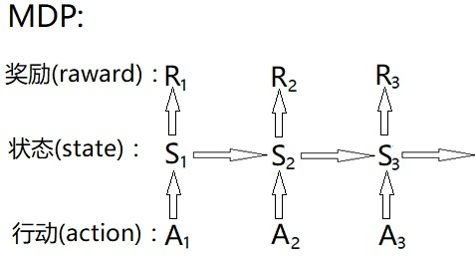
Background
Complex Robotic Tasks
Locomotion, Navigation , Manipulation, etc
Having a sequential nature
Difficult to model
Reinforcement Learning(RL)
Modeled as Markov Decision Process(MDP)
Learning a policy by interactions with the environment
Focus on the desired behavior rather than implementationh the evironment

Slide 3
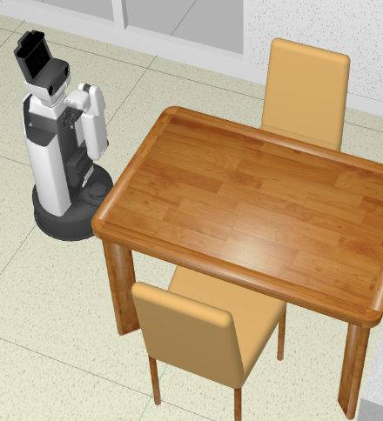
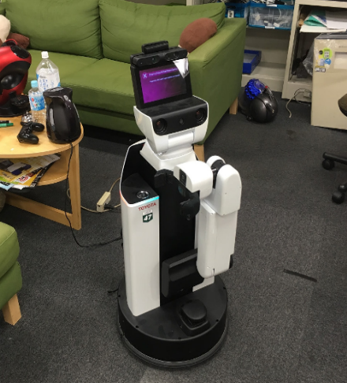
Main Problem
Property of RL
Require an enormous amount of data for training
Training in the robot is time-consuming and dangerous
Rely on training in the simulated environment
Simulated Environment
Real Environment

Slide 4
Main Problem
Property of RL
Observations are used instead of states
Limitations of Current Solutions
Hard to handle long sequences
Task-specific, Poor generalization
Limited Observability Problem
Observability refers to the ability:
output data/observation → current state
Limited observability proper of robotic tasks

Slide 5
Related Work
A: Visual Navigation
Former: perform poorly when used on unseen environments, due to a high number of environment-specific parameters.
New: using RL agents solve visual navigation tasks have almost perfect SPL score in simulations.
B: Sim-to-Real
Using photorealistic simulators reconstruct real environments.
Training agents in environments → A successful Sim-to-Real transfer obtained
Cons: Simulated robot’s performance is strongly affected when it presents changes between training and evaluation.

Slide 6
Proposed Method
The proposed method for sim-to-real transfer focuses on building a canonical space that enables observations to be projected in a standard form independent of the robot and non-essential environmental characteristics.
The method uses depth sensors, such as RGBD or depth images, but instead of considering their information as images, they are treated as point clouds.
These point clouds are projected onto a fixed frame of the robot to obtain a collection of points that are agnostic of the camera itself.
rew(t)=−slackness−distgoal(t)+success(t)

Slide 7
Theory
The method based that:
The use of point clouds is preferred over other 3D representations like meshes and shape primitives because point clouds are directly available from common robotic sensors.
How does this method implement the research:
The proposed canonical space can overcome the differences between simulations and reality, which can be separated into differences between environments, changes in the observation space, and differences in the action space.

Slide 8
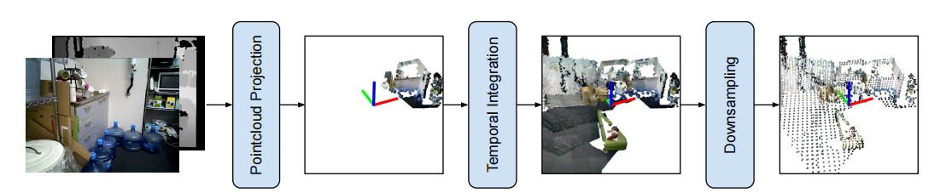
Pipeline of The Proposed Method
The RGBD image is projected into a robot’s frame (e.g., the robot’s base) using robot specific information, making it highly invariant to the particular robot. Afterward, previous observations are explicitly integrated, addressing partial observability. Finally, the resulting point cloud is down-sampled due to practical considerations.

Slide 9
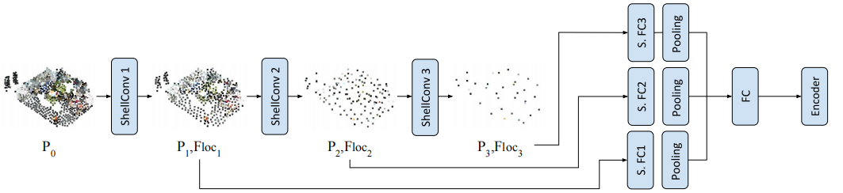
Modified ShellNet Architecture
Pi has dimensions Ni×3, Floci have dimensions Ni×fi , where Ni is the decreasing number of points at each layer, and fi is the number of features. Local features do not contain information of their associated points, so that particular information is added using shared-weights fully connected layers, and then pooled to obtain a fifixed-size vector. Finally, features from different levels are combined using similar arguments.

Slide 10
Experimental Result
The experimental results of the paper can be divided into two main parts: sim-to-sim and sim-to-real experiments.
Sim to Sim：
Sim to Real： HSR robot ， ORB-SLAM2
baseline
experiment
RGBD
MP3D and Gibson

Slide 11
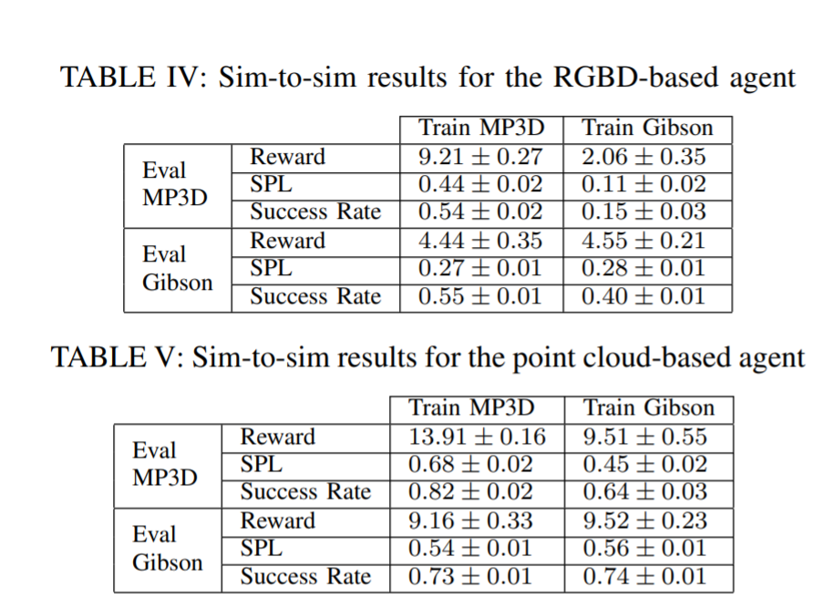
Set-Up：sim-to-sim
Set-Up
Two different simulation environments for experiments: MP3D and Gibson, for simulating more challenging and simpler situations. The baseline is RGBD.
Result
Analysis
Point cloud-based reinforcement learning methods have excellent performance and generalization ability in visual navigation, especially when faced with more challenging situations.

Slide 12
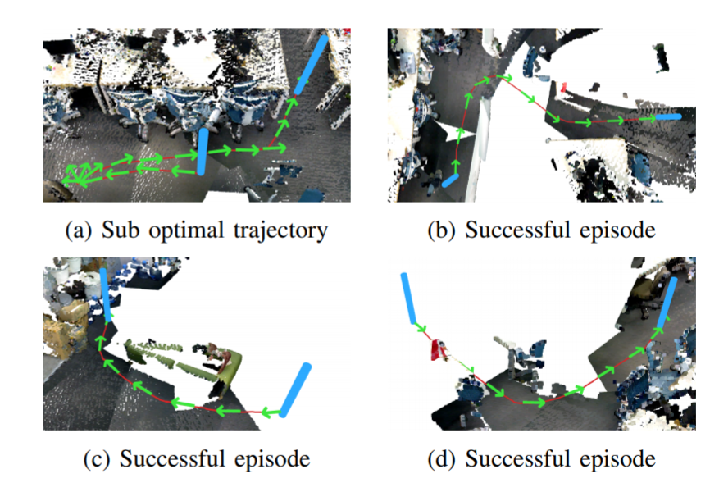
Set-Up：sim-to-real
Set-Up
Use a Toyota HSR robot to conduct experiments to verify the performance.
Real-world methods require integration of observations through a time-integrated system: ORB-SLAM2.
Used the full approach in experiments: domain randomization in simulated training, and simulated domain randomization in the real world...
Result
Analysis
Relative to RGBD-baseline, the proposed agent can navigate through most configurations, solving many non-trivial cases.
Most suboptimal trajectories occurred when the target was behind the robot, while most failures were collisions with objects that were never in view, and collisions with edges of difficult objects such as chair legs.

Slide 13
Future Work for Paper
Project extension from the author:
Most errors corresponds to objects which were never seen, RL signals not be enough
→ Directlyself-supervised curiosity & Common sense in the point cloud space
Presents more benefits for more challenging visual navigation tasks.
From our points of view:
Introduce supervised learning in reinforcement learning to provide the correct strategy as supervision information.

Slide 14
Summary
Contribution:
  (1)Propose a method propose a method to achieve out-of-the-box sim-to-real;
  (2)Explicitly address the limited observability proper of robotic tasks;
  (3)Present a point cloud network design that extracts multi-scale features.

Slide 15
Extended Readings
Cited in papers:
[1] V. Mnih, K. Kavukcuoglu, D. Silver, A. A. Rusu, J. Veness, M. G. Bellemare, A. Graves, M. Riedmiller, A. K. Fidjeland, G. Ostrovski, S. Petersen, C. Beattie, A. Sadik, I. Antonoglou, H. King, D. Kumaran, D. Wierstra, S. Legg, and D. Hassabis, “Human-level control through deep reinforcement learning,” Nature, vol. 518, no. 7540, pp. 529–533, 2015.
[2] Y. Zhu, R. Mottaghi, E. Kolve, J. J. Lim, A. Gupta, L. Fei-Fei, and A. Farhadi, “Target-driven visual navigation in indoor scenes using deep reinforcement learning,” in IEEE International Conference on Robotics and Automation (ICRA), 2017.
[3] J. Zhang, L. Tai, P. Yun, Y. Xiong, M. Liu, J. Boedecker, and W. Burgard, “Vr-goggles for robots: Real-to-sim domain adaptation for visual control,” IEEE Robotics and Automation Letters, vol. 4, no. 2, pp. 1148–1155, April 2019.
[4] X. B. Peng, M. Andrychowicz, W. Zaremba, and P. Abbeel, “Sim-to_x0002_real transfer of robotic control with dynamics randomization,” in IEEE International Conference on Robotics and Automation (ICRA), 2018.
[5] M. Jaderberg, V. Mnih, W. M. Czarnecki, T. Schaul, J. Z. Leibo, D. Silver, and K. Kavukcuoglu, “Reinforcement learning with unsupervised auxiliary tasks,” in International Conference on Learning Representations (ICLR), 2017.
[6] F. Leiva, K. Lobos-Tsunekawa, and J. Ruiz-del Solar, “Collision Avoidance for Indoor Service Robots Through Multimodal Deep Reinforcement Learning,” in RoboCup 2019: Robot World Cup XXIII, 2019.

Slide 16
Q&A

