Slide 1
Meta Reinforcement Learning for
Optimal Design of Legged Robots
presentor: 沈奕宁、
2024.3.19

Slide 2
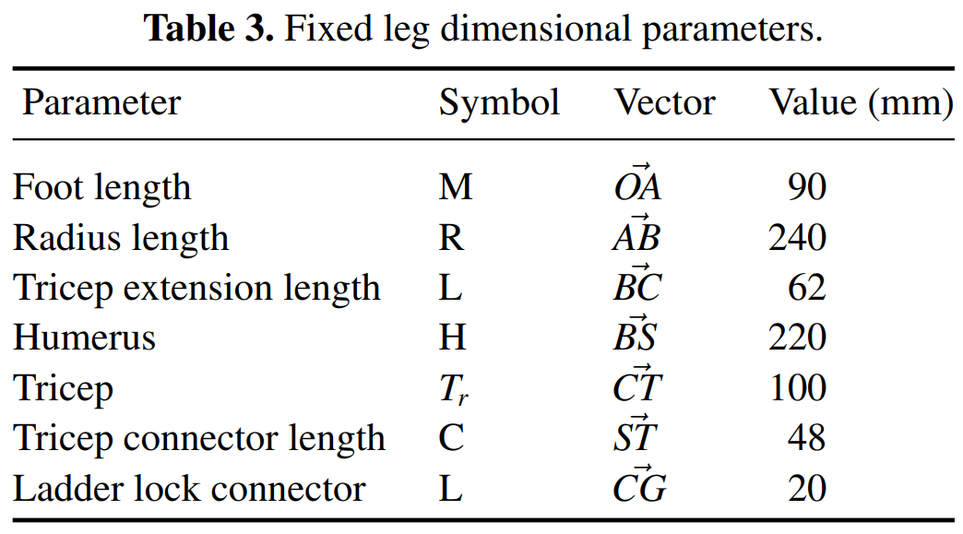
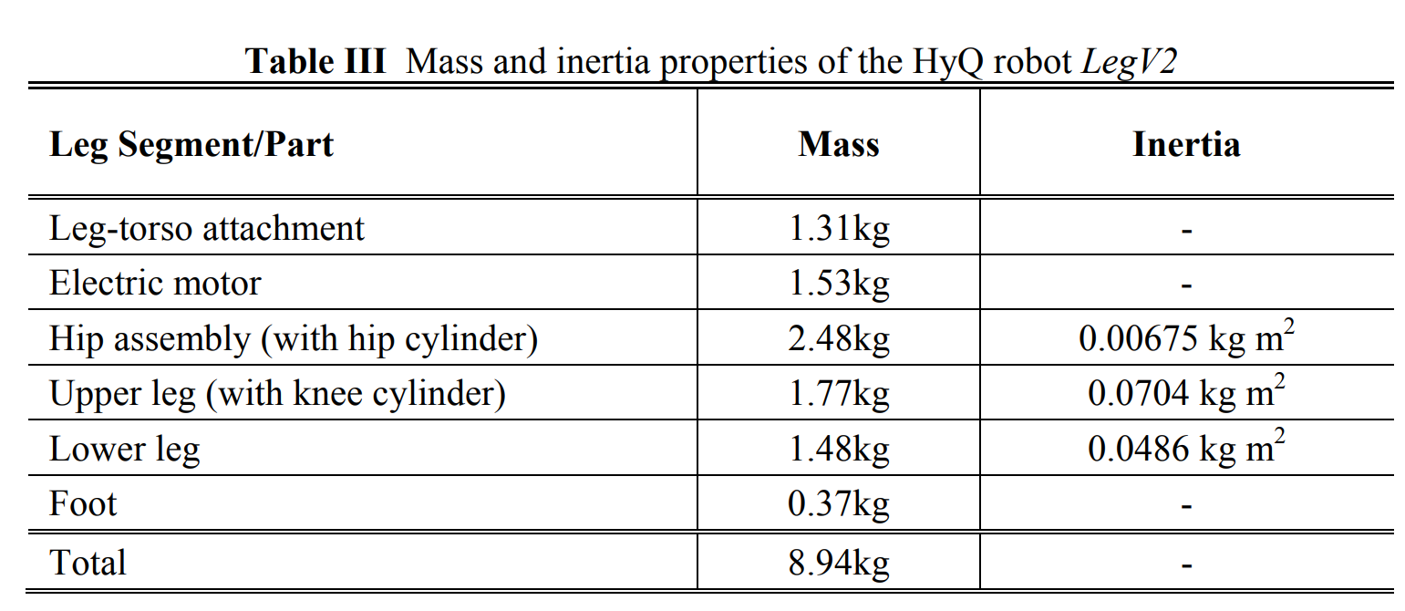
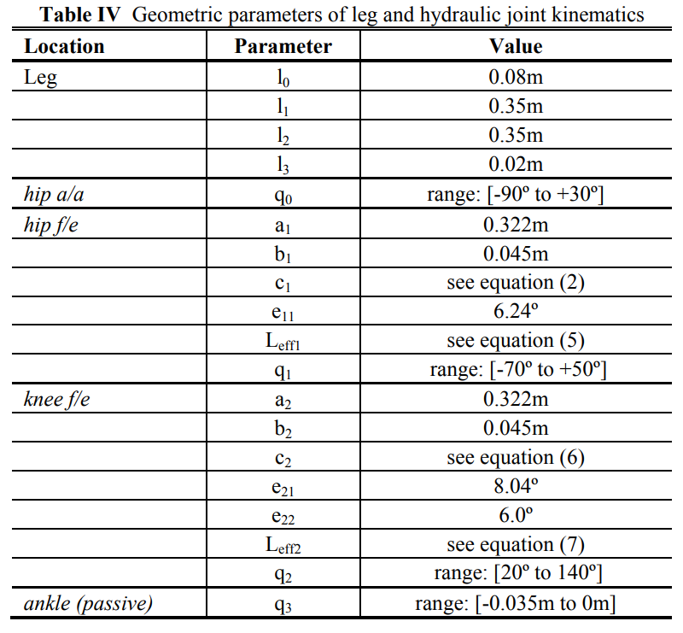
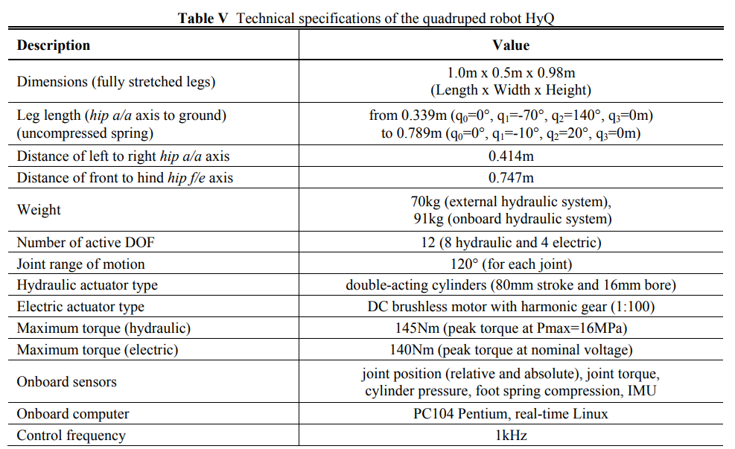
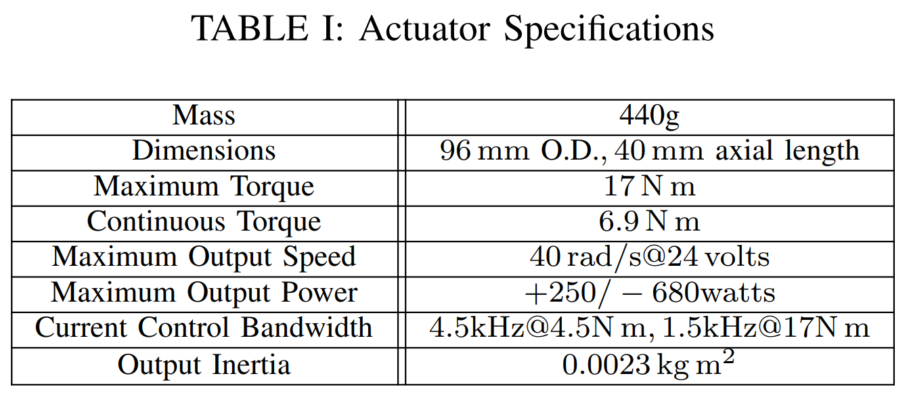
Main Problem
Unclear correlation between design parameters and robot behavior
Leg-Shape (A. Ananthanarayanan et al., 2012)
HyQ (C. Semini et al., 2011)
Mini Cheetah (B. Katz et al.,2019)

Slide 3
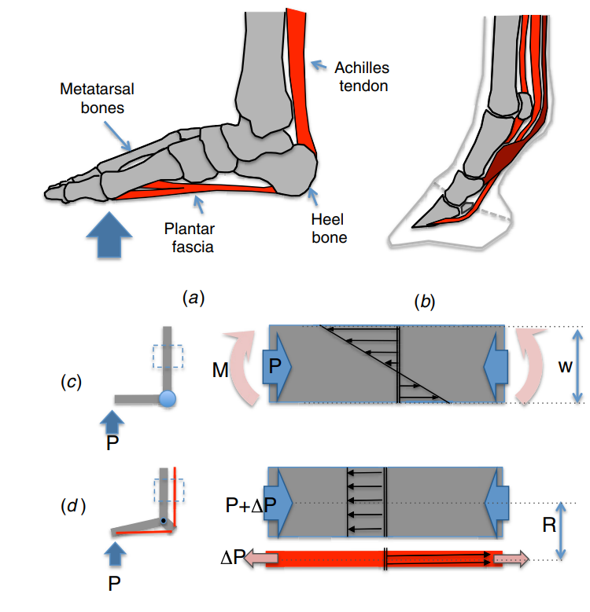
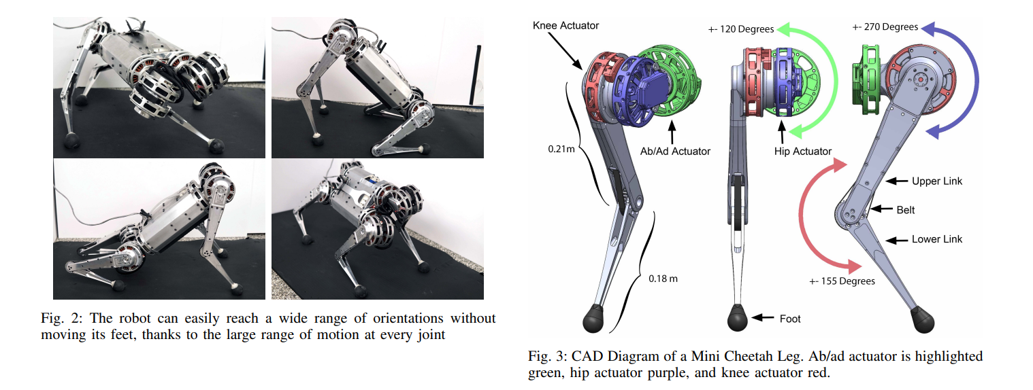
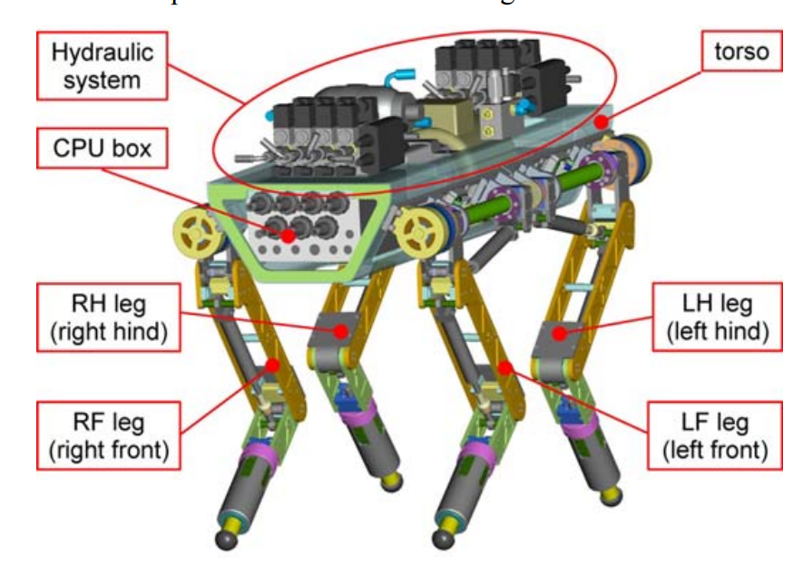
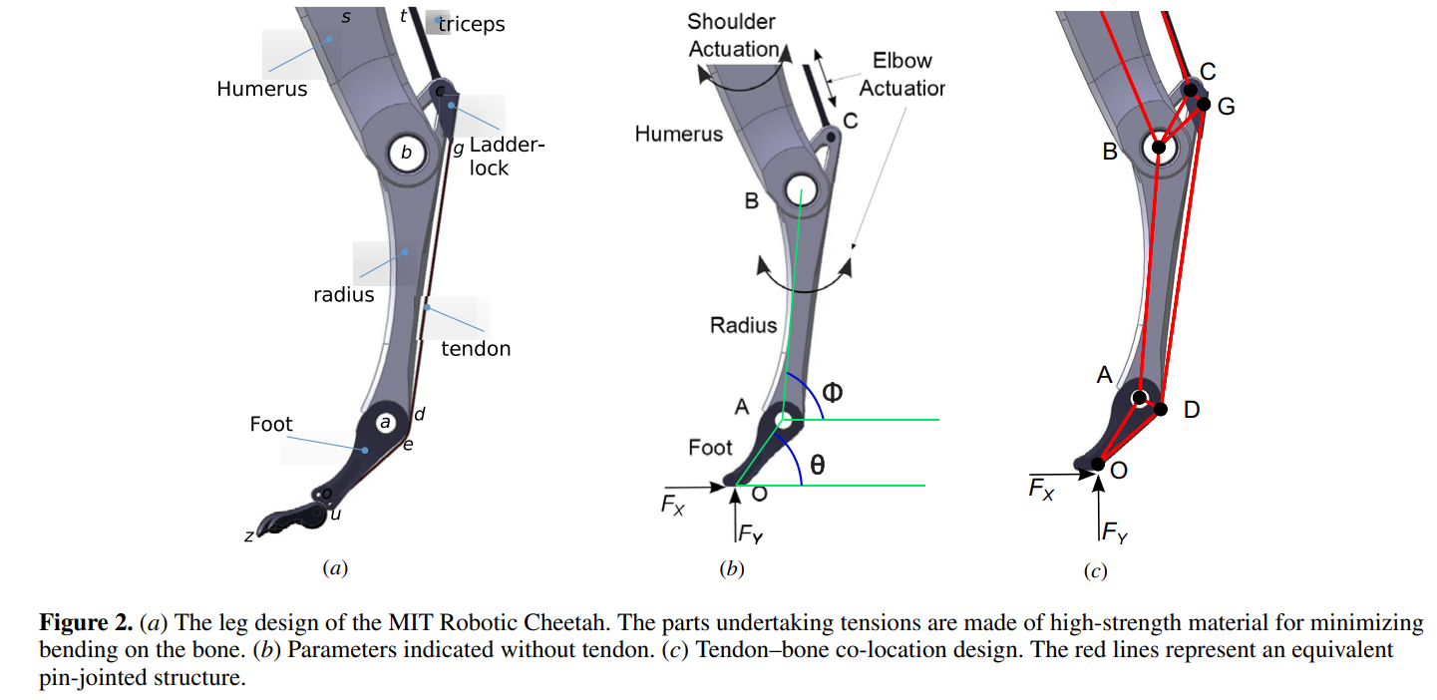
Limitations of Prior Work Ⅰ
In conventional paradigm of design optimization
Sparse principle in conventional robotic design
·Bio-inspired Leg
(A. Ananthanarayanan et al., 2012)
·Cheetah Leg Design by Approximation
(B. Katz et al.,2019)
·HyQ
(C. Semini et al., 2011)
“This elasticity, however, is believed to have a negative impact on the controller bandwidth and has to be further analysed.
The performance of two-stage servovalves with zero overlap and faster response are currently being investigated along with the effect of hose length on the actuator bandwidth. ” (C. Semini et al., 2011)

Slide 4
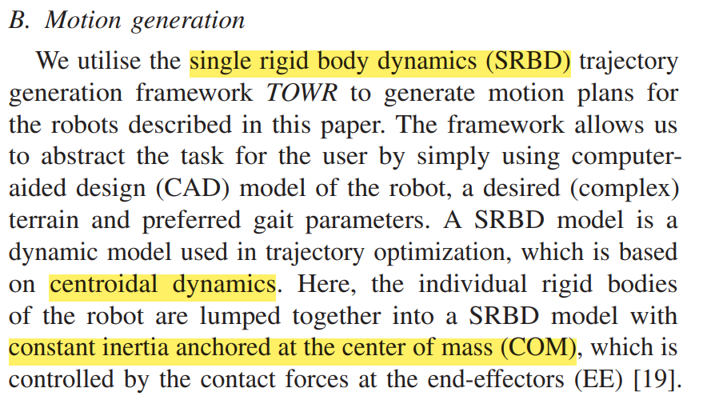
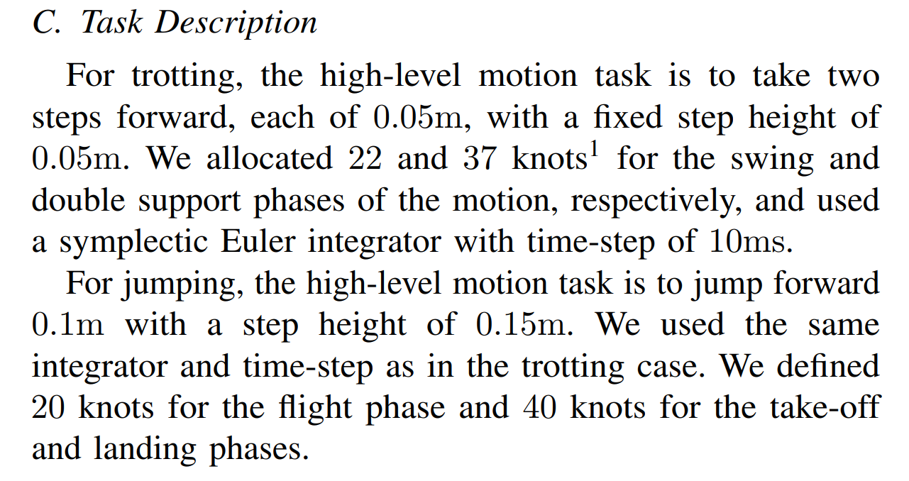
Limitations of Prior Work Ⅱ
In computational paradigm of design optimization
Dependence of model-based approach in computational optimization
Over-simplified model constraints
Results specifying in predetermined tasks or trajectories

Slide 5
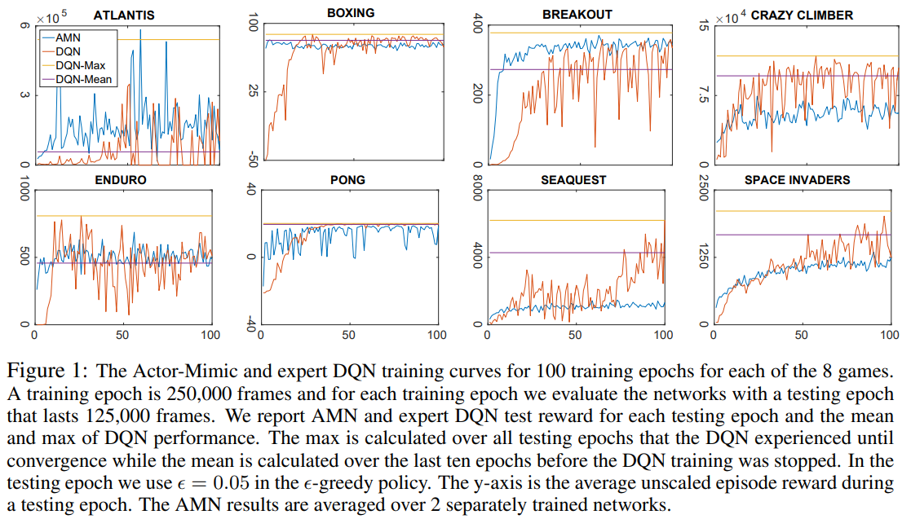
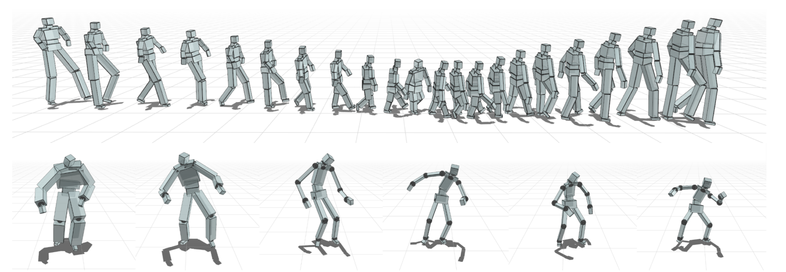
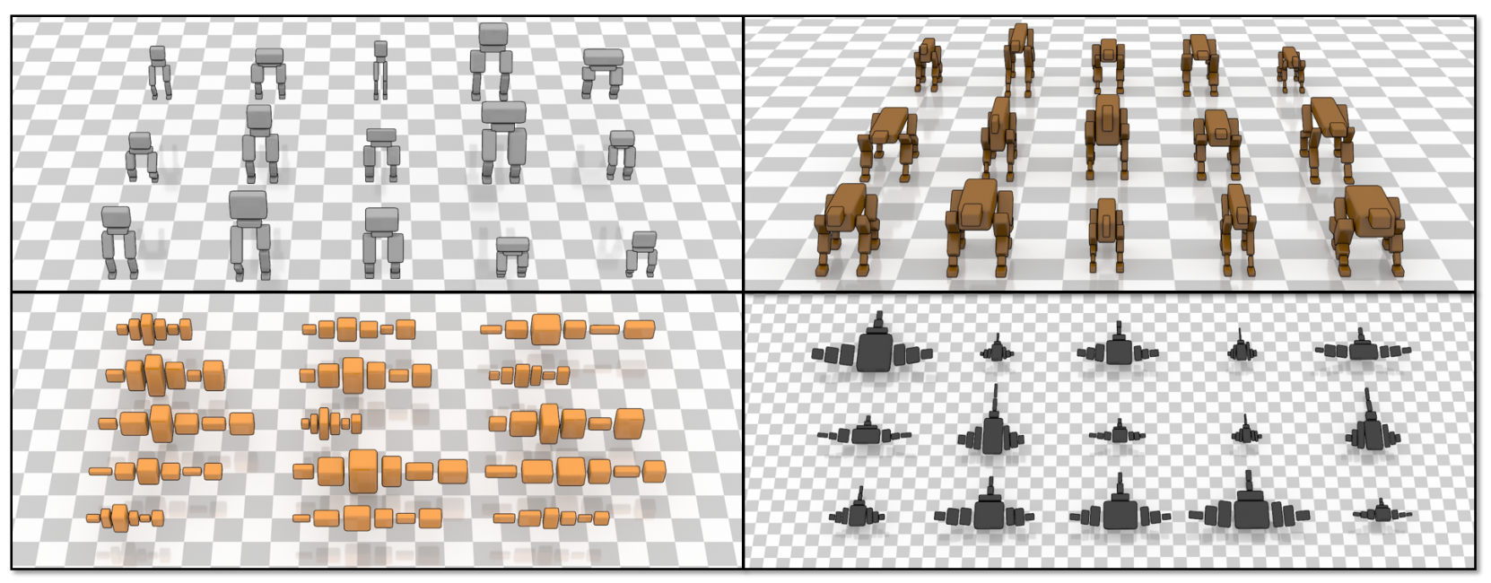
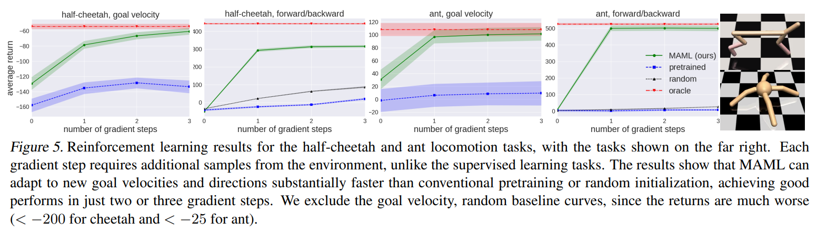
Model-Free RL in Design Parameters Controlling
Single Controller managing a range of parameters
(J. Won et al., 2019)
Actor-Mimic multi-task DRL model
(E. Parisotto et al., 2015)
Multi-task training policy based on Meta-RL
(C. Finn et al., 2017)

Slide 6
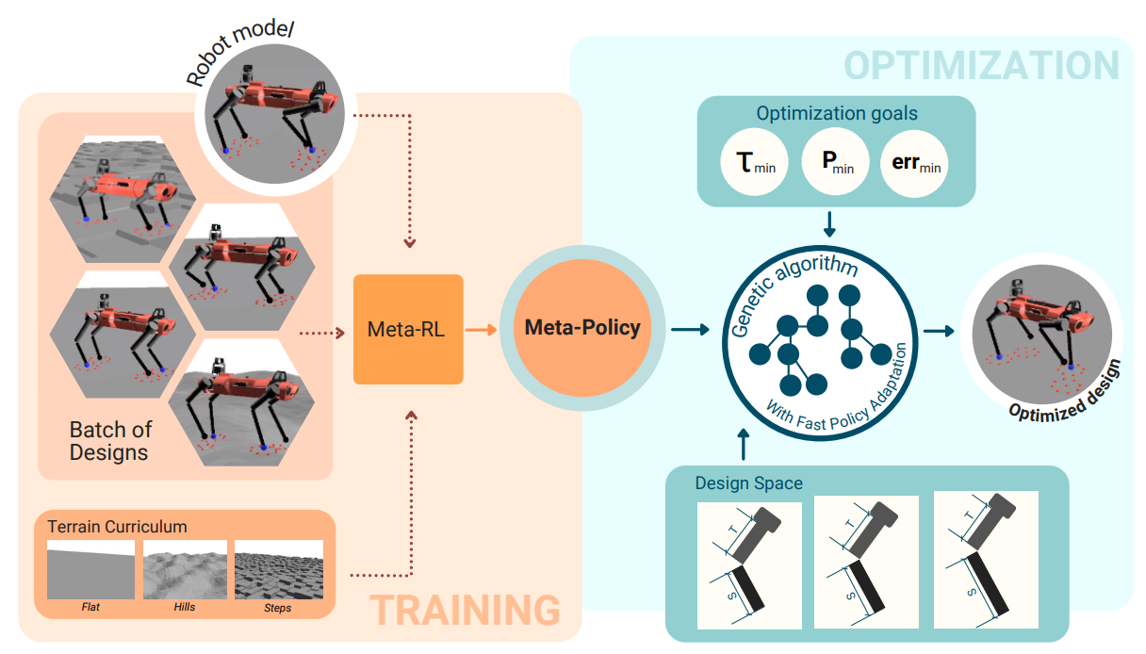
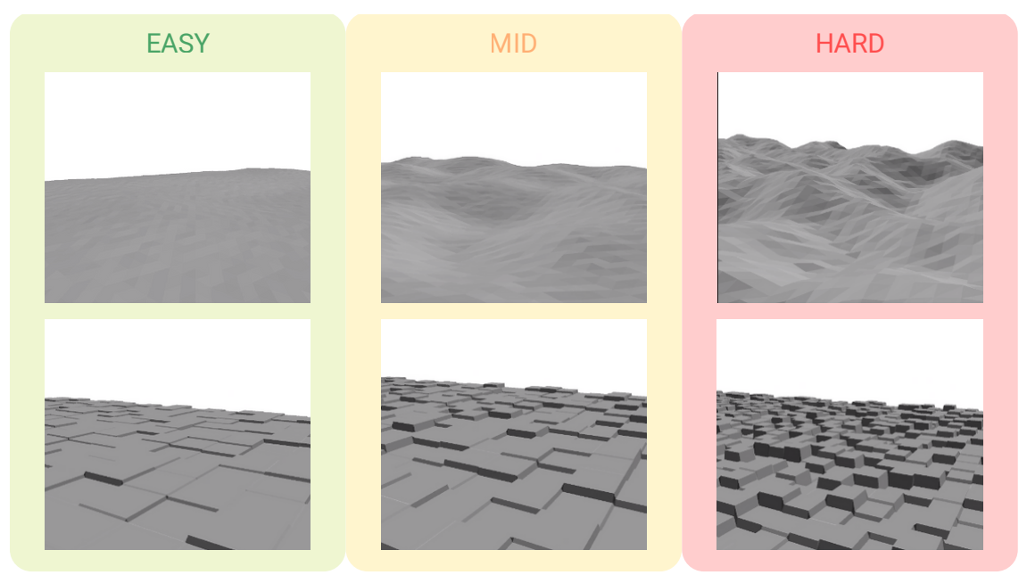
Proposal of Meta-RL to Quadrupedal Locomotion
A robust, adaptive neural network controller framework
A Meta-RL locomotion control policy
Experimental results on a quadrupedal robot

Slide 7
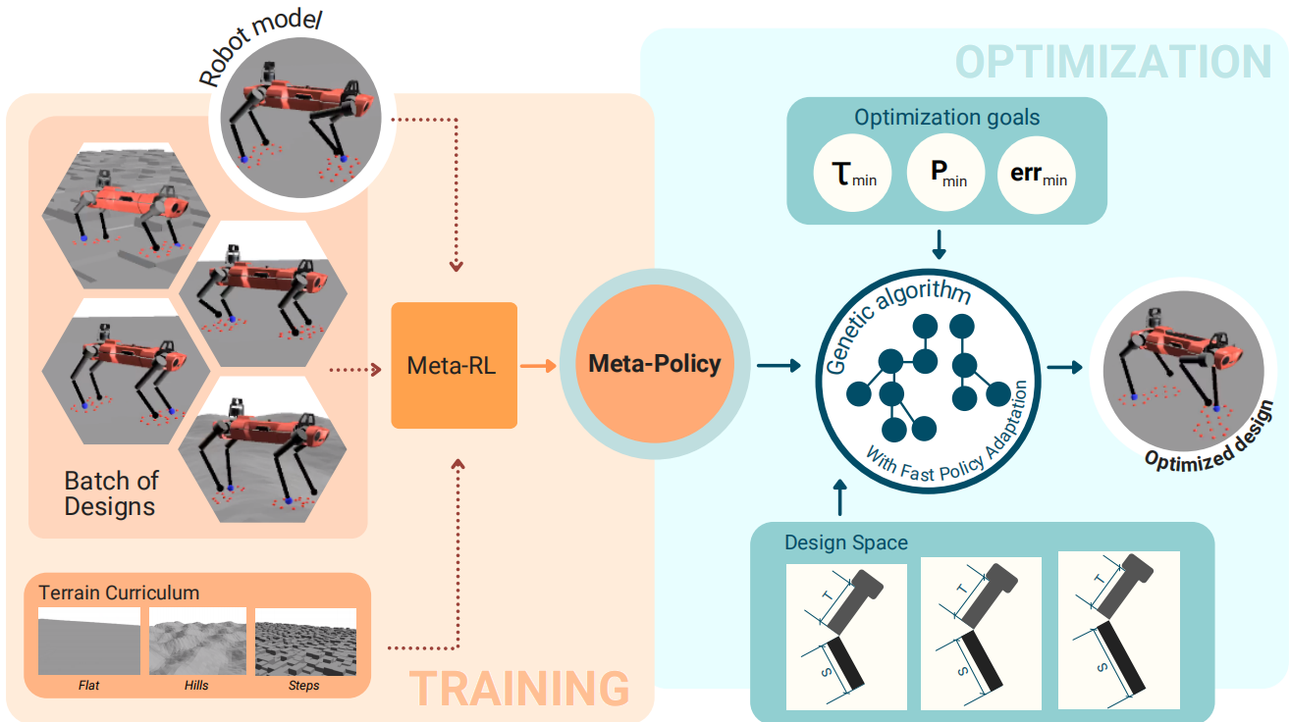
Proposed Approach
Policy training:
Meta Reinforcement Learning(Meta-RL)
Design optimization:
genetic algorithm

Slide 8
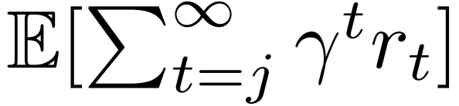
Algorithm
Markov Decision Process(MDP)
Defined by:
A tuple of state space S
Action space A
The transition probability density
A reward function :
The objective of RL:
Obtain an optimal policy π∗ that maximizes the cumulative discounted rewards

Slide 9
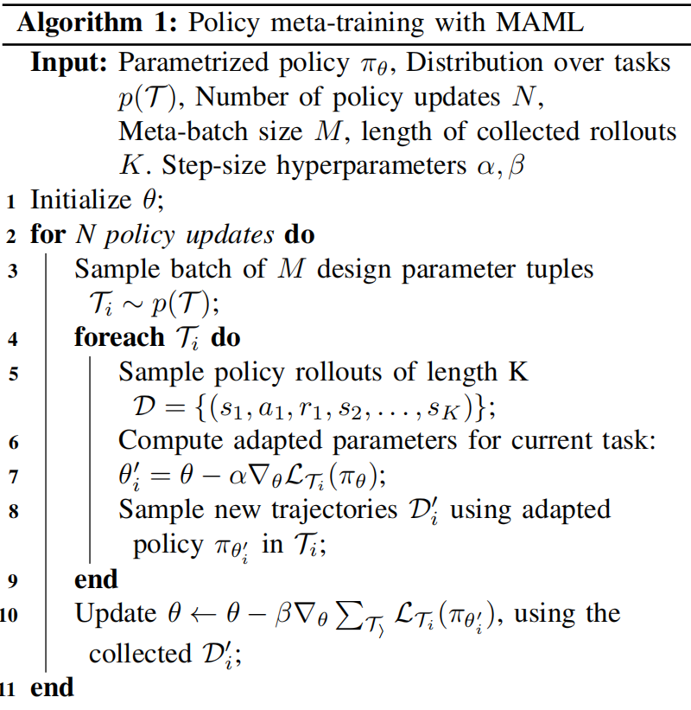
Algorithm
Fast Adaptation with Meta-learning
Model-Agnostic Meta-Learning (MAML)
a distribution of tasks p(T)
training process:

Slide 10
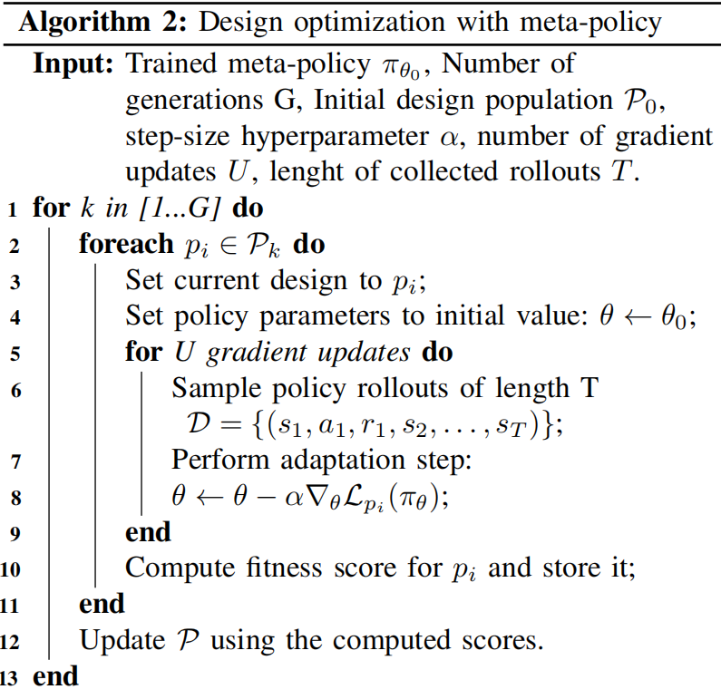



Algorithm
Design Optimization
Obtain a set of design parameters
that maximizes a given fitness function
Gradient-free algorithm
Use CMA-ES for the optimization
The fitness function (the Monte-Carlo estimation):

Slide 11
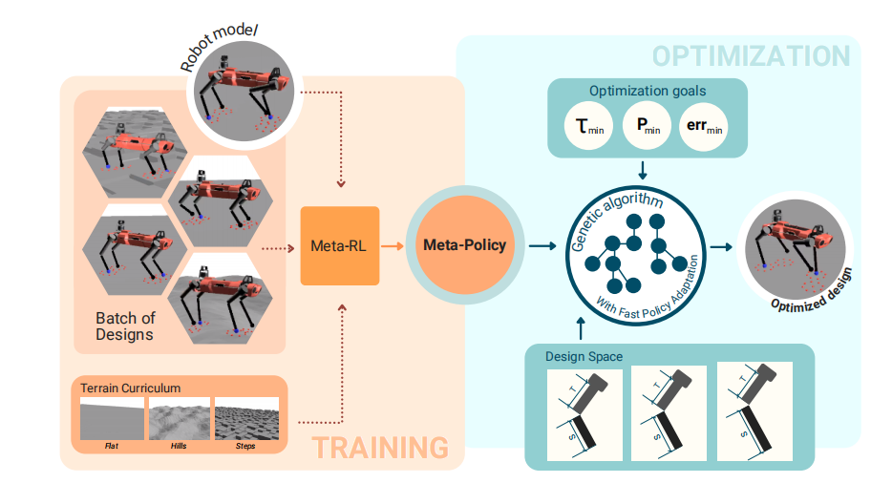
Experimental Setup
Domain
datasets：
  some established leg parameters
  tasks：
  speed tracking error
  joint torque
  joint positive mechanical power
robot hardware setups：
  simulated environment Raisim, includes simplified models for the speed and torque limitations of real actuators.

Slide 12
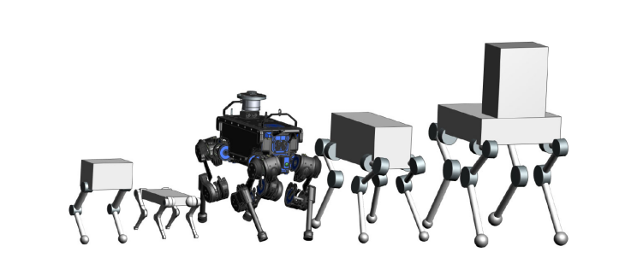
Experimental Setup
Baselines:
Vitruvio
Scientific hypotheses tested:
Using a design optimization framework based on meta reinforcement learning (Meta RL) can quickly adapt to different design instances and achieve near optimal performance.

Slide 13
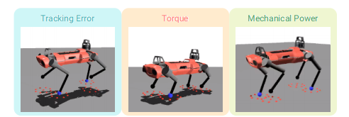
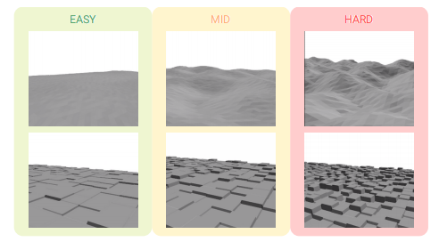
Experimental Setup
Evaluate metrics:
Analyzing the average rewards obtained under different parameters compared to naive strategies and specifically given strategies.

Slide 14
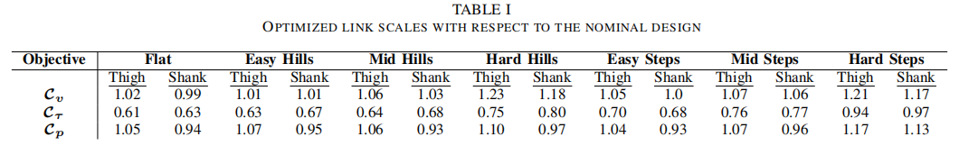
Experimental Results
1. The meta-policy consistently outperforms the naive multi-task policy in all cases.
2. After the adaptation steps, the meta-policy reaches rewards comparable to the specialized policies, achieving close-to optimal capabilities.

Slide 15
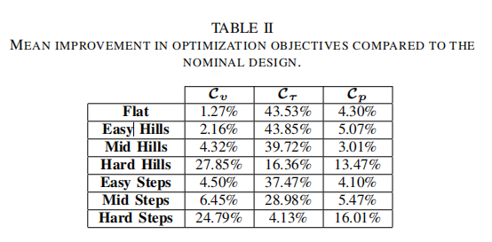
Experimental Results

Slide 16
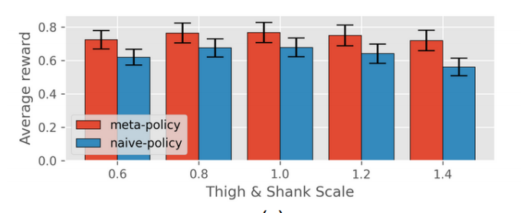
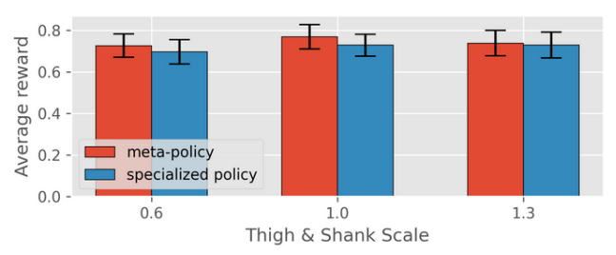
Experimental Results
The most interesting result is:
They further verify the performance of our meta-policy by comparing it against a set of policies trained for specific designs (specialized policy). After the adaptation steps, the meta-policy reaches rewards comparable to the specialized policies, achieving close-to optimal capabilities

Slide 17
Discussion of Results
They would like to highlight the flexibility of their approach in considering the robot’s operating environment during the design process, which can be limited in the conventional optimization-based approach, where we need analytic dynamics models.
他们想强调他们方法的灵活性，将机器人的操作环境在设计过程中就加入考虑。这在传统的，需要分析动力学模型的基于优化的方法中是受限的。

Slide 18
Limitations
1.The cost functions could not capture the actual dynamics of the system.
2.The ratio of different sources isunclear

Slide 19
Future Work for Paper
Subsequent optimization work
Adding cost functions for the design optimization.
Adding more design parameters including discrete and continuous.
Build prototypes of optimized designs and validate them on the physical system.

Slide 20
Extended Readings
References & related readings for this paper
[1] M. Chadwick et al., “Vitruvio: An open-source leg design optimization toolbox for walking robots,” IEEE Robotics and Automation Letters, vol. 5, no. 4, pp. 6318–6325, 2020.
[2] F. De Vincenti et al., “Control-aware design optimization for bioinspired quadruped robots,” in 2021 IEEE/RSJ International Conference on Intelligent Robots and Systems (IROS), 2021, pp. 1354–1361.
[3] A. W. Winkler et al., “Gait and trajectory optimization for legged systems through phase-based end-effector parameterization,” IEEE Robotics and Automation Letters (RA-L), vol. 3, pp. 1560–1567, July 2018.
[4] T. Miki et al., “Learning robust perceptive locomotion for quadrupedal robots in the wild,” Science Robotics, vol. 7, no. 62, 2022.

Slide 21


Extended Readings
Annual Conference on Robot Learning
http://corl2023.org/ http://corl2022.org/

Slide 22
Summary
The reading is discussing optimal design of legged robots by using meta reinforcement learning.
It is hard because there are many parameters affect final performance.
The key limitation of prior work is the design needs tedious manual tuning.
The key insight of the proposed work is Model-Free Reinforcement Learning for robot controlling.
This paper demonstrate that RL is an ideal solution to solve the inner optimization problem of the design optimization.

Slide 23
Thank you for your listening!
沈奕宁 11911613 许哲睿 12011230
雍志涛 12110824 范王卓12111942
乔凯 12211112 张草萌 12112223

