Slide 1
Fruit Classification
Based on the depth camera
Group9
Present 1 蒋李晟琦: 12110727 | Present 2 黑铂涵: 11912624
Present 3 谭焯灵: 12112009 | Present 4 牛牧: 12112004
2024/3/26

Slide 2
Proposed Project Title Summary
As the demand for fruit continues to grow, the fruit retail market is also expanding.In fruit sales, fruit sorting is a very important
step. Fruit sorting methods are divided into manual sorting and machine sorting, among them, manual sorting is still the most common
way used by fruit farmers at present, but its sorting efficiency and accuracy are relatively low. Therefore, we plan to select the size
of the fruit through the depth camera, and further classify the receiving place through the barcode identification on the fruit, so that
the fruit sorting can be completed quickly and efficiently.The literature we searched was mainly on visual fruit recognition and
added a deep learning system to optimize this process.
The method is mainly divided into two categories, one is weighing method, that is, the fruit is automatically measured on the
weighing plate of the classifier, the data is fed back to the central control system, and then the system issues instructions to send
the fruit to the designated container to complete the sorting of the fruit within a certain weight range, which needs to design an
appropriate processing rate according to metrology, electronics and cybernetics and other theories to improve the classification
efficiency;
The first method is weighing method, the fruit is automatically measured on the weighing plate of the classifier, the data is fed back to the central control system, and
then the system issues instructions to send the fruit to the designated container to complete the sorting of the fruit within a certain weight range.
The second is the sieve leakage method, especially suitable for small size, brittle texture of the fruit, the whole equipment needs to be arranged by 2 or more drums
(without bottom and cover) hanging horizontally connected, and there is a certain inclination Angle with the horizontal line, each barrel wall has the same size,
closely arranged round holes, but the size of the round holes in each barrel is different, from top to bottom, the round holes of the barrel increase in sequence.
We propose three methods: Convolutional Neural Networks (CNN), Random Forest, and Reinforcement Learning. CNNs excel in image recognition by learning image
features and classification. Random Forest uses multiple decision trees to classify and regress inputs. Reinforcement Learning guides decision-making with reward
signals. Each method involves data preparation, model training, and prediction. For CNNs, network architecture, optimizer, and batch normalization can be adjusted.
Random Forest benefits from parameter tuning, feature selection, and integration strategies. Reinforcement Learning can employ exploration functions and reward
function improvements. Advanced algorithms like DQN, A3C, and PPO can enhance training efficiency.
Results will be presented in tables. Including the training set of fruit recognition detection and the accuracy of detection set;
the comparison of identification accuracy under different network configurations; the change of accuracy and loss rate with cycle.
Data will all be evaluated using cross-tests to reduce the error.

Slide 3
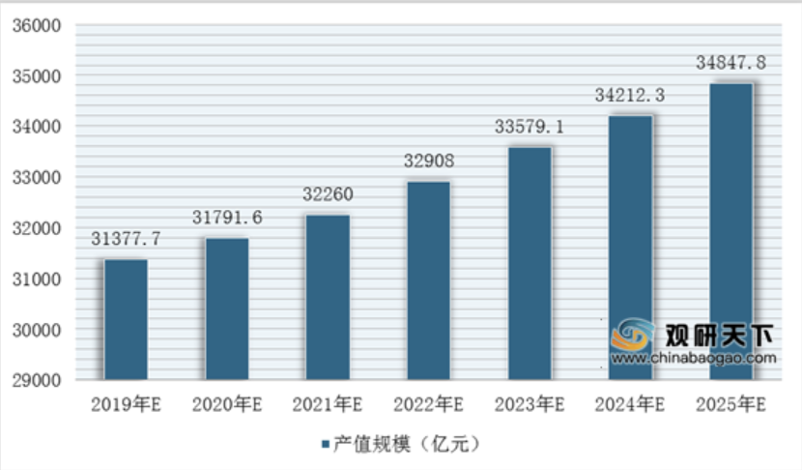
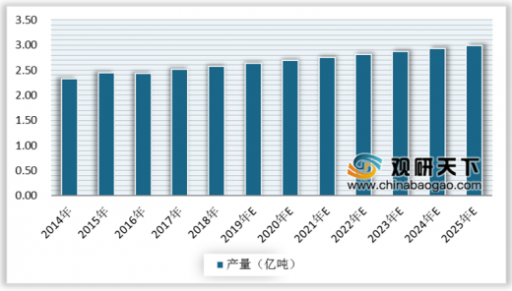
Motivation
Forecast of product scale of the fruit industry in 2019-2025
Market size trend of the fruit industry from 2014 to 2025
Fruit consumption has been growing year after year, and the
market is constantly expanding. We need a more efficient
production chain to meet the needs of the people.

Slide 4
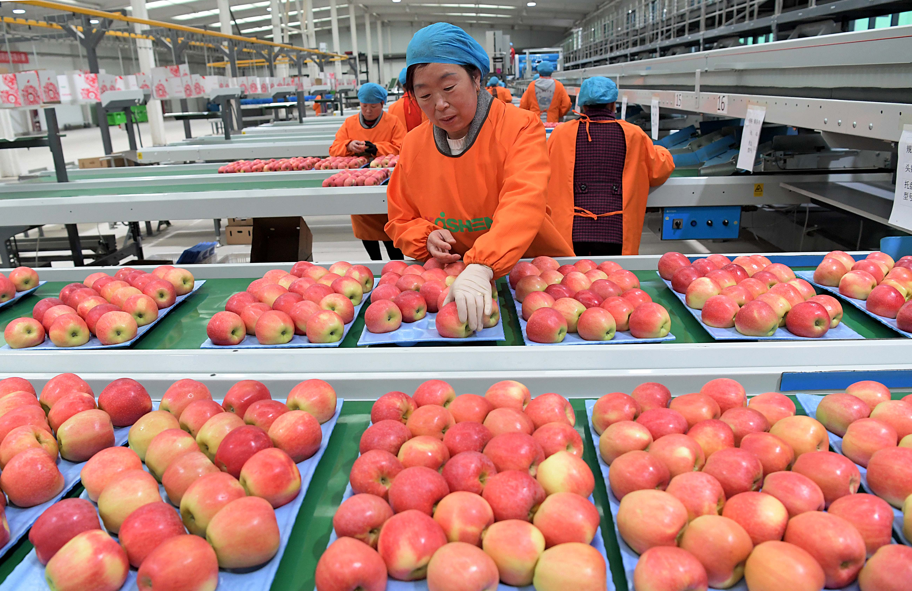
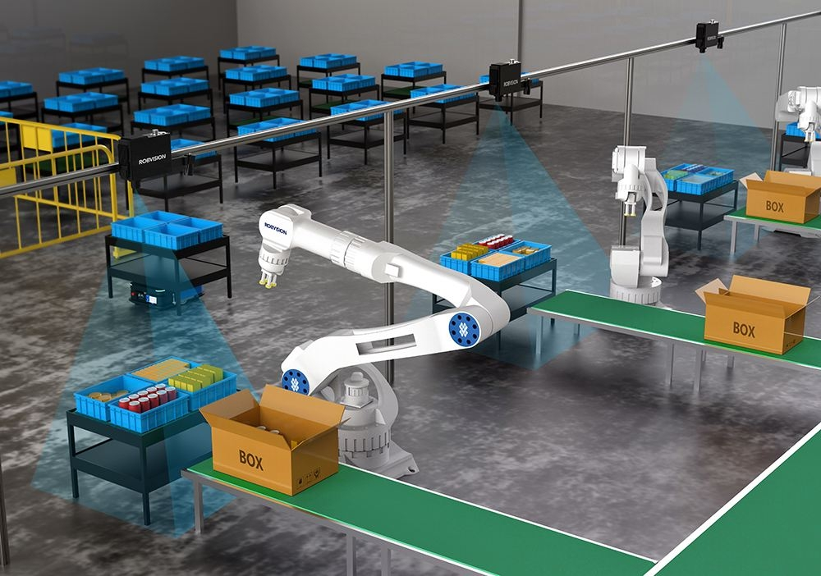
Backgroud and Related Essay
Manual Sorting
Machine Sorting
Fruit sorting methods are divided into manual
sorting and machine sorting, among them,
manuak sorting is still the most common.
Background:刘俊,郭磊磊,郭琳,等. 基于PLC的球形水果大小自动分拣系统设计[J]. 工业控制计算机,2021,34(5):126-127,132. DOI:10.3969/j.issn.1001-182X.2021.05.051.
Context:冉涌,郎朗,徐明灿. 水果视觉分级检测线控制器设计[J]. 安徽电子信息职业技术学院学报,2023,22(1):1-5. DOI:10.3969/j.issn.1671-802X.2023.01.001.
李赟,刘思雨,朱川,等. 基于深度学习的水果识别系统设计[J]. 农机化研究,2023,45(10):187-191. DOI:10.3969/j.issn.1003-188X.2023.10.029.
朱冬梅.基于深度学习的水果分类研究[D].赣南:赣南师范大学,2022.

Slide 5
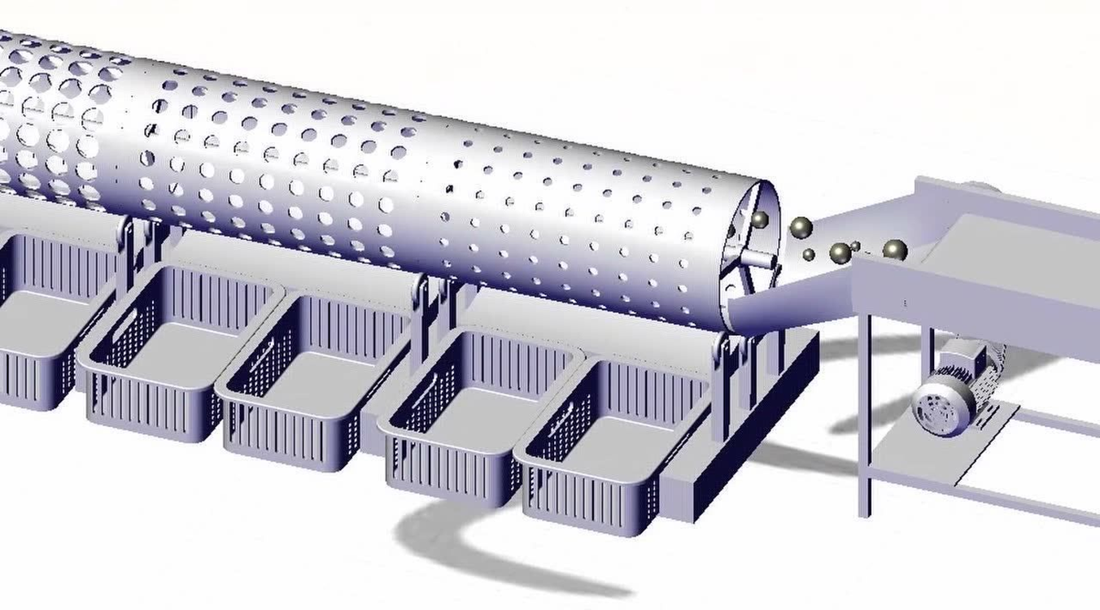
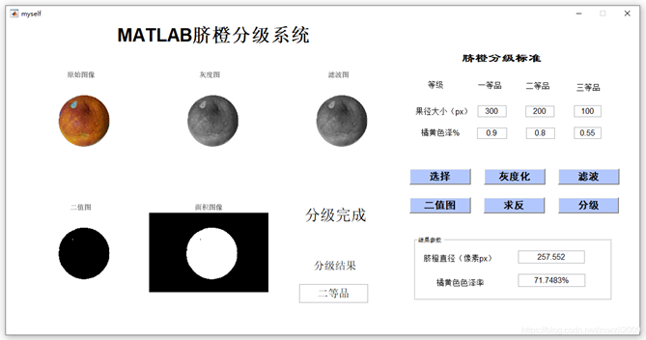
How to collect data
Fruit size classification
The method is mainly divided into two categories, one is weighing method,
The second is the sieve leakage method which is the most important, especially suitable for small size, brittle texture of the fruit, the whole equipment needs to be arranged by 2 or more drums (without bottom and cover) hanging horizontally connected, and there is a certain inclination Angle with the horizontal line, each barrel wall has the same size, closely arranged round holes, but the size of the round holes in each barrel is different, from top to bottom, the round holes of the barrel increase in sequence. The ground corresponding to each drum is placed with a material container. The fruit is sent into the highest drum by the elevator, the drum is rotated by the motor, and the fruit rolls in the drum with the rotation of the drum, and the fruit with a diameter less than the circular hole in the barrel wall is leaked out and falls into the material container placed on the ground.
Fruit color classification
The basic principle of fruit color classification is that before the fruit is transported to the electron luminescence point, the reflected light is accepted by the phototube of the measured wavelength, and the reflected light of different wavelengths represents the different colors of the fruit

Slide 6
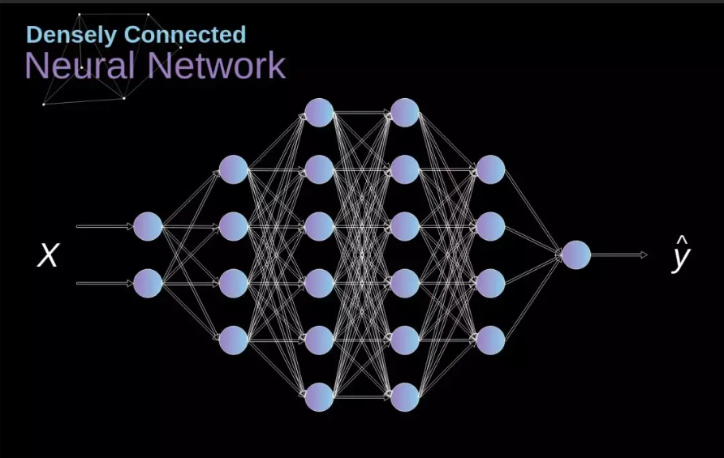
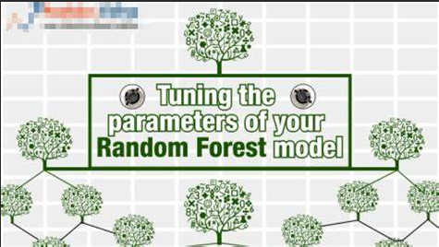
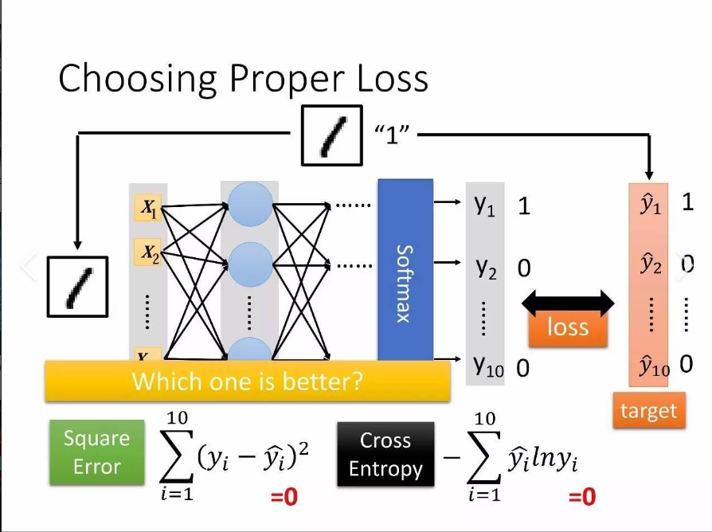
What method or algorithm are you proposing? If there are existing implementations, will you use them, and how? How do you plan to improve or modify such implementations?
We propose three approaches: Convolutional neural networks (CNNS), random forests, and reinforcement learning. cnn excels in image recognition by learning image features and classification. A random forest uses multiple decision trees to classify and regression inputs. Reinforcement learning uses reward signals to guide decision making. Each approach involves data preparation, model training, and prediction. For CNNS, you can adjust the network architecture, optimizer, and batch normalization. Random forests benefit from parameter tuning, feature selection, and integration strategies. Reinforcement learning can be improved using exploration functions and reward functions. DQN, A3C, PPO and other advanced algorithms can improve training efficiency

Slide 7
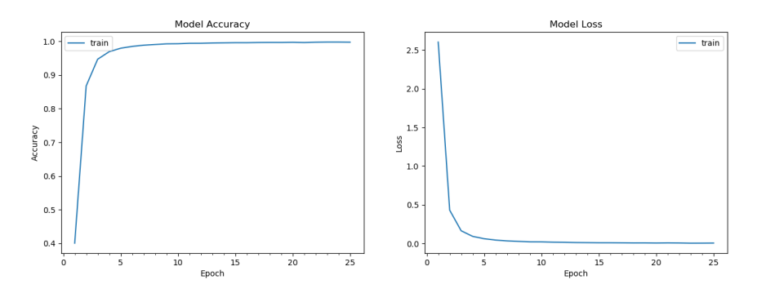
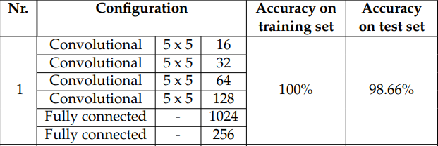
Evaluate results
Results of training different network configurations
Evolution of accuracy and loss during training
Every epoch we will calculate the accuracy using cross-validation

Slide 8
Thank you！

