Slide 1
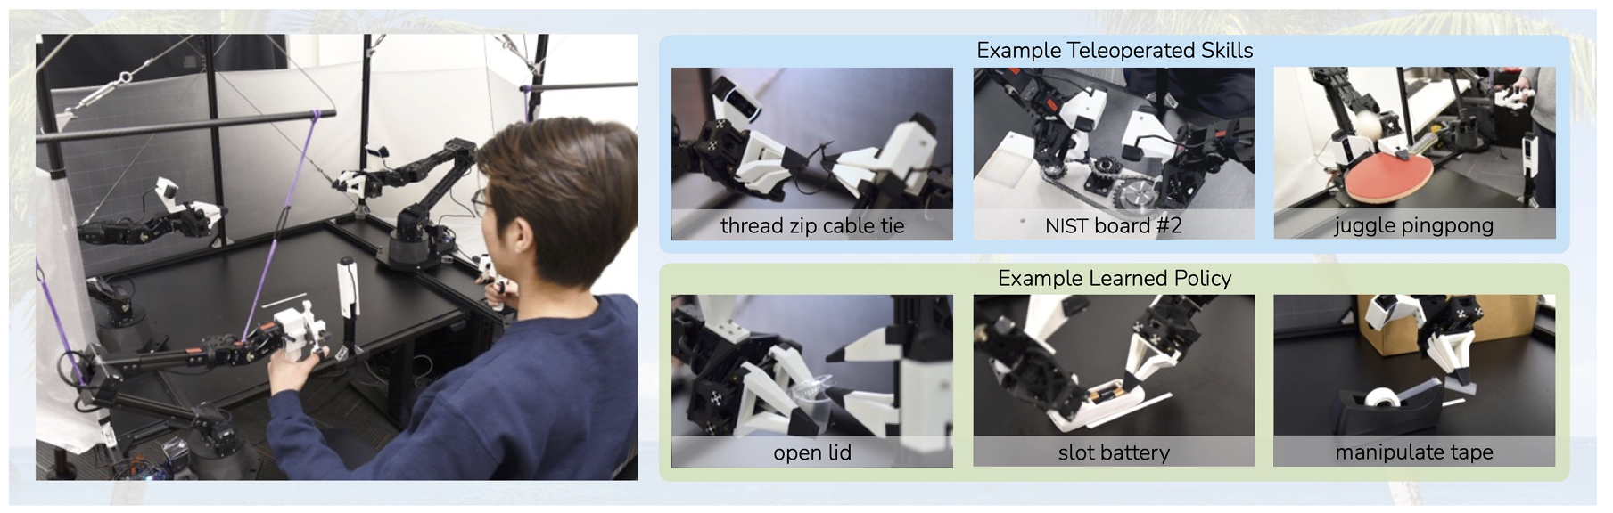
ALOHA
-->
-->
Presenter: Lu jinxuan, Hu Xinshu
5.14

Slide 2
Motivation and Main Problem
ALOHA-significance
ALOHA：A Low-cost open-source hardware system for bimanual teleoperation
ALOHA：A Low-cost open-source hardware system for bimanual teleoperation
Action Chunking with Transformers (ACT): learns a generative model over action sequences

Slide 3
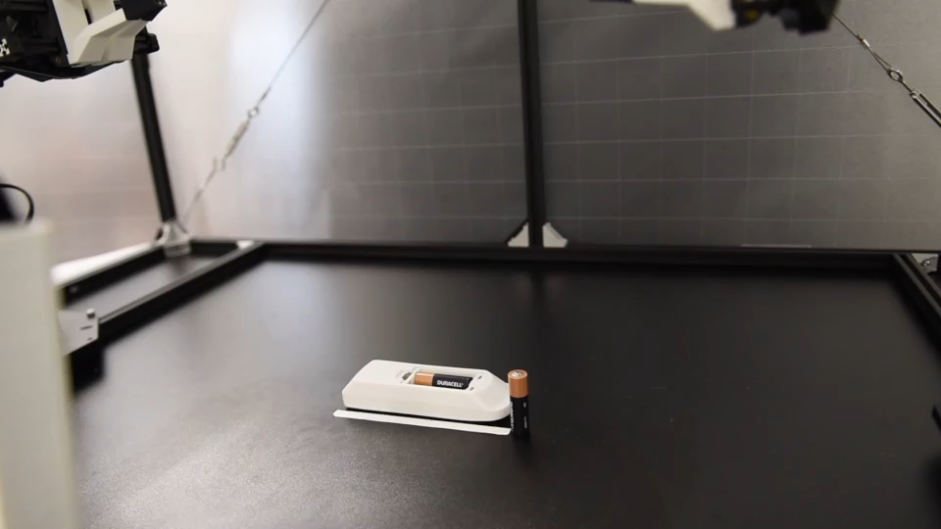
Motivation and Main Problem
ALOHA-significance
Learning Bimanual Manipulation with Low-Cost Whole-Body Teleoperation

Slide 4
Problem Setting
Low-cost:keep costs under $20,000
Versatile: It can be applied to a wide range of fine manipulation tasks with real-world objects
User-friendly: The system should be intuitive, reliable, and easy to use.
Easy-to-build & Repairable

Slide 5
Motivation and Main Problem
Learning Bimanual Manipulation with Low-Cost Whole-Body Teleoperation
With the imitation learning algorithm Action Chunking with Transformers (ACT), learning precise closed-loop behaviors, achieving a success rate of 80% to 90% in fine motor skills only requires 10 minutes or 50 demonstration trajectories.

Slide 6
Context / Related Work / Limitations of Prior Work
Related Work
Naoki Yokoyama, Alexander William Clegg, Eric Undersander, Sehoon Ha, Dhruv Batra, and Akshara Rai. Adaptive skill coordination for robotic mobile manipulation. arXiv preprint arXiv:2304.00410, 2023. 3
Cheng Chi, Siyuan Feng, Yilun Du, Zhenjia Xu, Eric Cousineau, Benjamin Burchfiel, and Shuran Song. Diffusion policy: Visuomotor policy learning via action diffusion. In Proceedings of Robotics: Science and Systems (RSS), 2023. 1, 2, 3, 5, 8, 9
limitations
High precision often involves costly industrial robots and correspondingly demands higher levels of expertise and knowledge from users.
everyday environments require whole-body coordination of both mobility and dexterous manipulation, rather than just individual mobility or manipulation behaviors.
everyday environments require whole-body coordination of both mobility and dexterous manipulation, rather than just individual mobility or manipulation behaviors

Slide 7
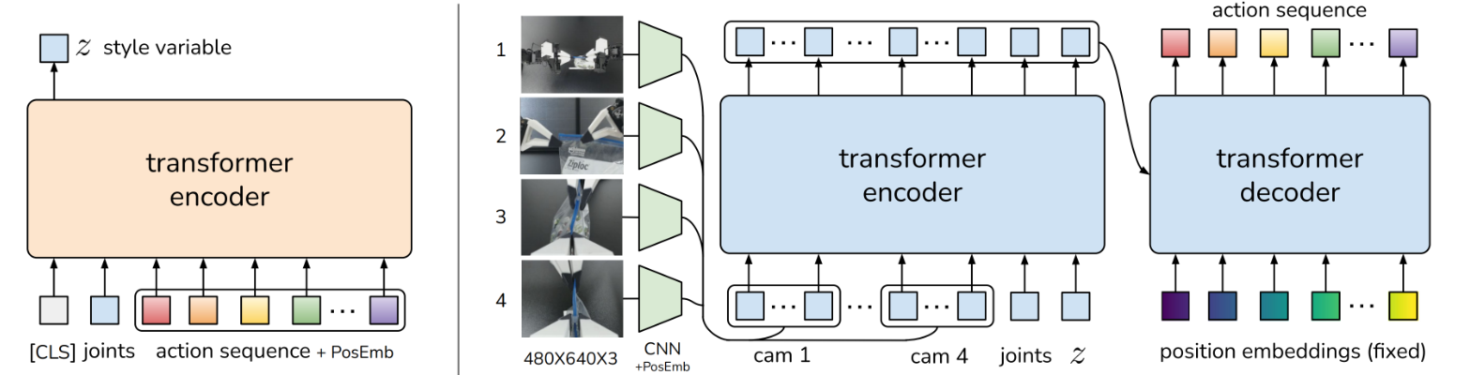
Theory
start with ACT(Action Chunking with Transformers), the method introduced with ALOHA

Slide 8
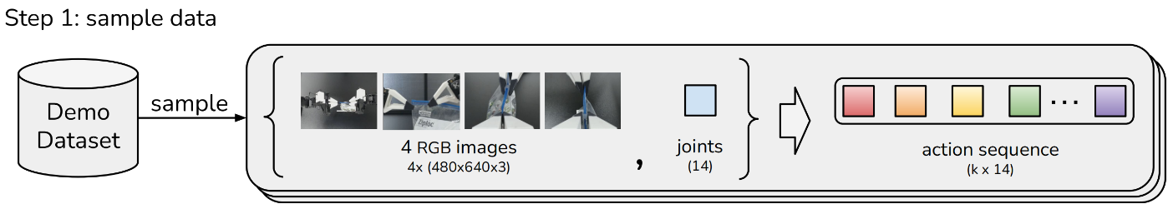
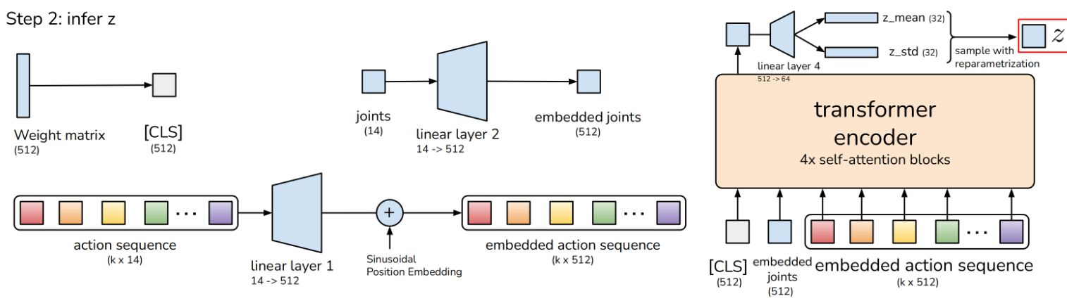
Theory
-->
-->

Slide 9
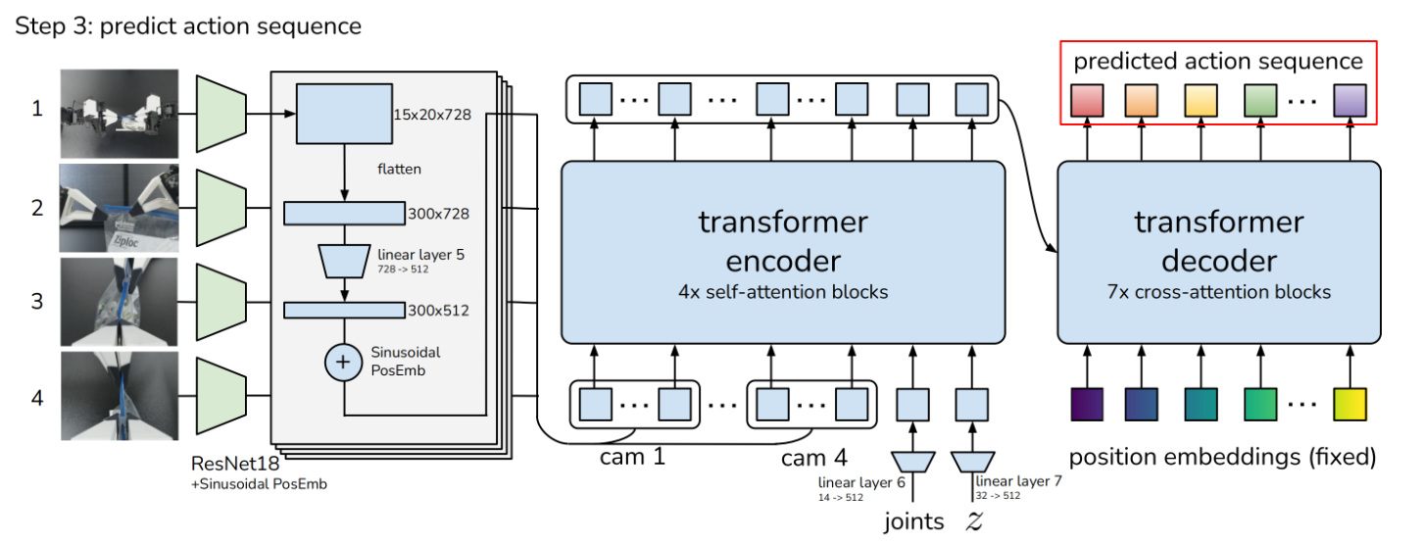
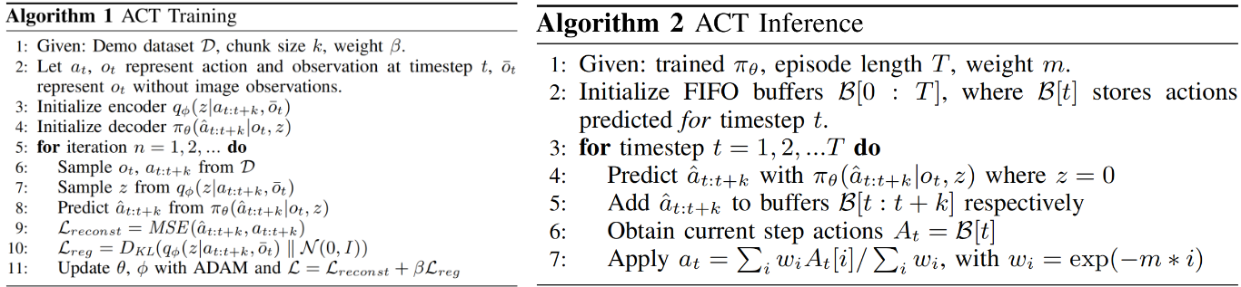
Theory
-->
-->
-->

Slide 10
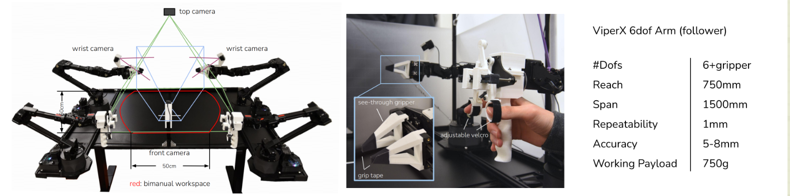
Proposed Approach / Algorithm / Method
-->
-->
-->
start with ACT, the method introduced with ALOHA
Innovation：
Developing a robotic arm capable of precision operations while maintaining costs below $20,000
Achieving high precision, coordination, and closed-loop visual feedback.
Minimizing the accumulation of errors and mistakes over time during training
-->

Slide 11
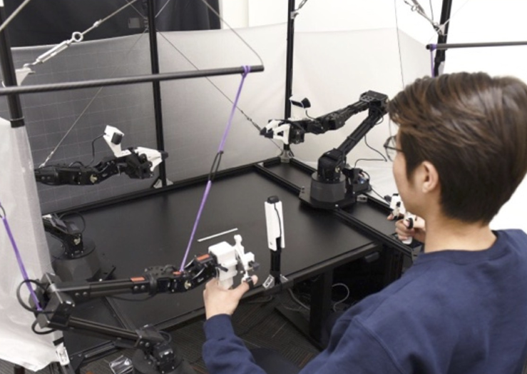
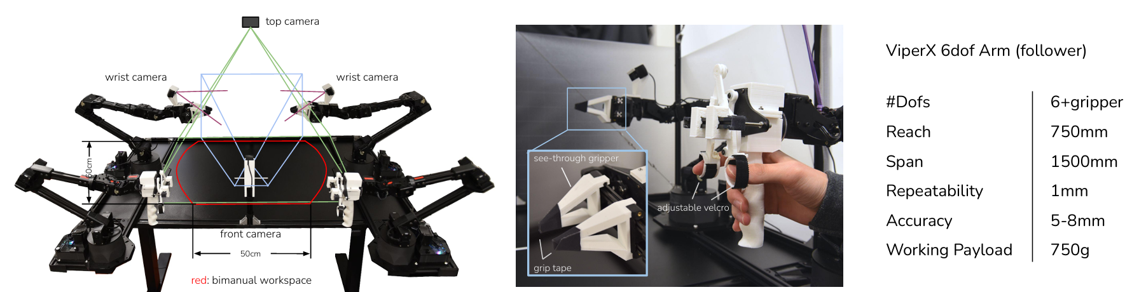
Experimental Setup
Hardware
ALOHA：A Low-cost open-source hardware system for bimanual teleoperation
Two ViperX 6-DoF robot arms
With 3D printed “see-through” fingers
A teleoperation system: WidowX

Slide 12
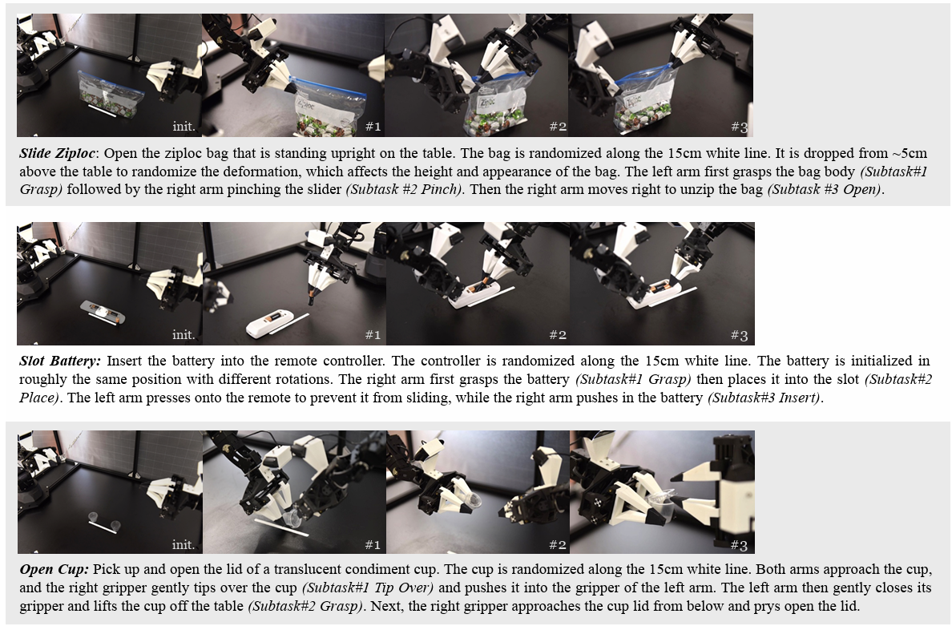
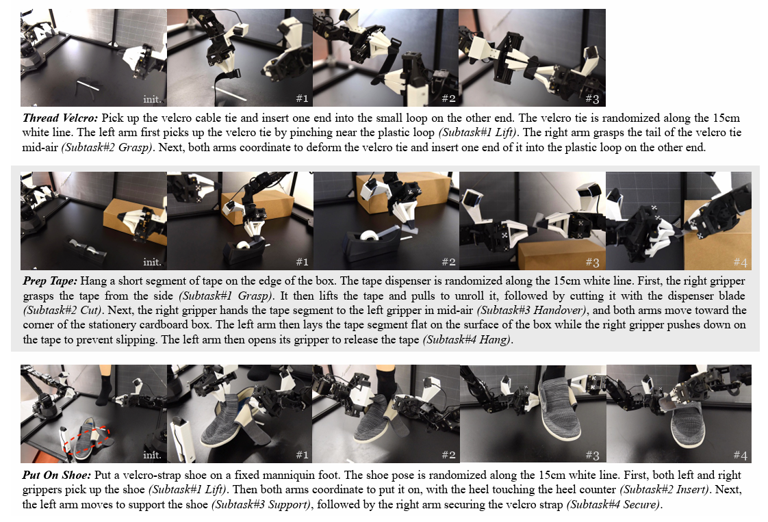
Experimental Setup
Tesk and Data Collection
6 real-world tasks:

Slide 13
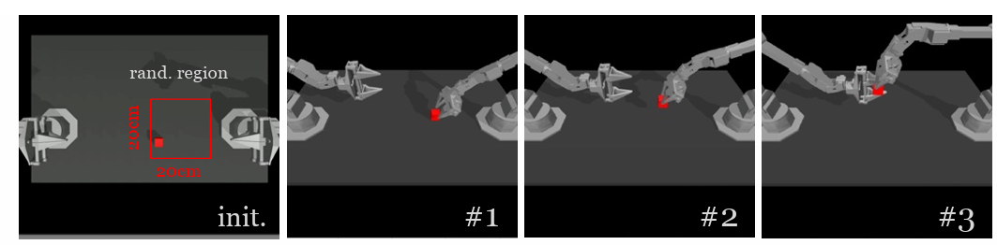
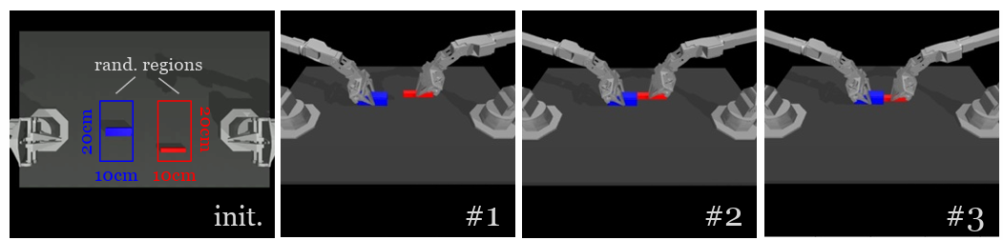
Experimental Setup
Tesk and Data Collection
2 simulated fine manipulation tasks in MuJoCo:

Slide 14
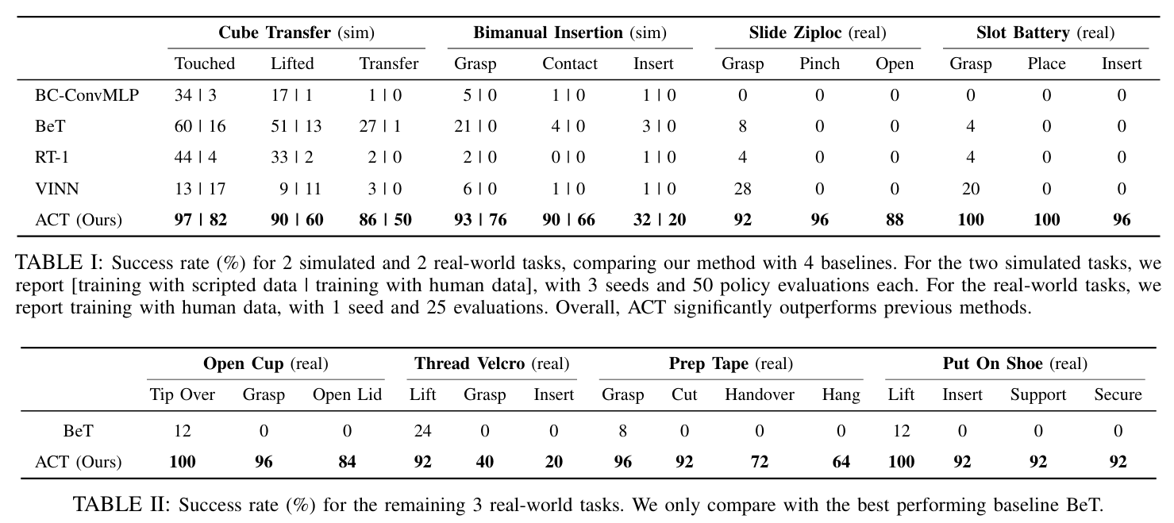
Experimental Results
Compare ACT with four prior mitation learning methods

Slide 15
Discussion of Results
For simulated tasks:
Average performance across 3random seeds with 50 trials each
ACT outperforms the best previous method in success rate by 59%, 49%, 29% and 20%
For real-word tasks:
Run one seed and evaluate with 25 trials.
ACT achieves 88% and 96% final success rates respectively
Other methods making no progress
compounding errors and non-Markovian behavior, ACT mitigates both issues with action chunking.

Slide 16
Critique / Limitations / Open Issues
Hardware Limitation
struggle with tasks that require multiple fingers
struggles with tasks that require high amount of forces
Tasks that requires finger nails are also difficult
Policy Limitation
ACT struggles with tasks like opening a candy and opening a small ziploc bag laying flat on the table, due to the difficulty of acurate way of perception and the insufficent of training data.

Slide 17
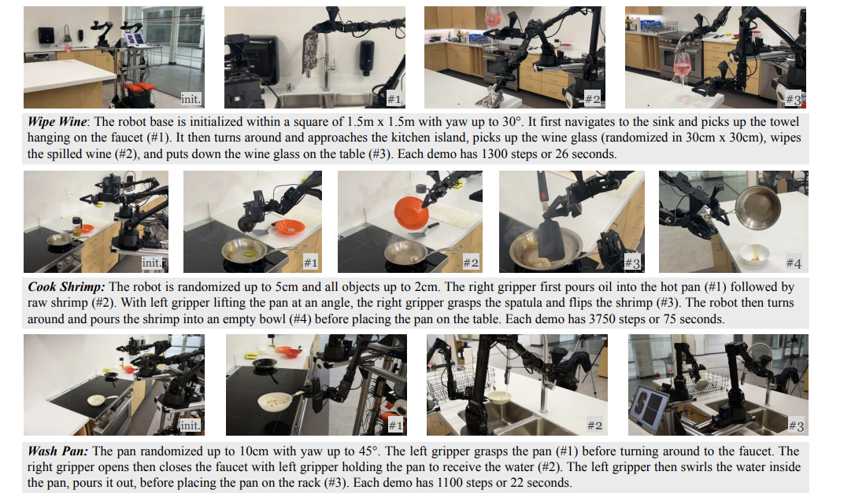
Future Work for Paper / Reading
Further explaination of the title with supporting evidence
Mobile Aloha

Slide 18
Extended Readings
Further explaination of the title with supporting evidence
2023CoRL – “Waypoint-Based limitation Learing for Robotic Manipulation” https://arxiv.org/abs/2302.12766
2023CoRL – “Language-Driven Reprentation Learing for Robotics”
Yell at your Robot – https://arxiv.org/pdf/2403.12910

Slide 19
Summary
A low-cost system for fine manipulation, comprising a teleoperation system ALOHA and a novel imitation learing algorithm ACT.
To learn fine manipulation skills directly in the real-world, such as opening a translucent condiment cup and slotting a battery with a 80-90% success rate and around 10 min of demonstrations.
ACT outperforms previous method, BC-ConvMLP, BeT etc.

Slide 20
Q&A
Team5

