Slide 1
Real-Time Grasp Detection Using Convolutional Neural Networks
Presenter: 杨雪 洪雨盈 魏毓瞳 李蕴哲
20240319

Slide 2
Motivation
General scene understanding requires complex visual tasks such as segmenting a scene into component parts, recognizing what those parts are, and disambiguating between visually similar objects. Due to these complexities, visual perception is a large bottleneck in real robotic systems.
Robot interaction with the physical world needs: general purpose robots need to be able to interact with and manipulate objects in the physical world. Robotic grasp detection lags far behind human performance.

Slide 3
the role of the AI and machine learning
Data Processing: Complex features can be automatically learned from large amounts of training data using deep learning. This is critical for understanding the shape, size, and possible grip points of an object.
Accuracy Improvement: The accuracy of grasp detection can be significantly improved through deep learning model training and optimization. This is critical for improving the success rate of robots operating in complex environments.
Real-Time Processing: Methods utilizing deep learning can significantly increase processing speeds, enabling robots to make grasping decisions at real-time or near real-time speeds.

Slide 4
Problem Setting
The core problem is to determine a method for safely picking up and holding an object, given its image. So the robot can grasp the object without causing damage or dropping it.
Grasp Representation:
A five-dimensional grasp representation, with terms for location,
size, and orientation. The blue lines demark the size and orientation of the gripper plates. The red lines show the approximate distance between the plates before the grasp is executed.

Slide 5
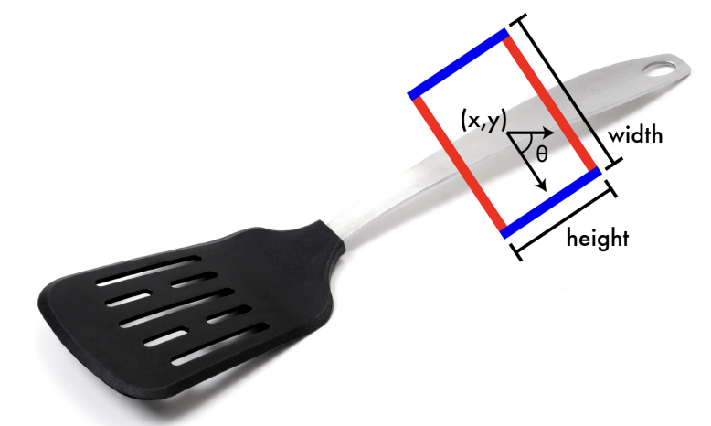
Problem Setting
g={x,y,θ,h,w}
(x,y): The center of the rectangle (grasp center).
θ: The orientation of the rectangle relative to the horizontal axis.
h: The height of the rectangle (gripper opening).
w: The width of the rectangle (gripper plate size).

Slide 6
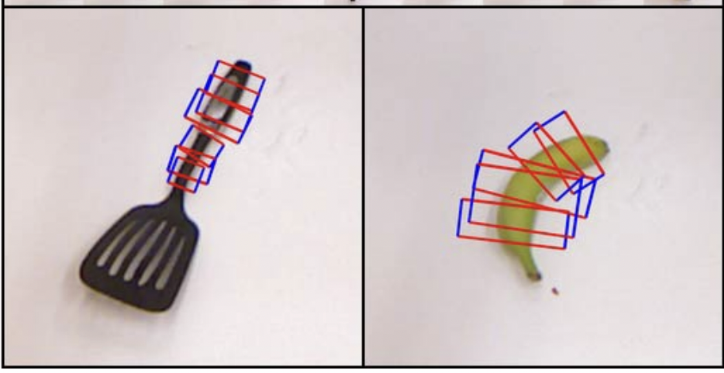
Limitations of Prior Work
Based on evaluation of the Cornell grasp detection dataset performed on the The latest findings on this dataset run at 13.5 seconds per frame with 75% accuracy.
This means that there will be a delay of 13.5 seconds between when the robot views the scene and when it determines where its gripper is moving.

Slide 7
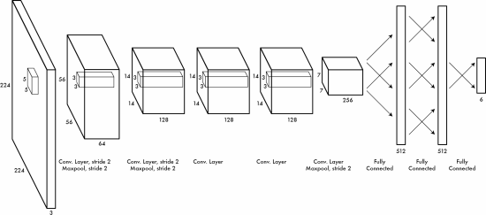
Proposed Approach / Algorithm / Method
Apply a single network to an image only once, using global information to predict grasp coordinates directly.
Sliding window
1. Sequential workflow
2. Time-consuming

Slide 8
Proposed Approach / Algorithm / Method
Model 1:
picks a random ground truth grasp every time it sees an object to treat as the single ground truth grasp.
Apply a single network to an image only once, using global information to predict grasp coordinates directly.
Model 2:
Model 1+extra neurons to the output layer that correspond to object categories.
Model 3:
Generalization of Model 1 .The preceding models assume only a single correct grasp per image while Model 3 divides the image into an NxN grid and assumes that there is at most one grasp per grid cell.

Slide 9
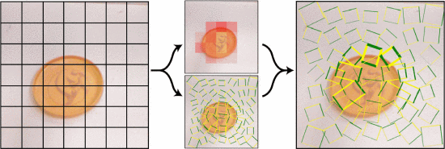
Proposed Approach / Algorithm / Method
1
2
Model 3 visualization:
For each cell in the grid, the model predicts
  ① a bounding box centered at that cell
  ②a probability that this grasp is a true grasp for the object in the image.
The predictions are weighted by this probability predicting multiple grasps for an object.

Slide 10
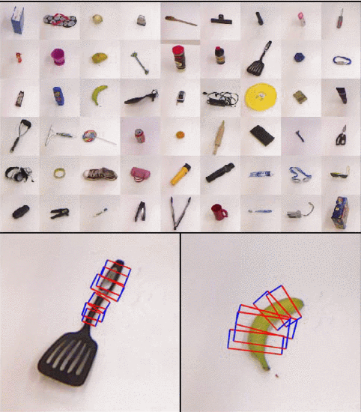
Theory
Compared to the sliding window method, this method scaled the network to generate a global understanding for the whole image.
①For items with multiple graspable points, grasping strategies can be generated by applying this network only once.
②Global information of the image provides good object classification.

Slide 11
Experimental Setup
Pretrain：
  Datasets：ImageNet
  Tasks：Classification
Train：
  Datasets：Cornell grasping dataset
  Tasks：Grasping strategy prediction
Hardware setups：
  Nvidia Tesla K20 GPU
As no actual grasping work contained, there is no actual robotic platform illustrated in this article.

Slide 12
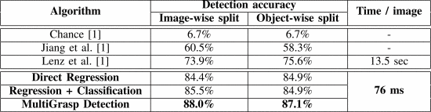
Experimental Setup
Baseline：
Proposed：

Slide 13
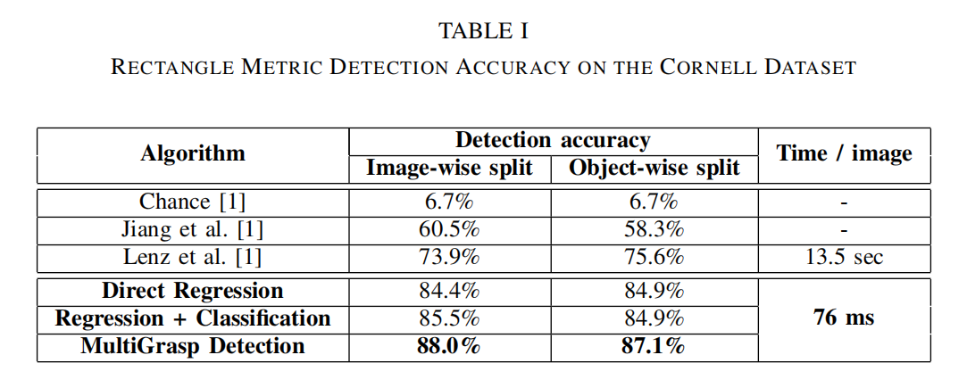
Experimental Results
In Table 1 we compare our results to previous work using their self-reported scores for the rectangle metric accuracy.
Across the board our models outperform the current state-of-the-art both in terms of accuracy and speed.

Slide 14
Experimental Results
Direct Regression
The direct regression model sets a new baseline for performance in grasp detection. It achieves around 85 percent accuracy in both image-wise and object-wise splits, ten percentage points higher than the previous best.

Slide 15
Experimental Results
At test time the direct regression model runs in 76 milliseconds per
batch, with a batch size of 128 images. While this amounts to processing more than 1,600 images per second, latency matters more than throughput in grasp detection so we report the per batch number as 13 fps..

Slide 16
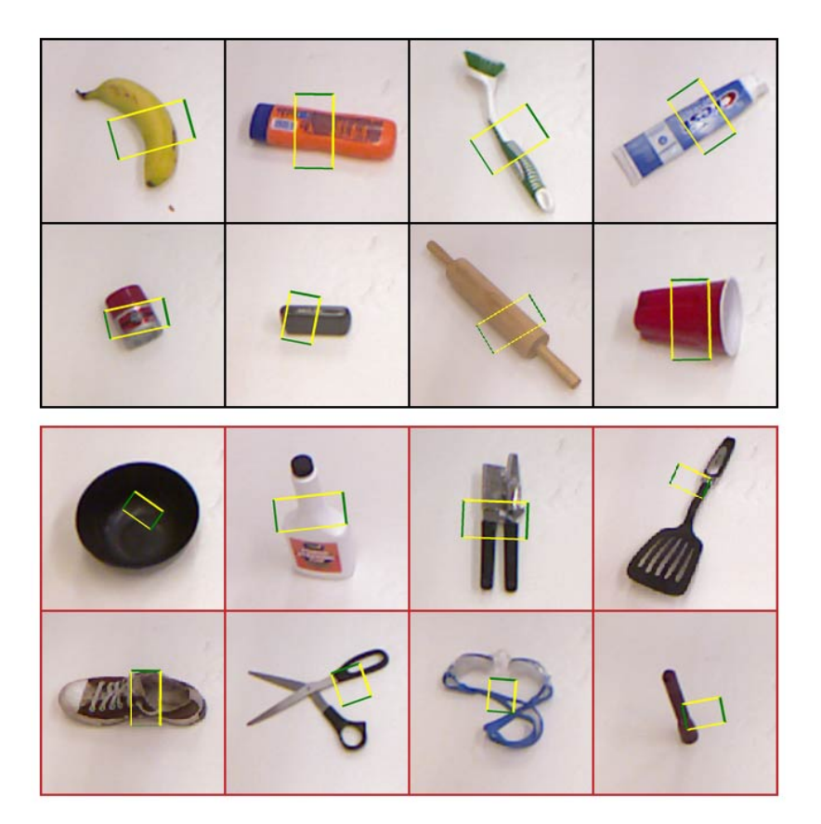
Experimental Results
Examples of correct (top) and incorrect (bottom) grasps from the direct regression model. Some incorrect grasps (e.g. the can opener) may actually be viable while others (e.g. the bowl) are clearly not.
Predicting average grasps works well with certain types of objects, such as long, thin objects like markers or rolling pins. This model fails mainly in cases where average grasps do not translate to viable grasps on the object, for instance with circular objects like flying discs.

Slide 17
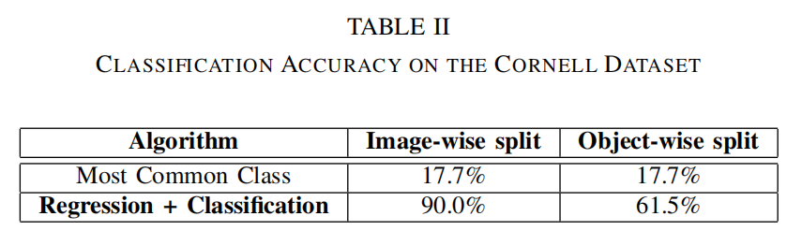
Experimental Results
Regression + Classification
We can extend our base detection model to simultaneously perform classification without sacrificing detection accuracy. Our model can correctly predict the category of an object it has previously seen 9 out of 10 times. When shown novel objects our model predicts the correct category more than 60 percent of the time. By comparison, predicting the most common class would give an accuracy of 17.7 percent.

Slide 18
Experimental Results
Even with the added classification task the combined model maintains high detection accuracy. It has identical performance on the object-wise split and actually performs slightly better on the image-wise split.
This model establishes a strong baseline for combined grasp detection and object classification on the Cornell dataset.

Slide 19
Experimental Results
MultiGrasp
The MultiGrasp model outperforms our baseline direct regression model by a significant margin. For most objects. MultiGrasp gives very similar results to the direct regression model.
MultiGrasp has a very similar architecture to the direct regression model and operates at the same real-time speeds. With a grasp detection accuracy of 88 percent and a processing rate of 13 frames per second.

Slide 20
Experimental Results
MultiGrasp
The MultiGrasp model outperforms our baseline direct regression model by a significant margin. For most objects. MultiGrasp gives very similar results to the direct regression model.

Slide 21
Discussion of Results
The paper present a fast, accurate system for predicting robotic grasps of objects in RGB-D images. Those models improve the state-of-the-art and run more than 150 times faster than previous methods. It show that grasp detection and object classification can be combined without sacrificing accuracy or performance. The MultiGrasp model gets the best known performance on the Cornell Grasping Dataset by combining global information with a local prediction procedure.

Slide 22
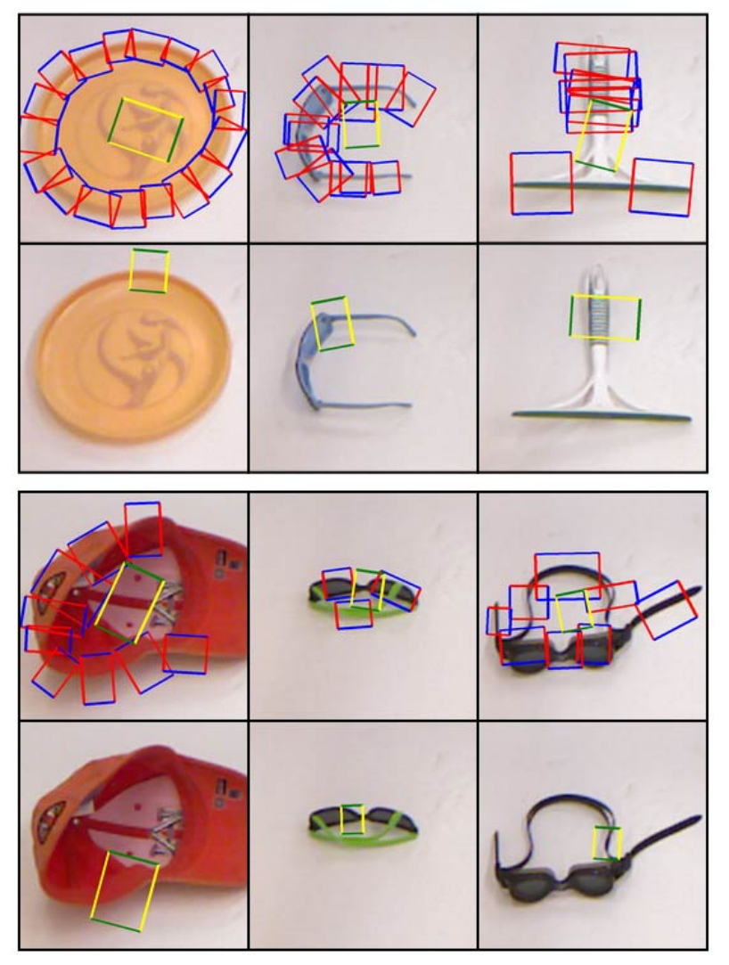
Limitations
The comparative performance of the direct regression model and MultiGrasp.
The top two rows show examples where direct regression model fails due to averaging effects but MultiGrasp predicts a viable grasp. The bottom two rows show examples where both models fail to predict good grasps. The ground truth grasps are shown in blue and red on the direct regression model images.

Slide 23
Limitations
Our direct regression model uses global information about the image to make its prediction, unlike sliding-window approaches. Sliding window classifiers only see small, local patches thus they can not effectively decide between good grasps and are more easily fooled by false positives.
Notably our direct regression model often tries to split the difference between a few good grasps and ends up with a bad grasp. A sliding window approach would never make the mistake of predicting a grasp in the center of a circular object like a flying disc.

Slide 24
Future Work for Paper / Reading
Our Ideas:
It is claimed that direct regression model often tries to split the difference between a few good grasps and ends up with a bad grasp as a global model. What’s the way to solve this problem？
  Is it possible to do so by spliting the difference between a few good grasps?
  How can we figure out the best grasp between the few good grasps?
What are the actual scenarios that can be applied to these models in real life? How?

Slide 25
Future Work for Paper / Reading
Others’ ideas
This study is based on 2D pictures. However, this means lacking of important shapes or contours of objects in real life. based on this research, we can expand our studies on single-view point cloud.
using the method in real cases like Human-like Grasp Generation
  When it is in low light condition, the detection performance will be poorer. How to propose a visual enhancement guided grasp detection model to improve detection performance under this situation?

Slide 26
Extended Readings
Z. Liu, Z. Chen and W. -S. Zheng, "Simulating Complete Points Representations for Single-View 6-DoF Grasp Detection," in IEEE Robotics and Automation Letters, vol. 9, no. 3, pp. 2901-2908, March 2024, doi: 10.1109/LRA.2024.3358757.
  single-view point cloud grasping
  https://ieeexplore.ieee.org/document/10414109
R. Miura, K. Fujita and T. Tasaki, "Increasing the Graspable Objects by Controlling the Errors in the Grasping Points of a Suction Pad Unit and Selecting an Optimal Hand," 2024 IEEE/SICE International Symposium on System Integration (SII), Ha Long, Vietnam, 2024, pp. 196-201, doi: 10.1109/SII58957.2024.10417393.
  improving the robustness toward errors in the estimation of grasping points
  https://ieeexplore.ieee.org/document/10417393
K. Yamamoto, H. Ito, H. Ichiwara, H. Mori and T. Ogata, "Real-Time Motion Generation and Data Augmentation for Grasping Moving Objects with Dynamic Speed and Position Changes," 2024 IEEE/SICE International Symposium on System Integration (SII), Ha Long, Vietnam, 2024, pp. 390-397, doi: 10.1109/SII58957.2024.10417201.
  Grasping Moving Objects
  https://ieeexplore.ieee.org/document/10417201

Slide 27
Extended Readings
E. Balazadeh, M. T. Masouleh and A. Kalhor, "HUGGA: Human-like Grasp Generation with Gripper’s Approach State Using Deep Learning," 2023 11th RSI International Conference on Robotics and Mechatronics (ICRoM), Tehran, Iran, Islamic Republic of, 2023, pp. 854-860, doi: 10.1109/ICRoM60803.2023.10412422.
  Human-like Grasp Generation based on the method
  https://ieeexplore.ieee.org/document/10412422
M. S. Sharif, A. Zorto, V. K. Brown and W. Elmedany, "Scalable Machine Learning Model for Highway CCTV Feed Real-Time Car Accident and Damage Detection," 2023 International Conference on Innovation and Intelligence for Informatics, Computing, and Technologies (3ICT), Sakheer, Bahrain, 2023, pp. 341-348, doi: 10.1109/3ICT60104.2023.10391543.
  employing computer vision algorithms to enhance real-time accident detection and response on highways
  https://ieeexplore.ieee.org/document/10391543
M. Niu, Z. Lu, L. Chen, J. Yang and C. Yang, "VERGNet: Visual Enhancement Guided Robotic Grasp Detection Under Low-Light Condition," in IEEE Robotics and Automation Letters, vol. 8, no. 12, pp. 8541-8548, Dec. 2023, doi: 10.1109/LRA.2023.3330664. keywords: {Feature extraction;Grasping;Visualization;Robot
  proposing a visual enhancement guided grasp detection model to improve detection performance under low-light conditions
  https://ieeexplore.ieee.org/document/10310093

Slide 28
Summary
Problem:
The approach to robotic grasp detection so robot can safely pick up and hold an object, given its image.
Why is it important and hard：
The needs for robots to interaction with physical world
Scene understanding requires complex visual tasks
key limitation of prior work：
run for a long time & low accuracy
key insight:
3 methods using global information to predict grasp and coordinates directly
Results:
Running less time with 76 milliseconds per batch, with accuracy up to 88%

Slide 29
Thanks for listening!
Presenter: 杨雪 洪雨盈 魏毓瞳 李蕴哲
20240319

