Slide 1
Identifying Fruit and Vegetable Types and Grasping the Dregs Based on Deep Learning
Ding Zhuoyang 12110111 | Yin Zhiqi 12112346
Qiu Tian 12111904 | Tong Xuan 12111917
Hu Xinshu 12112727 | Lu Jingxuan 12111546
2024/3/26

Slide 2
Proposed Project Title Summary
Summary
In today's China, with the growth of population and the acceleration of urbanization, the food safety problem of public canteens has become a key concern. In our project, we will use visual recognition and machine learning methods to identify the types of fruits and vegetables and pick out the unfresh ones with robotic arm, aiming to achieve a sorting success rate of 85% or higher. Through this project, we can reduce the labor demand for traditional vegetable and fruit sorting, reduce the workload and working time of the chef. At the same time, this design optimizes the sorting process and improves the efficiency of sorting. At the national level, this project can respond to the call of "Artificial Intelligence +" and further promote the innovative development of digital economy.
We searched for many articles on visual recognition and machine learning. Among them, we selected three articles as our main references. These three articles all focused on the recognition and classification of common fruits and vegetables, including visual recognition and machine learning. This was of great help to our project.

Slide 3
Proposed Project Title Summary
Summary
The main data sources are the datasets provided in the paper and the datasets designed by ourselves. After being processed to some extent, these datasets will be input to the deep learning model we have established for training.
The project will refer to the visual recognition and machine learning models and algorithms in other papers, analyze the advantages and disadvantages of different models and algorithms, and then modify and optimize our model. For example, data preprocessing and vision transformers(ViT).
Finally, we will analyze the output results of our model from both qualitative and quantitative perspectives. From a qualitative perspective, we expect the model to accurately identify the types of fruits and vegetables and extract those that are not fresh. From a quantitative perspective, we expect the model's recognition accuracy and extraction success rate to reach 90% or higher.

Slide 4
What is the problem that you will be investigating?
Why is it interesting?
Growth of population | Acceleration of urbanization
Food safety issues in public canteens

Slide 5
What is the problem that you will be investigating?
Why is it interesting?
The current problem of sorting ingredient through chefs
The cost of human and material resources is high
Long duration
human subjective problem

Slide 6
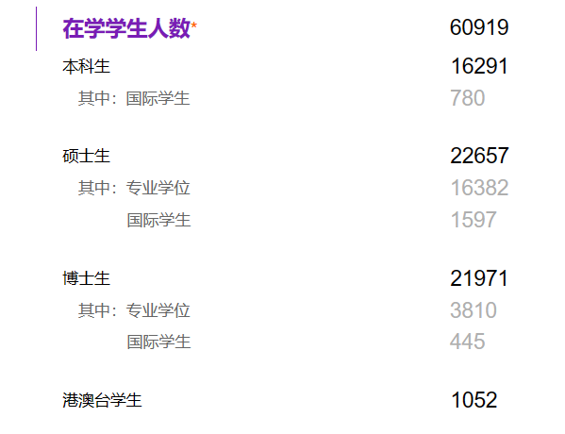
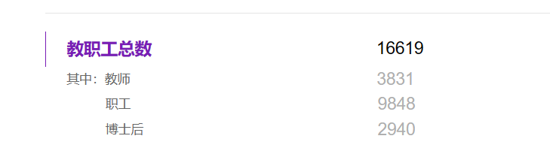
What is the problem that you will be investigating?
Why is it interesting?
Example:

Slide 7
What is the problem that you will be investigating?
Why is it interesting?
The interesting points of this project are as follows:
Reduced the labor demand for traditional vegetable and fruit sorting, reducing the workload and working hours of chefs.
Optimized the sorting process and improved the efficiency of sorting.
Respond to the call of "Artificial Intelligence +" and further promote the innovative development of the digital economy.

Slide 8
What reading will you examine?
To provide context and background
Apostolopoulos ID, Tzani M, Aznaouridis SI. A General Machine Learning Model for Assessing Fruit Quality Using Deep Image Features. AI. 2023; 4(4):812-830.
https://doi.org/10.3390/ai4040041
Karadağ, A.E., & Kiliç, A. (2023). Non-destructive robotic sorting of cracked pistachio
using deep learning. Postharvest Biology and Technology.
Liu Zhen. (2019). Master's degree thesis on visual recognition and maturity detection technology of guava in natural environment, South China Agricultural University. https://link.cnki.net/doi/10.27152/d.cnki.ghanu.2019.000626 doi:10.27152/d.cnki.ghanu.2019.000626.

Slide 9
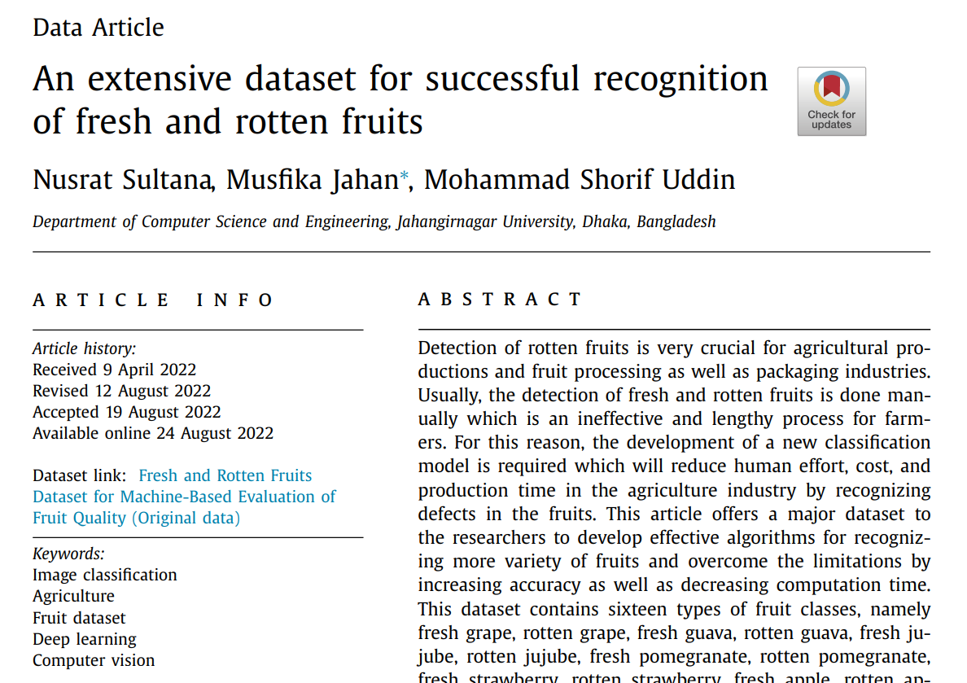
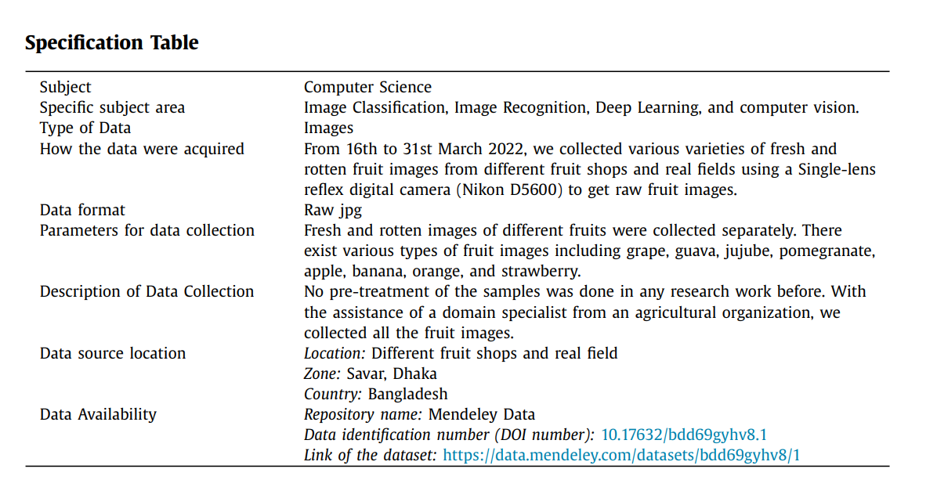
What data will you use?
How to find the data?
Search for datasets through the content of the paper:

Slide 10
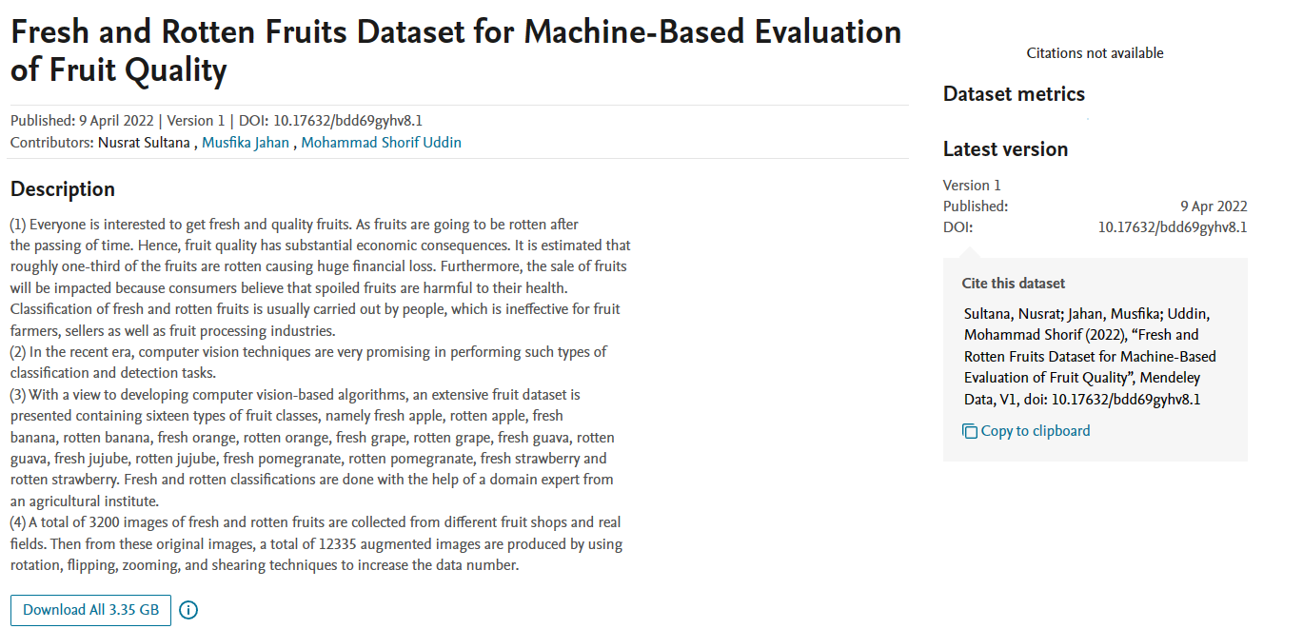
What data will you use?
How to find the data?
Search for datasets through the content of the paper:

Slide 11
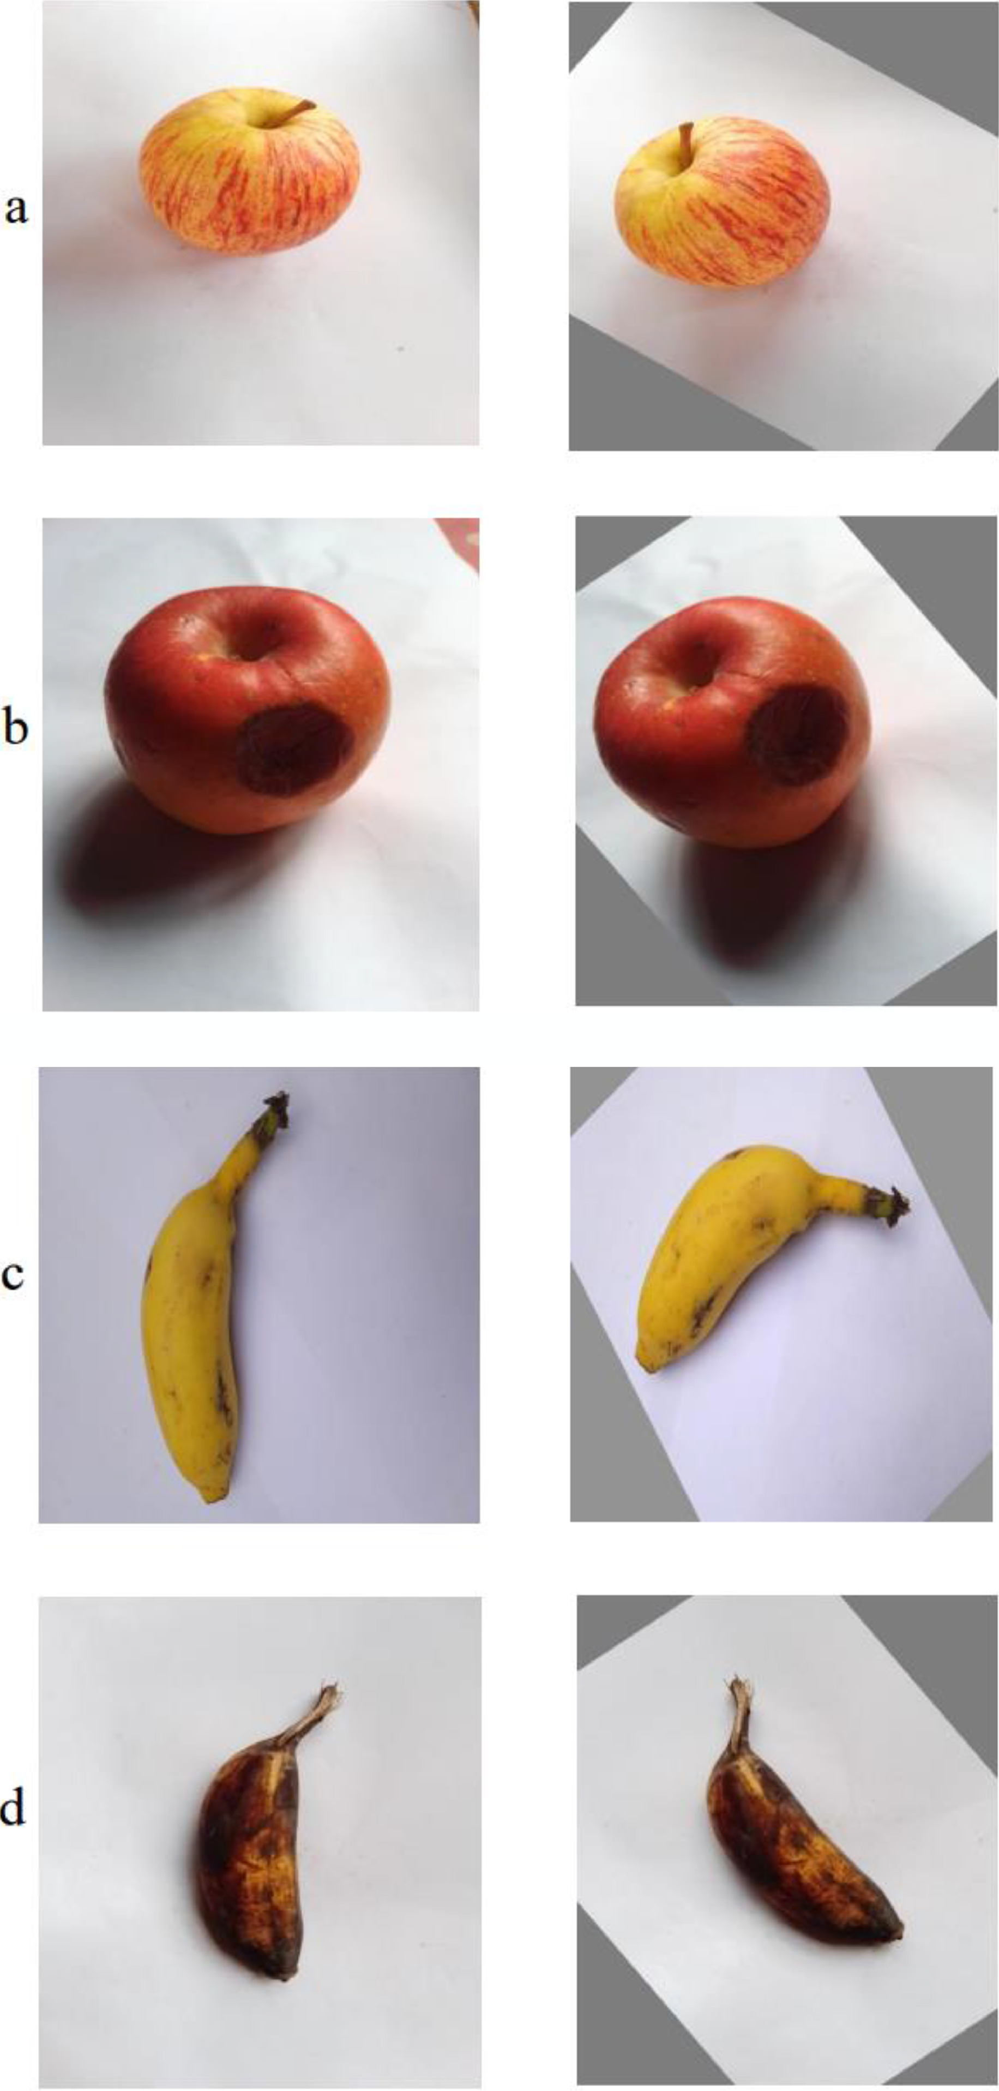
What data will you use?
How to find the data?
Search for datasets through the content of the paper:

Slide 12
What data will you use?
How to find the data?
Search for datasets through the content of the paper:
“A General Machine Learning Model for Assessing Fruit Quality Using Deep Image Features”
FruitNet: Indian Fruits Dataset with Quality:https://www.kaggle.com/datasets/shashwatwork/fruitnet-indian-fruits-dataset-with-quality )
FruitQ dataset: https://www.kaggle.com/datasets/sholzz/fruitq-dataset
Lemon quality dataset: https://www.kaggle.com/datasets/yusufemir/lemon-quality-dataset
Mango varieties classification and grading: https://www.kaggle.com/datasets/saurabhshahane/mango-varieties-classification

Slide 13
What data will you use?
How to find the data?
Design based on network pictures
For some of the mentioned fruits and vegetables, we will make reasonable design based on the actual situation of the picture of the ingredient, so that this picture can basically meet the different states of fruit and vegetable in real life.

Slide 14
What data will you use?
If you are collecting new data, how will you do it?
Build deep learning algorithm
Preprocess the dataset
Input the processed dataset into the model
Training model
Input the test set and compare the results

Slide 15
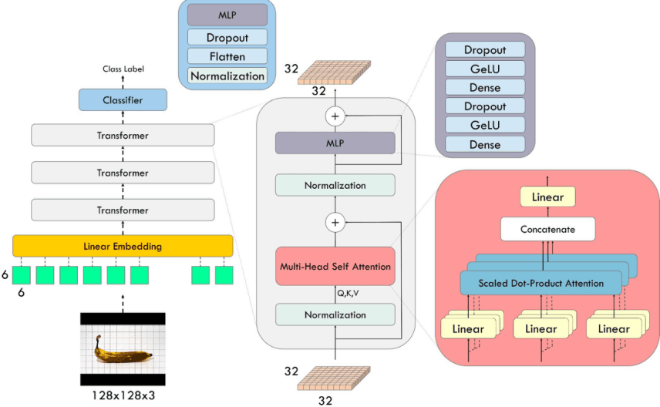
What method or algorithm are you proposing?
The algorithms and models will be used in the project
Vision transformers

Slide 16
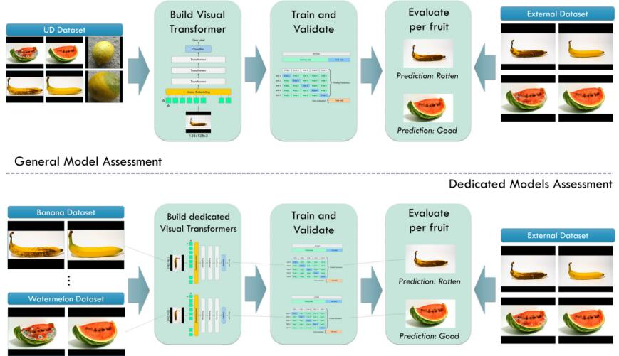
What method or algorithm are you proposing?
The algorithms and models will be used in the project
Research methodology

Slide 17
How will you evaluate your results?
Qualitative and quantitative analysis
Qualitative analysis
  The model can identify fruit and vegetable varieties
  The robotic arm can sort stale vegetables and fruits
Quantitative analysis
  The accuracy of identifying fruits and vegetables reaches 90% or above
  The success rate of grasping fruits and vegetables reaches 90% or above
  The final success rate reaches 85% or above

Slide 18
How will you evaluate your results?
Qualitative and quantitative analysis
Output results
  Table: The success rate of recognition and grasping
  Image: The situation of grabbing fruits and vegetables
Extended work
  Compare the accuracy of other models on this issue, summarize the advantages and disadvantages, and then make improvements and optimizations

Slide 19
Thanks for listening
Ding Zhuoyang 12110111 | Yin Zhiqi 12112346
Qiu Tian 12111904 | Tong Xuan 12111917
Hu Xinshu 12112727 | Lu Jingxuan 12111546

