Slide 1
PetWave: Interactive Robotic Arm for Human and Dog Interaction
Present Name :赵振海 12110434
2024/3/26

Slide 2
Summary
Aims to develop a robotic arm capable of recognizing and interacting with humans and dogs by waving to humans and patting dogs on the head.
This project addresses the challenge of enabling robotic systems to perceive and respond to different types of entities in their environment.
The investigation will explore techniques in computer vision, deep learning, and ROS to achieve the desired functionality.
The background literature will include studies on object detection and recognition, human-robot interaction, and literature on computer vision and deep learning methods applicable to object detection and recognition in ROS simulations
The project will utilize image datasets containing annotated images of humans and dogs for training and evaluation purposes. Existing datasets such as COCO, ImageNet, and OpenImages may be leveraged, supplemented by additional data collection if necessary.
The proposed method will involve developing a deep learning model for object detection and classification, combined with kinematics and control algorithms for the robotic arm's movement. Existing implementations of object detection algorithms such as YOLO, SSD, or Faster R-CNN may serve as a starting point, with modifications to suit the specific requirements of the project.
Evaluation of the results will involve qualitative assessment through video demonstrations showcasing the robot's interaction capabilities with humans and dogs. Quantitative evaluation will include metrics such as detection accuracy, precision, recall, and F1-score for object recognition tasks.

Slide 3
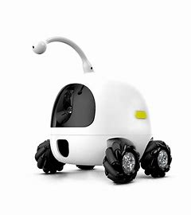
The problem under investigation
Interactive Robotic Arm for Human and Dog Interaction
Potential Applications: Human-Robot Interaction, Assistive Robotics, Pet Care
Objective: Enhancing Robotic Systems' Capabilities in Recognizing and Interacting with Various Entities

Slide 4
The scope of the literature review
ROS architecture
database management
image processing algorithms
robot modeling and simulation
control algorithms
robot perception
path planning strategies within the ROS framework.

Slide 5
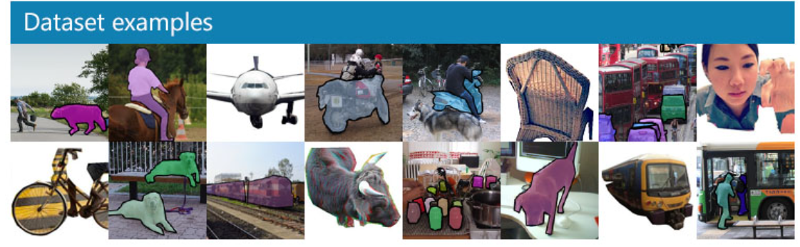
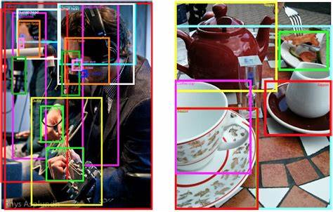

Database management
COCO
ImageNet
Open Images

Slide 6
The method and algorithm
A deep learning model for object detection and classification
  YOLO
  SSD
  Faster R-CNN
A robotic arm model
  URDF
  Movelt
  Gazebo
A ROS-based path planning model
  ROS Navigation Stack
  MoveIt!(RRT、RRT*、OMPL)
  SBPL
  OMPL

Slide 7
The system of evaluation
Qualitative Evaluation:
  Qualitative evaluation of the interaction capabilities between the robot, humans, and dogs demonstrated through video demonstrations.
Quantitative Evaluation:
  Object Detection Accuracy
  Interaction Action Accuracy
  Interaction Response Time

Slide 8
Thank you for listening!

