Slide 1
Determining grasp selection from arm trajectories via deep learning to enable functional hand movement in tetraplegia
Presenter: 12110521 Gou Guotao
Group: 8
2024.4.7

Slide 2
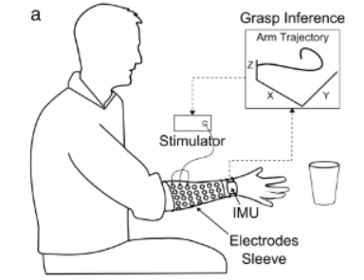

Slide 3
Problem Setting
Problem Formulation: The study focuses on predicting the grasping intentions of individuals with spinal cord injuries by analyzing their arm movement trajectories towards target objects in three-dimensional space, using deep learning algorithms, and realizing hand movements through neuromuscular stimulation.
Key Definitions and Notations: Arm movement data collected by Inertial Measurement Unit (IMU) are used as input to identify motion trajectories through Dynamic Time Warping (DTW) and Long Short-Term Memory (LSTM) networks, culminating in grasping actions executed by a neuromuscular stimulation device.

Slide 4
Motivation and Main Problem
Description: The study addresses how to utilize functional hand movements in individuals with tetraplegia by analyzing arm movement trajectories combined with deep learning and neuromuscular stimulation technologies.
ML: Key to solving this problem is the use of deep learning algorithms, specifically Long Short-Term Memory (LSTM) networks, to process and classify complex motion trajectory data.
Key Insight: Utilizing arm movement trajectory information collected by wearable devices (IMU) and deep learning through LSTM models can effectively predict and identify different types of grasps, thus controlling neuromuscular stimulation devices to achieve functional hand movements.

Slide 5
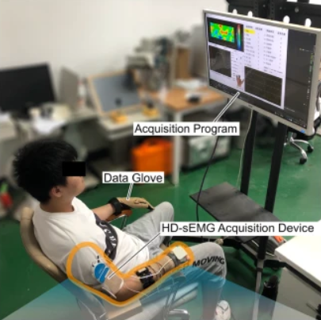
Context / Related Work / Limitations of Prior Work
Context / Related Work: Previous studies have attempted to restore or augment hand movements in individuals with tetraplegia using surface electromyography (sEMG) signals or brain-computer interface technologies.
Limitations of Prior Work: Past works may have limitations in the accuracy, real-time performance of user intent recognition, and the portability and usability of the system.
INCONVENIENT !!!

Slide 6
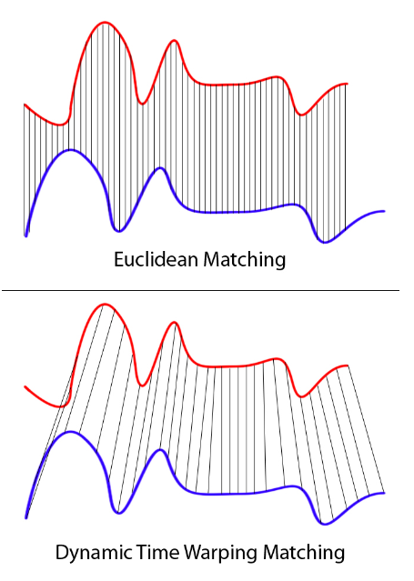
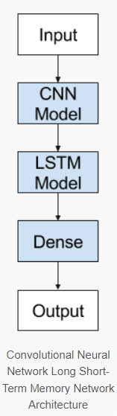
Proposed Approach / Algorithm / Method
Proposed Method: The framework employs an LSTM network and DTW to analyze time-series data, with the optimization objective being to maximize the accuracy of motion trajectory classification.
Core Technical Innovations: The integration of the LSTM deep learning model and DTW with neuromuscular stimulation technology allows for high-accuracy motion trajectory recognition and real-time control of hand movements.
DTW ->

Slide 7
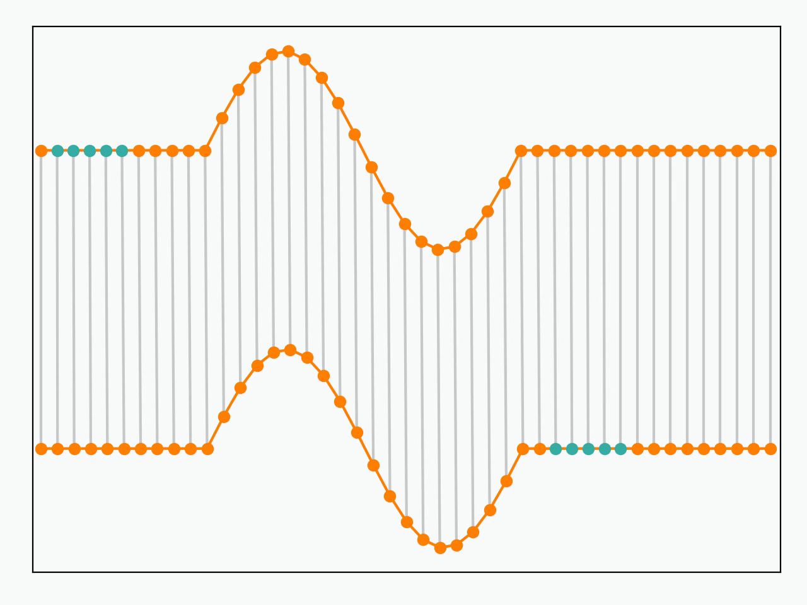
Proposed Approach / Algorithm / Method

Slide 8
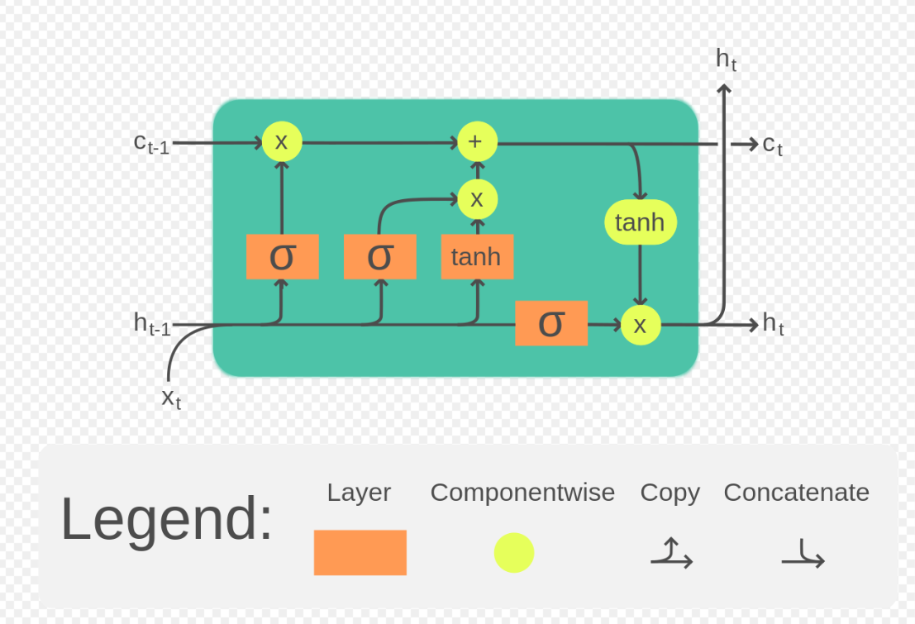
Theory
Theory Assumptions: It's assumed that grasping intentions can be accurately predicted through arm movement trajectories, and these trajectories can be effectively identified by deep learning algorithms.
Theory Basis and References: The study is grounded in previous theories on Long Short-Term Memory (LSTM) networks for processing time-series data, further applied to the classification of motion trajectories. See paper "LSTM: A Search Space Odyssey,"

Slide 9
Theory
需要上臺證明LSTM：State main results formally
Give proof sketches
Refer students to the full proofs in paper

Slide 10
Experimental Setup
Experimental Setup: Arm movement trajectories towards specific targets in three-dimensional space were collected from individuals with spinal cord injuries using inertial sensors.
Domains: The study was conducted in individuals with spinal cord injuries, utilizing data from natural and arbitrary arm movement trajectories.
Baselines: Compared with traditional neuromuscular stimulation control methods and previous deep learning approaches.
Scientific Hypotheses Tested: Validated that integrating arm movement trajectory information with deep learning improves the accuracy and real-time performance of grasping intention recognition.

Slide 11
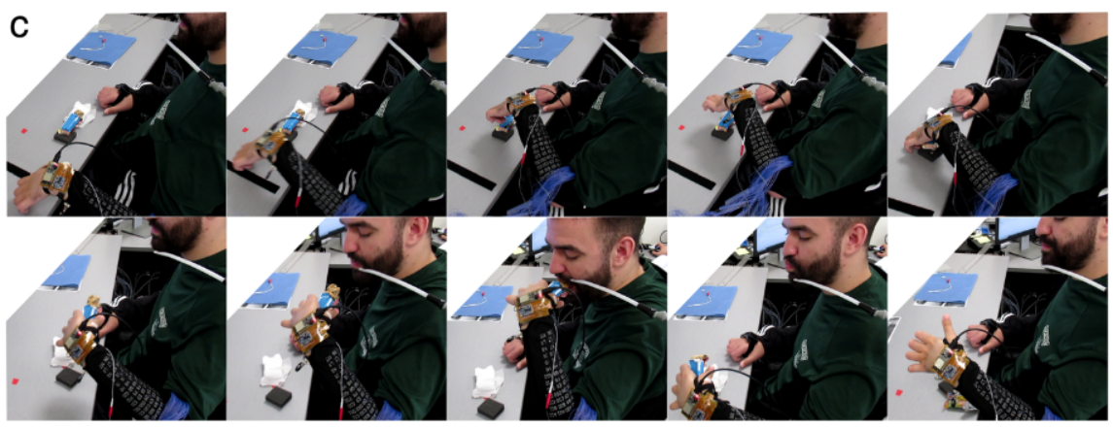
Experimental Setup

Slide 12
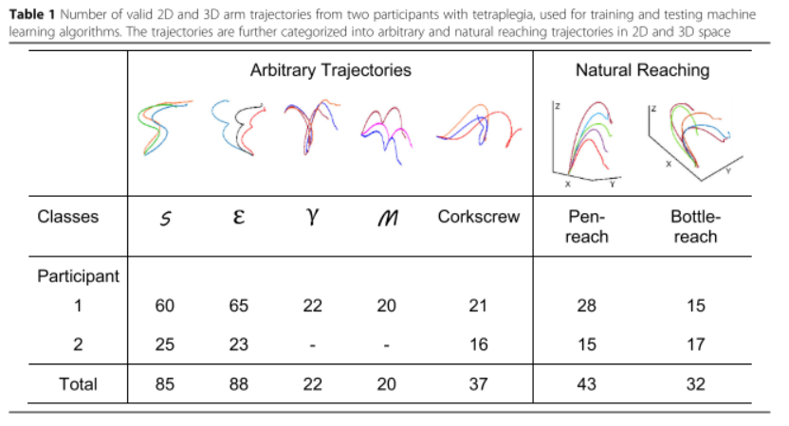
Experimental Setup

Slide 13
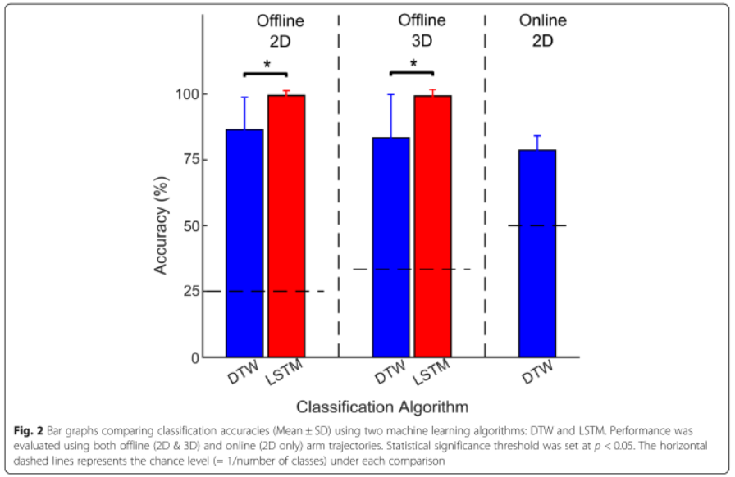
Experimental Results

Slide 14
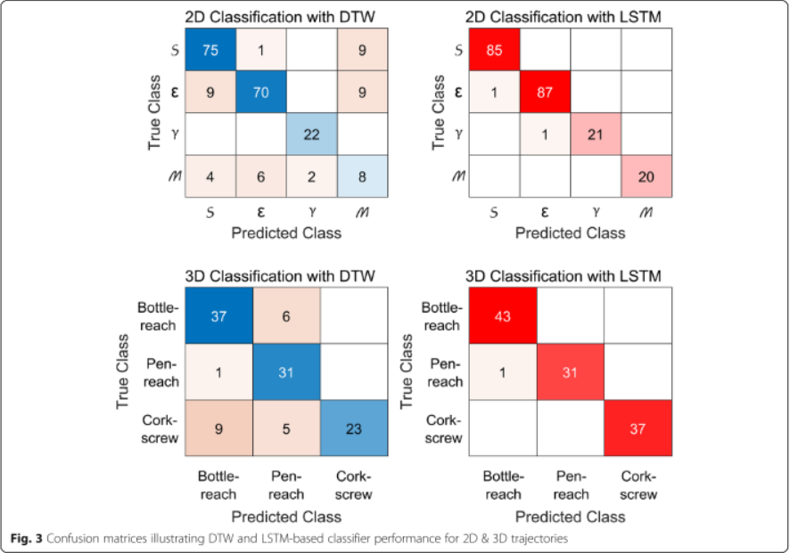
Experimental Results

Slide 15
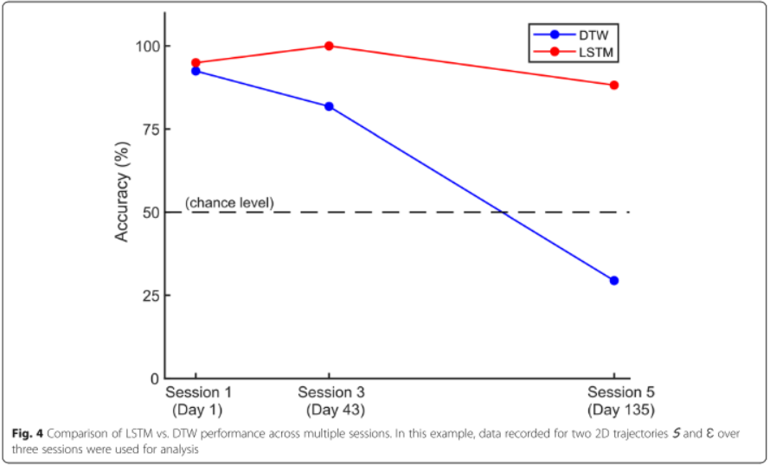
Experimental Results

Slide 16
Discussion of Results
Conclusions: Demonstrated the feasibility and effectiveness of using arm movement trajectory information combined with deep learning methods to restore functional hand movements in individuals with tetraplegia.
Insights Gained from Experiments: Deep learning, especially LSTM networks, is extremely effective in recognizing complex motion trajectories and improving the accuracy and real-time performance of neuromuscular stimulation device control.

Slide 17
Limitations
Limitations: LSTM -> Neuron Network -> Large dataset requirement
Although the LSTM model performs well, it requires a high volume and quality of data, potentially necessitating extensive training data to maintain accuracy and real-time performance.

Slide 18
Future Work
What interesting questions does it raise for future work?
Multiple IMUs (more physical meanings)

Slide 19
Extended Readings
Bhagat N, King K, Ramdeo R, Stein A, Bouton C. Determining grasp selection from arm trajectories via deep learning to enable functional hand movement in tetraplegia. Bioelectronic Medicine. 2020 Dec;6:1-8.
Yu Y, Si X, Hu C, Zhang J. A review of recurrent neural networks: LSTM cells and network architectures. Neural computation. 2019 Jul 1;31(7):1235-70.
Staudemeyer RC, Morris ER. Understanding LSTM--a tutorial into long short-term memory recurrent neural networks. arXiv preprint arXiv:1909.09586. 2019 Sep 12.

Slide 20
Summary
Problem Discussed: How to realize functional hand movements in individuals with tetraplegia through analyzing arm movement trajectories and deep learning.
Why It's Important and Hard: This issue is significant for enhancing the quality of life for individuals with tetraplegia, with technical challenges including accurate trajectory recognition and real-time performance.
Key Limitation of Prior Work: Previous methods might not have fully utilized arm movement information, or lacked in real-time performance and accuracy.
Key Insight(s) of the Proposed Work: Utilizing deep learning, particularly LSTM models, can effectively identify arm movement trajectories and control neuromuscular stimulation devices to achieve intended actions.
What Was Demonstrated by This Insight: Showed the feasibility and effectiveness of using arm movement trajectory information combined with deep learning to restore functional hand movements in individuals with tetraplegia.

Slide 21
Thank you for listening!
Group 8

